Slide 1
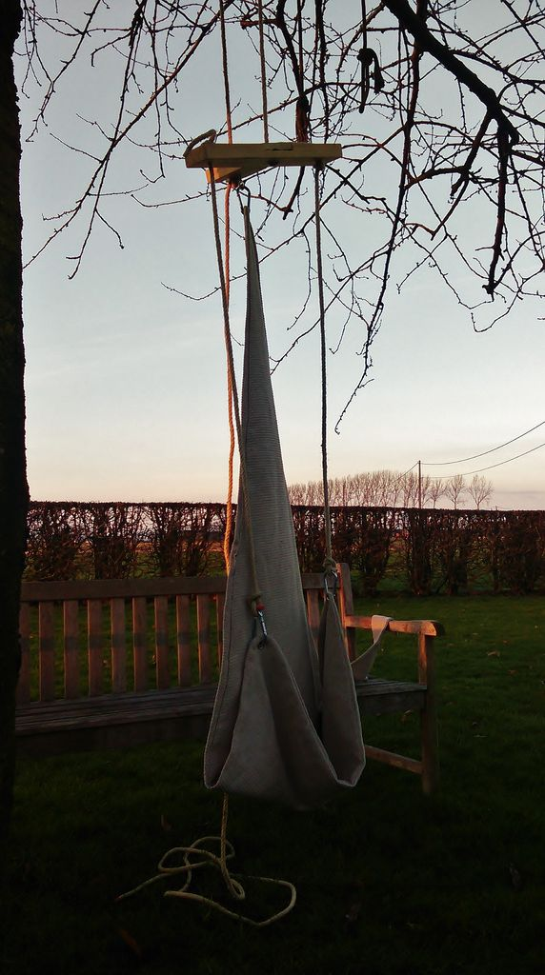
=
The Chilling-Swing

Slide 2
Choose a tree

Slide 3
Remove the storage-belt

Slide 4
Unfold

Slide 5
Throw the rope

Slide 6
Pull up

Slide 7
Secure the knot

Slide 8
Swing

Slide 9
Remove the knot

Slide 10
Pull down

Slide 11
Store

Slide 12
Fold

Slide 13
Close the storage-belt

