Slide 1
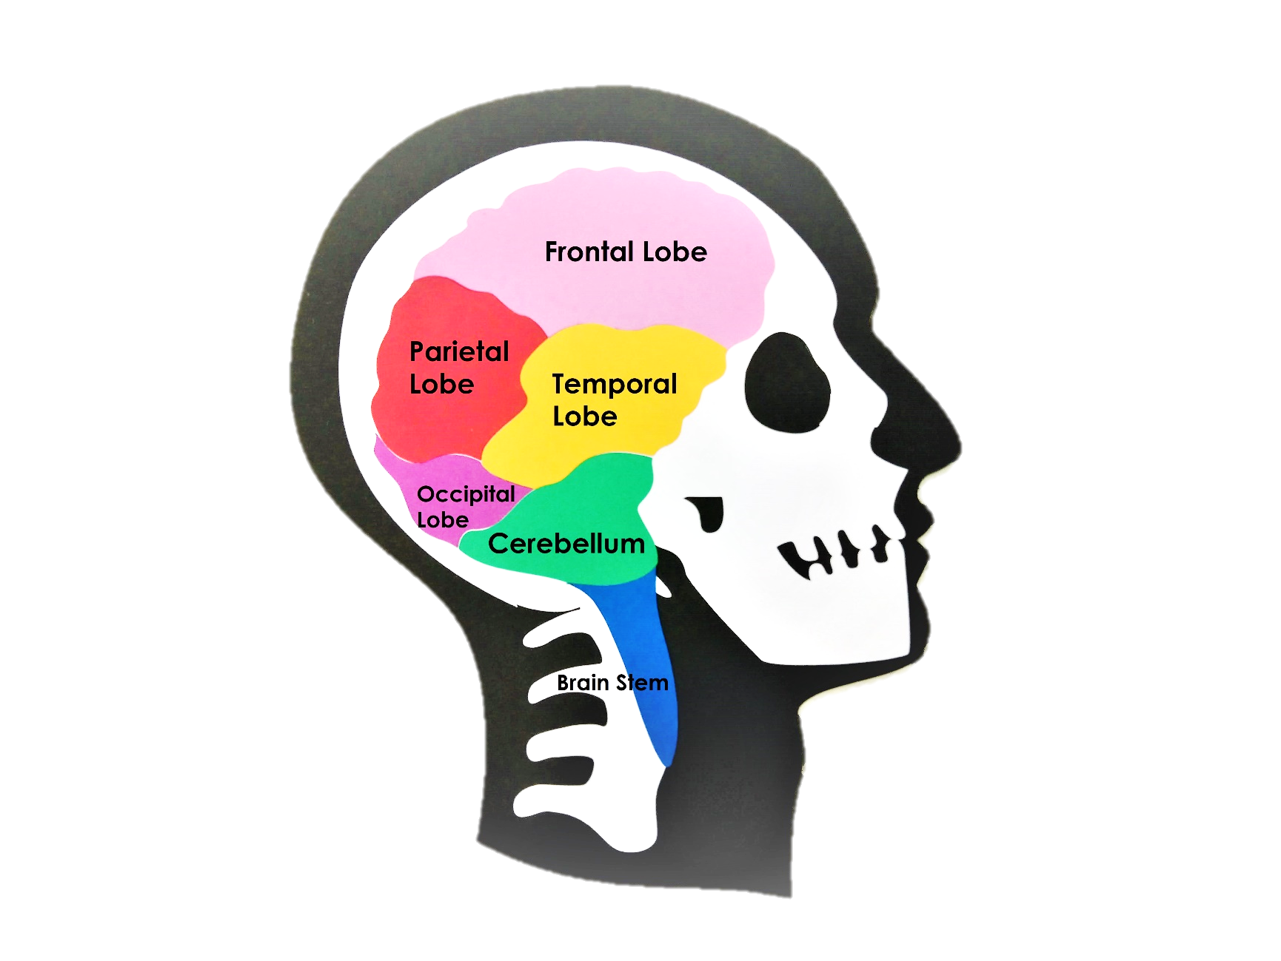
It’s In Your Mind

Slide 2
Frontal Lobe

Slide 3
The Frontal Lobe
RED GREEN BLUE BLACK YELLOW PURPLE ORANGE RED PINK YELLOW ORANGE RED BLUE BLACK BROWN GREEN GREY BLUE PINK RED

Slide 4
The Frontal Lobe
GREEN YELLOW BLUE BLACK PINK BROWN RED GREEN PURPLE GREY BROWN PINK YELLOW BLUE PURPLE ORANGE RED YELLOW BLACK

Slide 5
Parietal Lobe

Slide 6
The Parietal Lobe
The movement of neurotransmitters (chemical messages) across a synapse (gap between nerves)

Slide 7
Temporal Lobe
Occipital Lobe

Slide 8
The Temporal & Occipital Lobes

Slide 9
Cerebellum

Slide 10
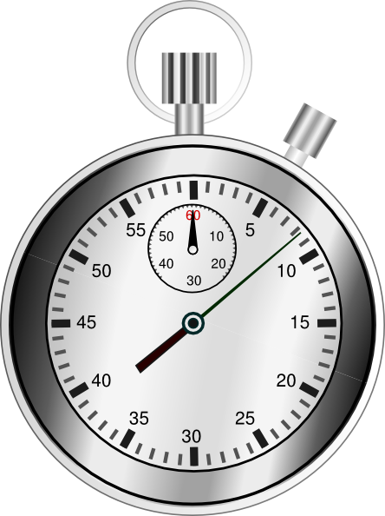
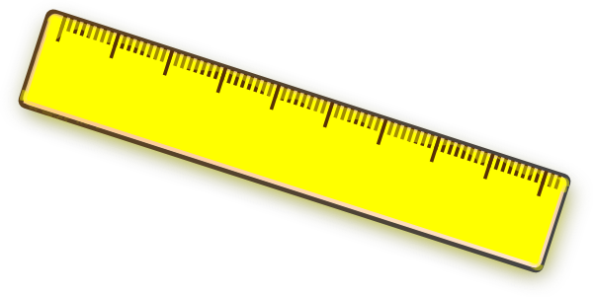
The Cerebellum
You will need…

Slide 11
Limbic System

Slide 12
The Limbic System
Will chance be on your side?
If you roll…
1 or 2- take a sweet from the player on your left
3 or 4- keep your sweets
5 or 6- give a sweet to the player on your left

