Slide 1
Water For Survival, Day 1
STEAM Camp
International School of Aruba

Slide 2
Schedule for Today
9:20AM - 9:35AM Setting the Stage
9:35AM – 9:55AM Fact or Fiction Activity
9:55AM - 10:15AM How Much Water Activity
10:15AM – 10:30AM Break
10:30AM – 11:00AM Ecosystem Introduction
11:00AM – 11:30AM Cyber Investigation: Make a Mangrove
11:30AM – 12:20PM Lunch
12:20AM – 1:40PM Engineering Challenge: Terrarium Aquarium
1:40PM – 1:50PM Clean Up & Reflection
1:50PM - 2:00PM Dismiss to Buses

Slide 3
Rule of Three
You can live 3 minutes without air, though we don't recommend trying.

Slide 4
How Long can you survive without the basic Necessities?

Slide 5
Rule of Three
In a harsh environment, you have 3 hours to survive without shelter.

Slide 6
Rule of Three
After 3 days, you need water or you'll perish.
(Despite this possibly helpful rule, some people have survived 8 to 10 days without water.)

Slide 7
Rule of Three
You can make it 3 weeks without food, though we promise you that won't be fun.

Slide 8
Importance of Water
As 65 percent of the human body, water is essential to people.
Water flows through the blood, carrying oxygen and nutrients to cells and flushing wastes out of our bodies.
It cushions our joints and soft tissues.
Without water as a routine part of our intake, we cannot digest or absorb food.

Slide 9
What Would Happen If We Didn’t Drink Water?

Slide 10
Water: Fact or Fiction
Source:
United States Environmental Protection Agency

Slide 11
True or False?
There is the same amount of water on Earth as there was when the Earth was formed. The water from your faucet could contain molecules that dinosaurs drank.
Notes:
TRUE

Slide 12
True or False?
Water is composed of two elements, Hydrogen and Oxygen. 1 Hydrogen + 2 Oxygen = H2O.
Notes:
FALSE: Water is composed of two elements, Hydrogen and Oxygen. 2 Hydrogen + 1 Oxygen = H2O.

Slide 13
True or False?
Nearly 75% of the world’s water is salty or otherwise undrinkable.
Notes:
FALSE: Nearly 97% of the world’s water is salty or otherwise undrinkable. Another 2% is locked in ice caps and glaciers. That leaves just 1% for all of humanity’s needs — all its agricultural, residential, manufacturing, community, and personal needs.

Slide 14
True or False?
Water regulates the Earth’s temperature. It also regulates the temperature of the human body, carries nutrients and oxygen to cells, cushions joints, protects organs and tissues, and removes wastes.
Notes:
True

Slide 15
True or False?
50% of the human brain is water and 50% of a living tree is water.
Notes:
False: 75% of the human brain is water and 75% of a living tree is water.

Slide 16
True or False?
A person can live about a month without food, and live 2 weeks without water.
Notes:
False: A person can live about a month without food, but less than a week without water.

Slide 17
True or False?
Water is part of a deeply interconnected system. What we pour on the ground ends up in our water, and what we spew into the sky ends up in our water.
Notes:
True

Slide 18
True or False?
The average total home water use for each person in the U.S. is about 50 gallons a day.
Notes:
True

Slide 19
True or False?
Frozen water (ice) is heavier than water, which is why ice floats in water.
Notes:
False: Frozen water (ice) is lighter than water, which is why ice floats in water.

Slide 20
True or False?
Water expands by 25% when it freezes.
Notes:
False: Water expands by 9% when it freezes.

Slide 21
https://goo.gl/RDxfw1
How Many Gallons Of
Water Does It Take?
Matching Activity

Slide 22
15 Minute Break!

Slide 23
WHAT ARE ECOSYSTEMS?

Slide 24
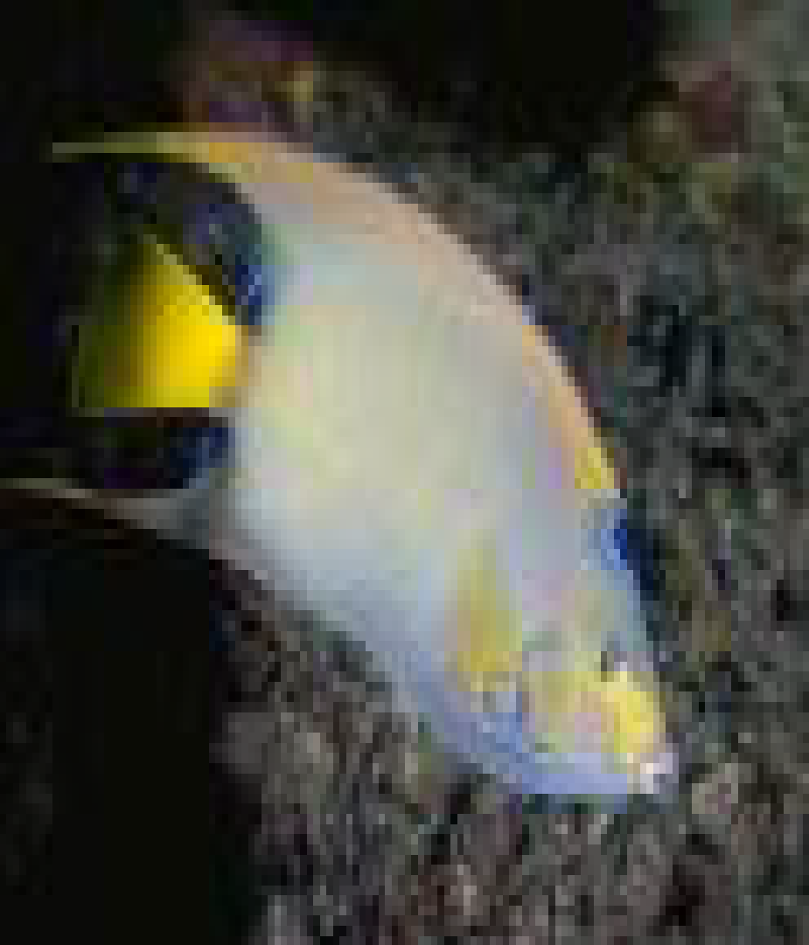
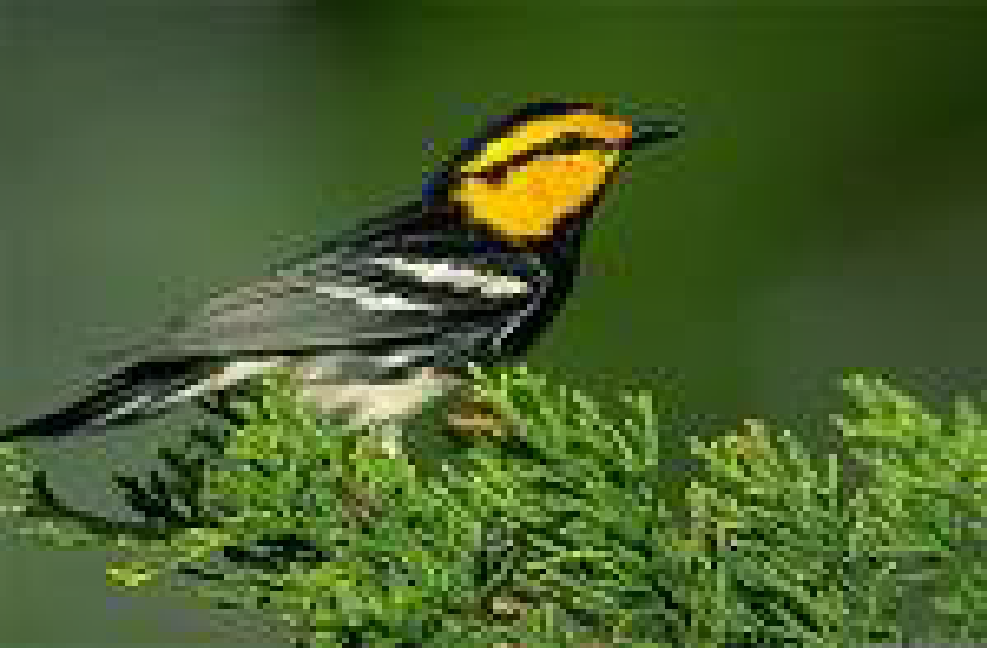
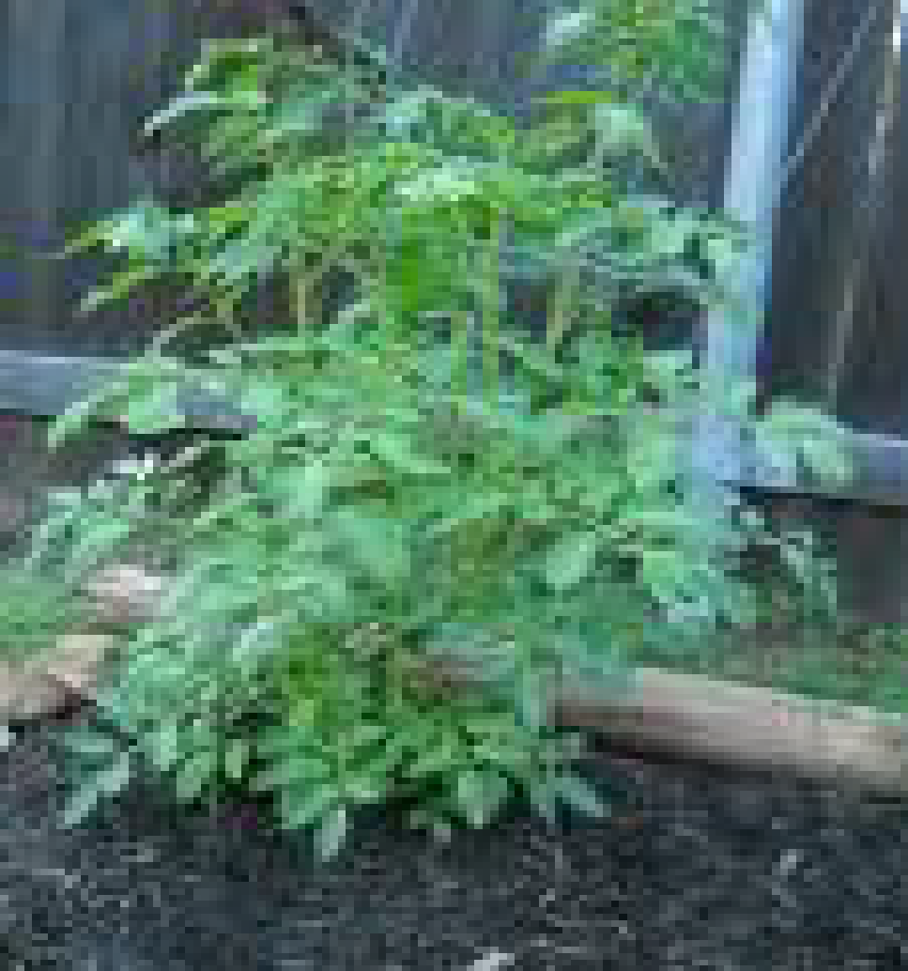
Where Things Live
Living things need a place to live and grow.
Birds live in trees and fly through the air.
Plants grow where there is soil, water and sun.
Fish live in water.

Slide 25
ENVIRONMENT
The living and nonliving things that surround a living thing make up its environment.

Slide 26
What do living things get from their environments?
Many living things share their environments and its resources.
Food
Water
Oxygen
Space

Slide 27
Parts of an Ecosystem
An ecosystem is made up of all the living and nonliving things in an environment.

Slide 28
Different types of organisms live in an ecosystem.
A group of organisms of the same kind living in the same place is a population.

Slide 29
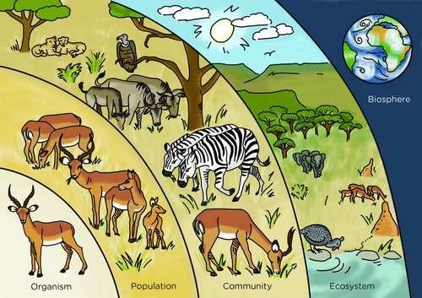

Slide 30
Where Plants and Animals Live
Habitat is a place where plants and animals lives.
It is a place where they can meet their needs.
Animals get food, water, and shelter from their habitat

Slide 31
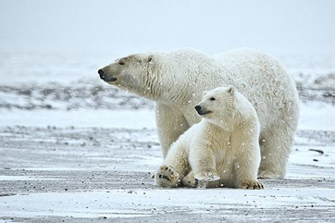
Organisms and their Habitats
Some organisms can survive only in certain habitats.
For example, a polar could not find the water it needs in a desert.

Slide 32
Classify Living and Nonliving things
Living Things
Fish
Water lily
Plants
Animals
People
Non Living Things
Air
Rocks
Cave
Soil
water

Slide 34
What are some types of ecosystems?

Slide 35
Deserts
Deserts are very dry ecosystems.
Desert plants and animals can survive with very little water.
Desert plants, such as cactus, have thick stems that store water.
The roots of a cactus lie just below the soil and spread far from the plant.

Slide 36
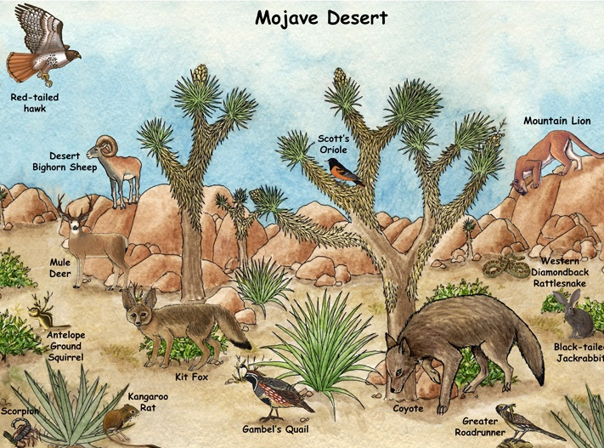

Slide 37
Grasslands
Grasslands are dry, often flat areas of land that are hot in the summer and cold in the winter.
They get more rain and snow than deserts but less that most other ecosystems.
The main plant in a grassland ecosystem is grass.
There are not many bushes in the grassland.
Trees are found only by rivers and streams.

Slide 38
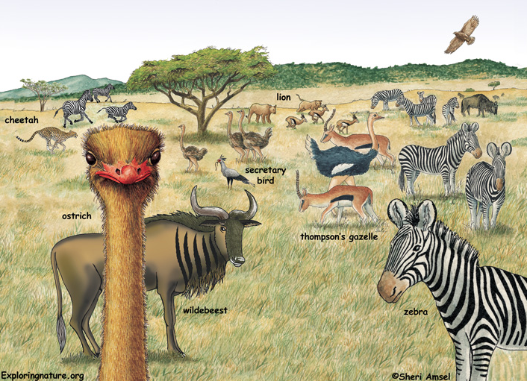

Slide 39
Forests
Forest are ecosystems in which many trees grow.

Slide 40
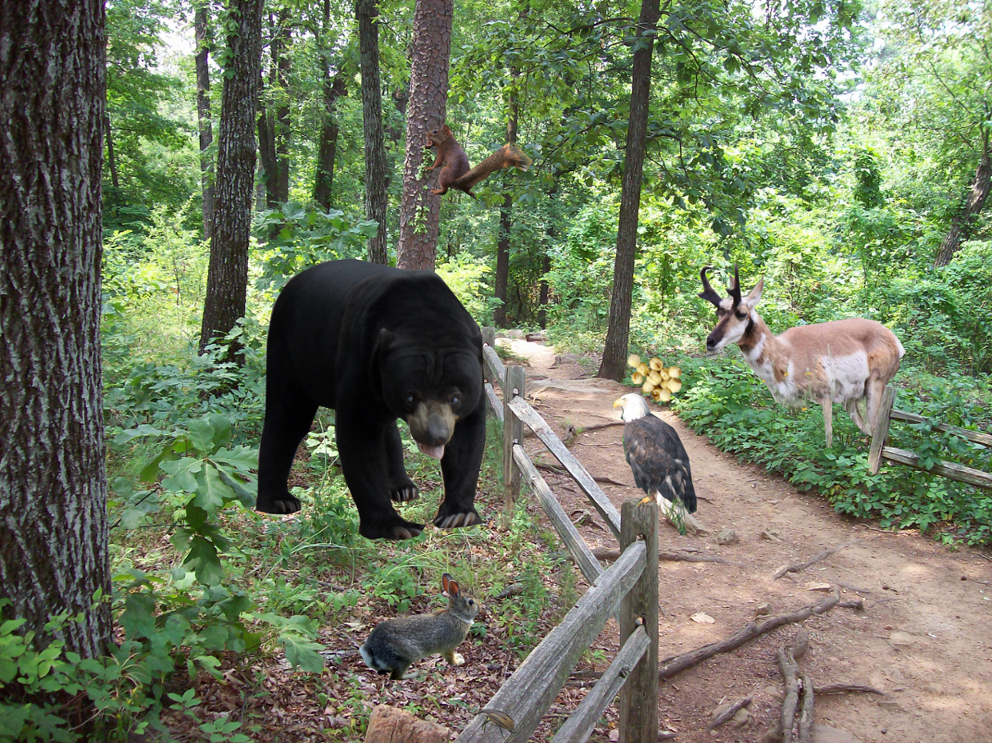

Slide 41
RainForest
A tropical rain forest grows where it is hot and wet all year long.
Animals such as jaguars and monkeys live there.

Slide 42
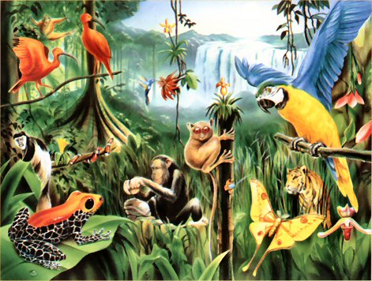

Slide 43
Freshwater
Rivers, ponds, lakes and streams have fresh water.
Lakes and rivers are closely tied. Some lakes are the source for some rivers. Important rivers, most often, originate from lakes. Some rivers end in lakes.
Since both rivers and lakes are freshwater and flow in and out of each other, they share similar characteristics and many species reside in both habitats.

Slide 44
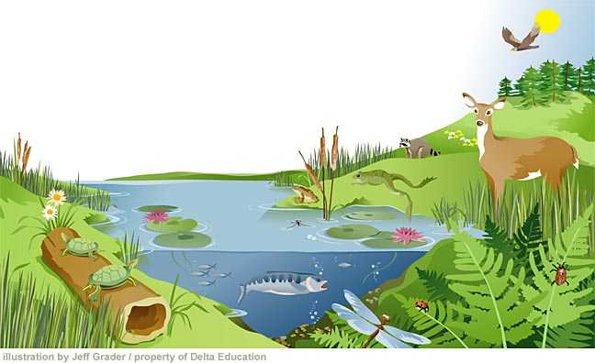

Slide 45
Saltwater
Saltwater ecosystems are oceans.
Oceans cover about three –fourths of Earth’s surface, so there are more saltwater ecosystems than any other.
Sharks, sea turtles, corals and octopus are all ocean animals.

Slide 46
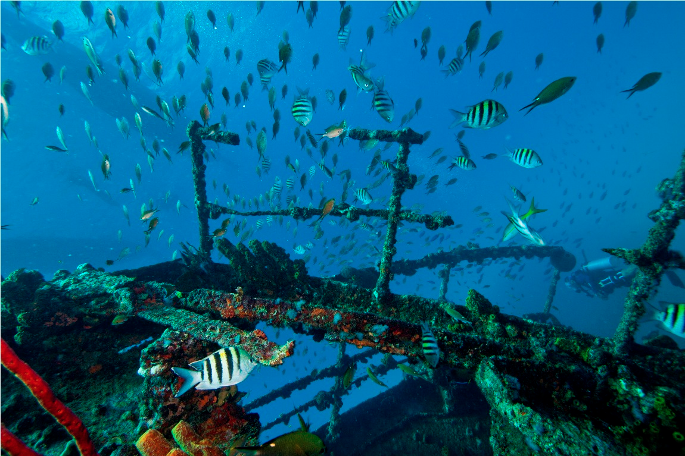

Slide 47
Aquatic Ecosystems

Slide 48
Mangroves

Slide 49
https://goo.gl/35JzC4
Mangrove Ecosystems

Slide 50
Lunch!

Slide 51
45 YEARS?!

Slide 52
Engineering Challenge:
Build a Terrarium Aquarium

Slide 53
Terrarium
Aquarium
Usually a sealable glass container containing soil and plants, and can be opened for maintenance to access the plants inside.
A transparent tank of water in which fish and other water creatures and plants are kept.

Slide 54
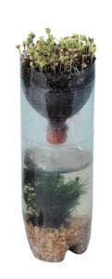
Materials
2-2 liter bottles per student/group
One bottle cap
Nail to put hole in bottle cap
Hammer
1 Strip of fabric per student
Scissors
Markers
Water
Soil
Elodea (water plant)
Clear duct tape
Shrimps
Grass seeds
Sand
Gravel

Slide 55
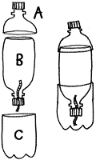
Procedure: Day 1
Draw a circle around the top of Bottle 1 (like image). Cut the top off of Bottle 1. Label the top “A” and label the bottom “C”
Draw a circle around the bottom of Bottle 2. Cut the bottom off of Bottle 2. Label the top of it B. (we don’t need the bottom of bottle 2.)
Thread the wick (piece of fabric) through the hole in the cap with ¾ of the fabric on outside.
Put the cap on the top of part B.
Add a layer of sand to part C about 1 inch high.

Slide 56
Procedure: Day 2
Fill up part C with water (fill up slowly & have the water fill in on the side of the bottle. to not disturb the sand.
Slowly add the shrimps and waterplant to part C.
Insert Part B with the cap upside down into Part C.
Tape Part B & Part C together (tape around the bottle twice then cut the tape).
Fill in Part B with 1 layer of gravel and then a 5 till 8 cm of soil
Add grass seeds to the soil of Part B
Add a little water to the soil.
Use Part A as the lid. Tape Part A to Part B (wrap around many times). Make sure it is completely closed.

