Slide 1
Let’s Help, Day 3
STEAM Camp
International School of Aruba

Slide 2
Physical Scarcity Activity
Population Resources
Agricultural Needs
Industrial Needs
Human Needs

Slide 3
Discussion Questions
Did your population have enough water to fill the water bottle? Explain.
How did you decide to fill your paper cups?
What would it mean if you were only able to provide half the agriculture resources needed? Industrial resources? Human resources?

Slide 4
Global Water Crisis
Notes:
‹#›

Slide 6
Term Definitions
Access to drinking water means that the clean water is less than 1 kilometer away from you and that it is possible to get at least 20 litres per person
Drinking water is water used for household purposes
Drinking
Cooking
Personal Hygiene
Notes:
‹#›

Slide 7
Drinking Water
Each person needs 20-50 liters of safe freshwater a day for drinking, cooking and cleaning.
One in nine people worldwide don't have access to this amount of safe freshwater.

Slide 8
Water use
By 2025:
800 million people will experience absolute water shortness
two-thirds of the world population could be under stress conditions.
Notes:
‹#›

Slide 9
In comparison…
On average, people in Europe use more than 200 liters—in the United States more than 400 liters PER DAY
1.1 billion people who don’t have access to drinking water only use up to 5 liters (not enough to flush some toilets)!
Notes:
‹#›

Slide 10
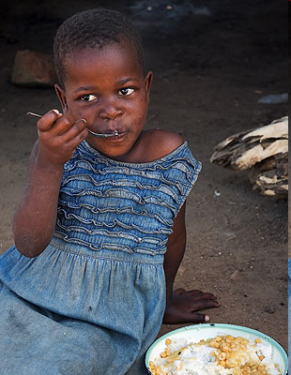
Water and World Poverty
Access to clean water allows for better absorption of nutrients from food
Clean water = healthy livestock and crops
Dirty water is the world’s second biggest killer of children.

Slide 11
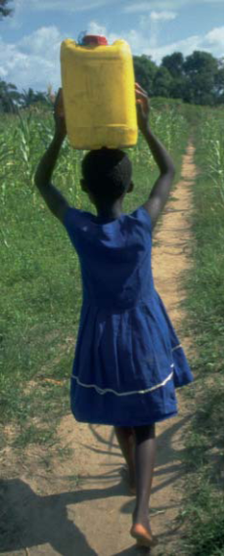
Students Without Water
Over 50% of world’s schools have no access to drinking water/sanitation
Clean water leads to fewer diseases, which means fewer missed classes
Children (esp. girls) often miss class to fetch water
Notes:
‹#›

Slide 12
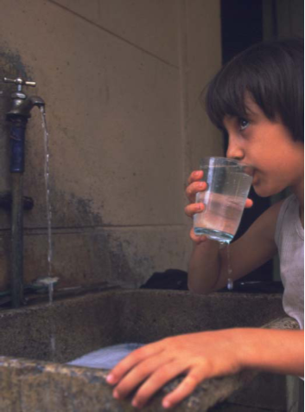
Reducing Child Mortality
5,000 children die each day from water/sanitation related causes

Slide 13
Facts & Figures

Slide 14
1 in 9 people worldwide do not have access to safe and clean drinking water.
13

Slide 15
1 in 3 people, or 2.4 billion, are without improved sanitation facilities.

Slide 16
Less than 1 in 3 people in Sub-Saharan Africa have access to a proper toilet.

Slide 17
Nearly 1 out of every 5 deaths under the age of 5 worldwide is due to a water-related disease.

Slide 18
Google Slides Demonstration
Add new slide
Add text & lists
Change theme
Add image

Slide 19
Break!

Slide 20
Create a
Google Slide Presentation
Your presentation must include:
Title slide
Colorful theme
Bullets
Images
At least 4 slides
How can YOU conserve water indoors, outside & at school?

Slide 21
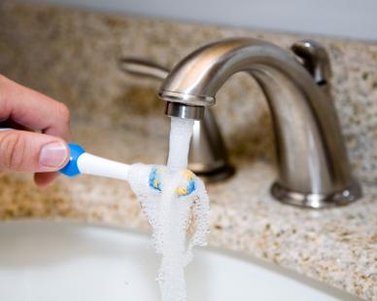
Water Conservation Tips for Indoors
Let your parents know about leaks in your house
Leaks are easily fixable and save you water and money
Tell your parents about high-efficiency washers, faucets, and toilets
Run your dishwasher or washing machine only with full loads
Turn off the faucet when brushing or shaving
Take shorter showers

Slide 22
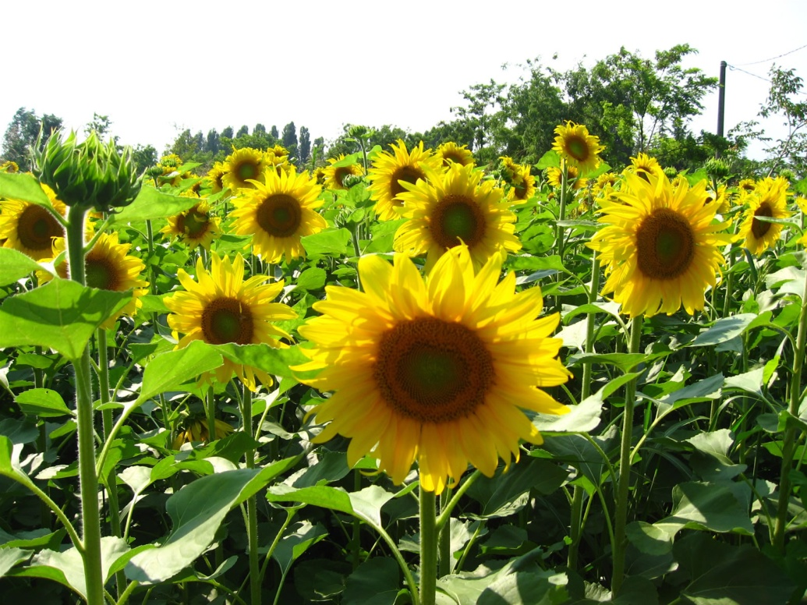
Water Conservation Tips for Outside
Water your lawn only when it needs it
Water your plants earlier in the day when less can evaporate
Plant plants and shrubs that use less water, like sunflowers, lavender, and marigolds
Don’t water the gutter
Don’t run the hose while washing your car

Slide 23
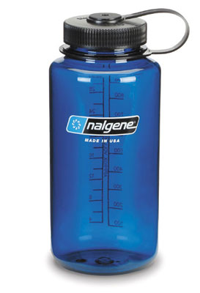
Water Conservation Tips for School
Bring or use a reusable water bottle instead of the drinking fountain
Turn off the tap while washing your hands
Pay attention to water conservation signs in bathrooms and drinking fountains
Inform administration if there are any leaking pipes, hoses, or hydrants

Slide 24
Lunch!

Slide 25
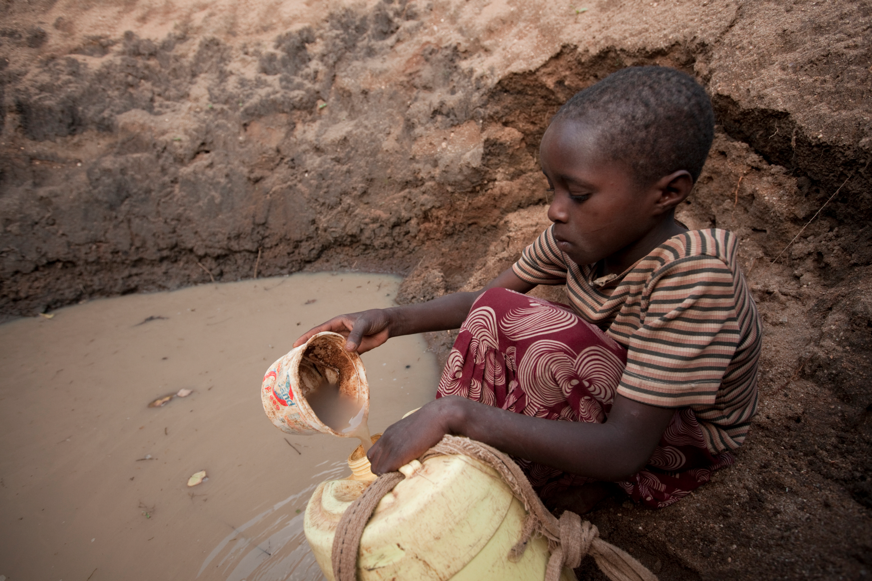

Slide 26
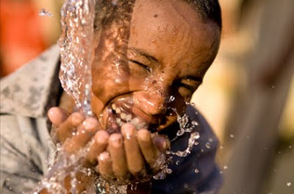

Slide 27
Engineering Challenge: Build a Water Purifier

Slide 29
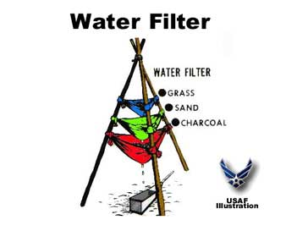
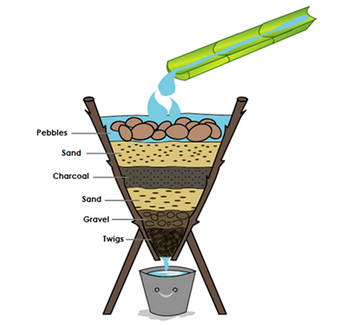
Simple Water Purifiers
Day 1 Task: Design a water purifier to clean muddy water with the materials available. Students must draw their design and write a materials list by the end of the day.

