Slide 1
The Power of Water
STEAM Camp
International School of Aruba

Slide 2
Schedule for Today
9:00AM - 9:15AM Opening
9:15AM – 9:30AM Setting the Stage
9:30AM – 10:15AM Cyber Investigation: Water Power
10:15AM – 10:30AM Break
10:30AM – 11:30AM Creating a Water Turbine
11:30AM – 12:20PM Lunch
12:20PM - 12:45PM Test Water Turbines
12:45PM – 1:45PM Build Water Purifier
1:45PM – 2:00PM Cleanup & Wrap Up

Slide 5
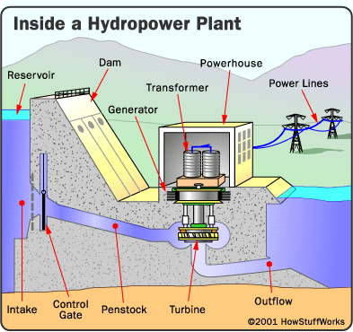

Slide 6
https://goo.gl/M5bpum
Cyber Investigation: Water Power
Water is stored in a reservoir on the left side of the dam.
The gate controls the volume of water flowing through the penstock to spin the turbine.
The turbine connects to the generator, which produces electricity.
The resulting electricity moves through power lines to provide electrical power to homes.

Slide 7
Questions
Did raising only the volume of water always increase the amount of electricity produced?
Did raising only the head height always increase the amount of electricity produced?
What happened to the gate as you increased the volume of water?
4. What are some of the advantages of hydropower?
Notes:
Answer 1: Yes
Answer 2: Yes
Answer 3: It lifted to allow more water into the penstock
Answer 4: Advantages include no pollution to the air, land, or water; the source of the energy (rushing river water) is free, renewable, and reliable; and it often can be generated near where it is needed.

Slide 8
Discussion Questions
Why do you think we aren’t building more hydroelectric power plants?
What are some of the disadvantages provided by other types of fuel (coal, oil, gas)? What about nuclear fuel?
Notes:
Why do you think we aren’t building more hydroelectric power plants?
Possible answers:
There are few new sites where effective dams and plants could be built.
Dams are expensive to build.
Dams often disrupt the wildlife that live on or near the river.
What are some of the disadvantages provided by other types of fuel (coal, oil, gas)? What about nuclear fuel?
Possible answers:
The use of coal, oil, and gas depletes valuable and limited natural resources.
Coal, oil, and gas can produce a lot of pollution.
Coal, oil, and gas require mining or drilling into the Earth.
Nuclear power plants encounter waste disposal problems and can pose extreme danger to surrounding populations in cases of malfunction.

Slide 9
Break!

Slide 10
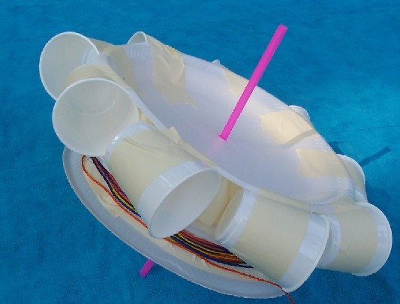
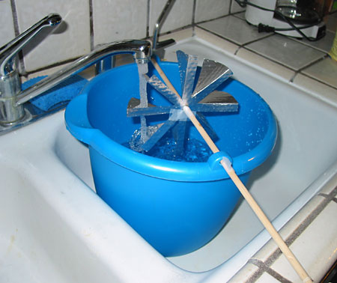
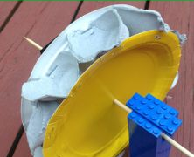
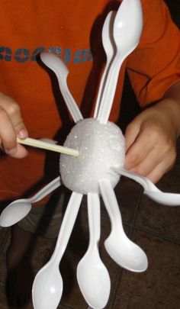
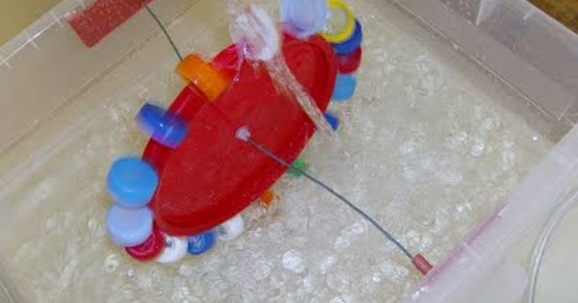
Task:
Create a
Water Turbine

Slide 11
Lunch!

Slide 12
Let’s test your water turbines!

Slide 13
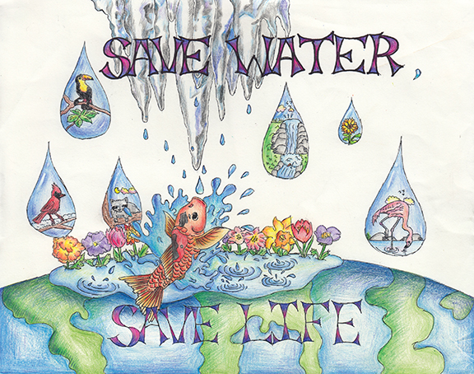
Task:
Water is Life Illustration
If all four products are finished, you can work on an illustration to represent the phrase “Water is Life”
If you are interested in working on the computer to design a poster/infographic (& the teacher feels it is possible) please speak to the teacher.
Canva: canva.com
Finish all of your final products by Friday at 11:30AM.
terrarium aquarium
3D Water Cycle
water purifier
water turbine
Google Slide Presentation
Optional: Infographic about terrarium aquarium

Slide 14
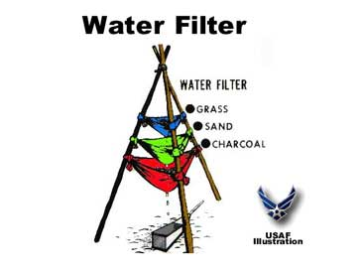
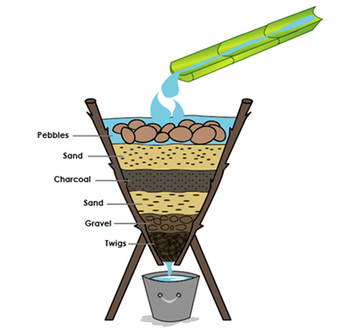
Simple Water Purifiers
Task: Design & build a water purifier to clean muddy water with the materials available.

Slide 15
Discussion Questions
Did you succeed in creating a filtration system that passed the source water? What "grade of clarity" did you achieve?
What aspect of your design do you think worked best? Why?
What aspect of your design would you have revised if given more time? Why?
What was unique about the design of the filtration system in your class that had the best results on this challenge? How did it work better than yours, if it did, and what would you have done differently if you had seen this design prior to developing your own?
Did you decide to revise your original design while in the construction phase? Why? How?
If you could have used a material or materials that were not provided to you, what would you have requested? Why do you think this material might have helped with the challenge?
What was your favorite part of the challenge? Design Phase? Building Phase? Testing Phase? Why?

