Slide 1
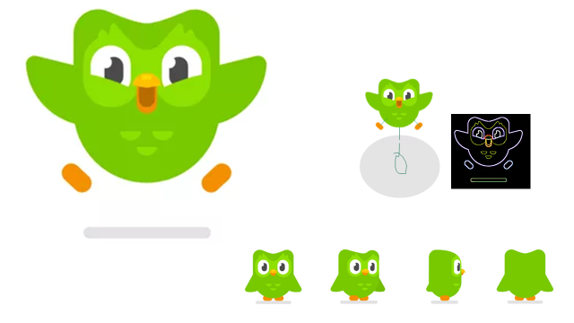
Used just for measurenents
How to use this presentation
The large picture is to show the details(there is not much details in this project but it helps)
This neon picture is to make drawing on tracing paper easier when it is dark in the work place
This picture is supposed to be the same size as the final duo would be (it is easier to change the zoom so every thing changes at the s me rate)
All shapes in the circle are the same size
This slide is just instructions
Use next page →

Slide 2
