Slide 1
Arduino Pulse Oximeter
By: Takuya Seaver

Slide 2
What is a pulse oximeter?
A device that measures the proportion of oxygenated blood through blood vessels.
Something that you usually find in a doctors office.

Slide 3
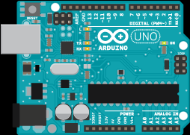
Arduino
In this project I will be using an Arduino to represent the electrical aspect of this project into numbers that can be used as data for the user to see.

Slide 4
Interest
I’ve always had a passion for fitness. Many people want to be fit, but what’s the most optimal way of achieving a person’s goal?

Slide 5
Interest Continued
Some people who talk about the gym have aesthetic goals in mind. One of these goals is to lose fat. What’s the best way to lose fat?

Slide 6
Research
The research shows that a heart rate of around 60%-70% is optimal to burn fat. What if a device could tell you exactly when you’ve reached the beginning of the “fat burning zone” and when you’re reaching the limit of the “fat burning zone” so you don’t need to overwork yourself?

Slide 7
Variety of exercise options
This device should not limit the user in any way. Take any form of activity and it will just track your heart rate and let you know when you are in or out of the fat burning zone.

Slide 8
What if fat-loss isn’t my main goal?
Very Light – best for recovery
Light – Basic endurance and fat burning
Moderate – improves aerobic fitness
Hard – increases performance for shorter durations
Maximum – helps athletes for speed

Slide 9
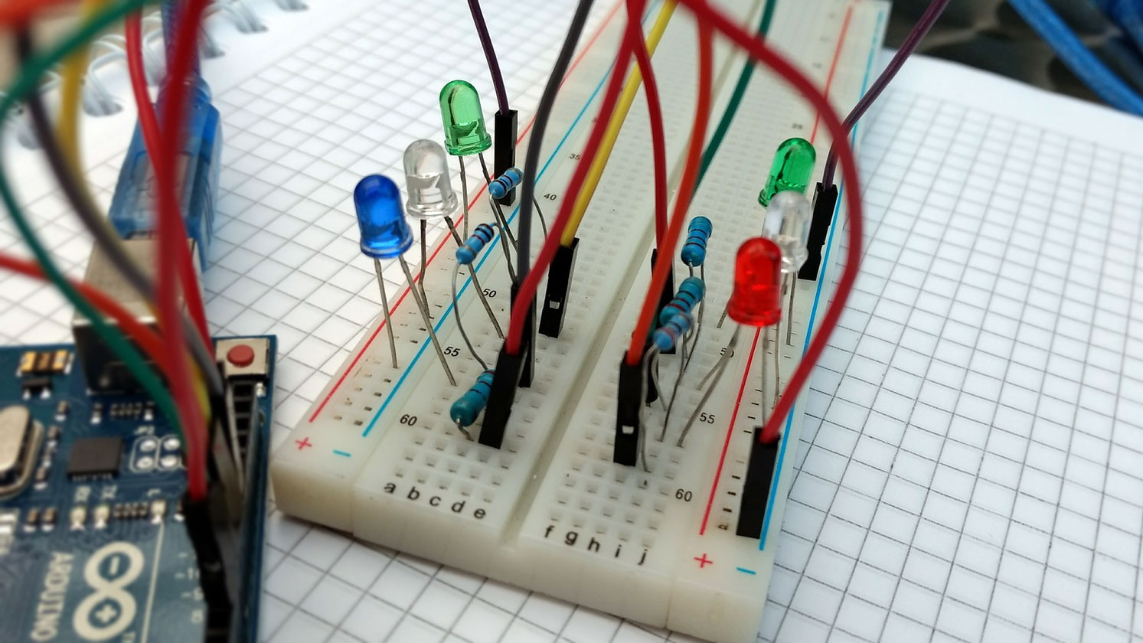
A device in the making
So far, the board is being made. The project is broken up into four main parts:
IR LED and Photodiode
Transimpedance Amplifier
High Pass Filter
AC Gain Stage

Slide 10
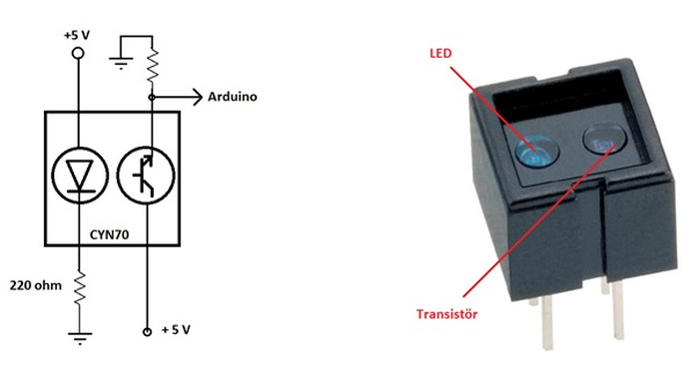
IR LED and Photodiode
The part I will be using for the IR LED/Photodiode will be CNY70 which is a reflective optical sensor with transistor output.

Slide 11
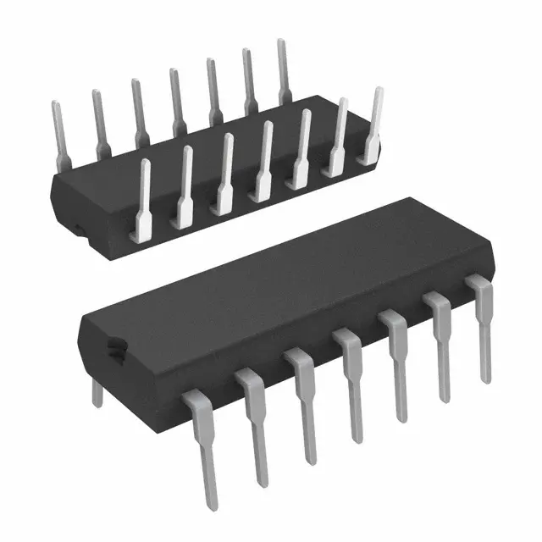
Transimpedance Amplifier
In this project, the transimpedance amplifier will convert a current to a voltage. The photodiode will give off a current which will then be translated to voltage through a resistor, using Ohm’s Law. The output of the op-amp will then be that voltage.

Slide 12
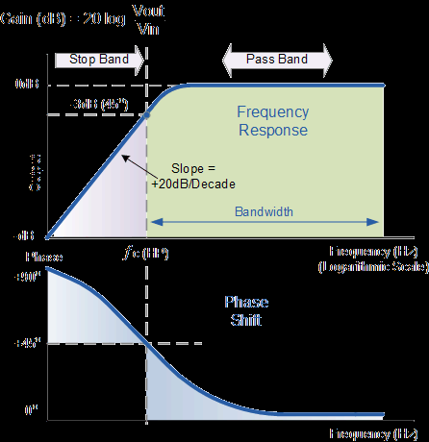
High Pass Filter
A high pass filter removes low frequency signals. It allows for high frequency signals to pass, hence the name. A high pass filter will filter out the signals that are produced from the absorbance of light while allowing the signals from the users pulse to go through.

Slide 13
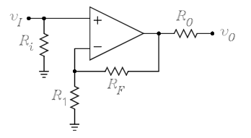
AC Gain Stage
The AC Gain Stage will use a non-inverting op-amp to amplify the input voltage. The Arduino will then read the output using an analog-to-digital converter.

Slide 14
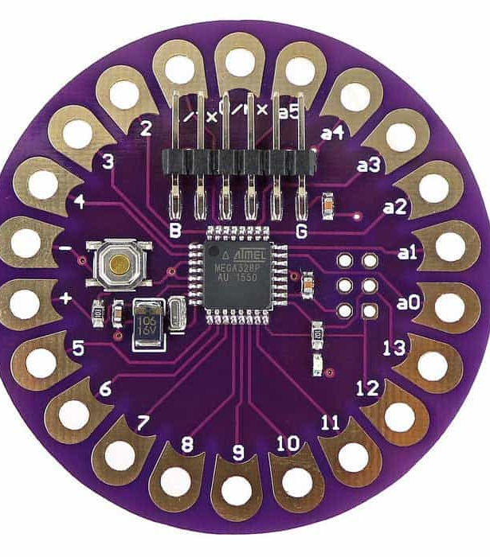
Arduino Lilypad
I plan on using an Arduino Lilypad for my Arduino device. The Arduino Lilypad allows flexibility when testing needs to be done. The Arduino Lilypad can be sewn into clothing which is convenient for my project.

Slide 15
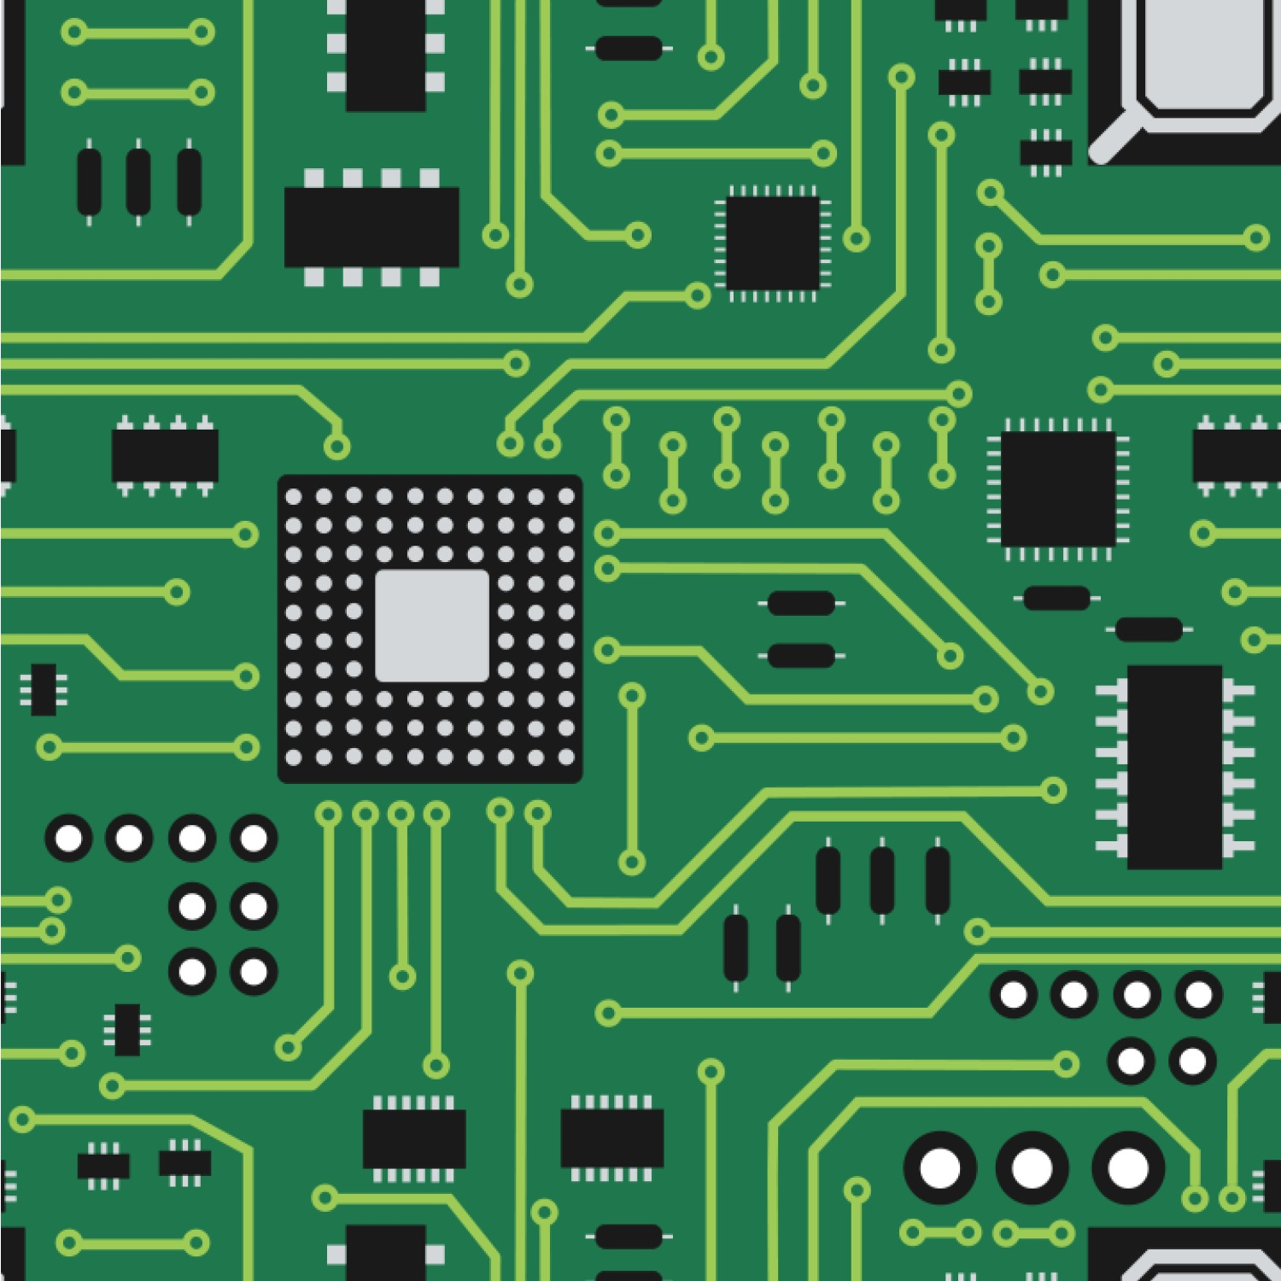
Current Obstacle
The biggest problem so far has been figuring out how to implement the reflective optical sensor into my circuit. Finding out how the pin layout works into my schematic has been somewhat problematic.

Slide 16
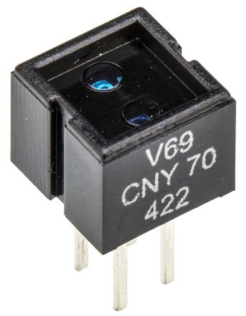
Future Obstacle
When it comes time to test the device. There will be the issue of holding the reflective optical sensor in place where there won’t be much disruption.

Slide 17
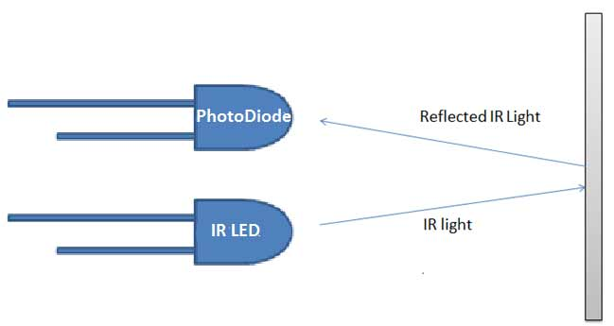
IR LED/Photodiode Issues
The issue with the IR LED and Photodiode is that they are sensitive to light which can be an issue when the data you want needs to be accurate. The encasement needs to be dark and stable for use, especially when in use for cardiovascular exercise.

Slide 18
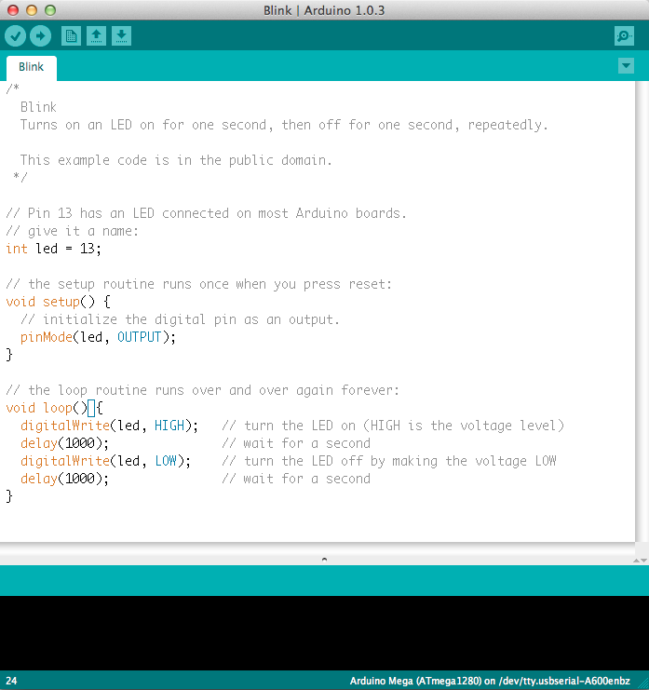
Future Plans
I plan on finishing the hardware aspect of the circuit in the near future while I also want to create the basic software aspect of this project after that.

Slide 19
Possible Continuation of the Project
If time allows it, I would like to make an app that can allow the user to track their progress. It would basically be a version of the Arduino program but viewable through your phone.

Slide 20
Questions?

