Slide 1
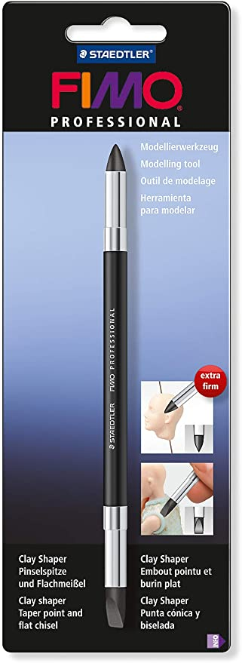
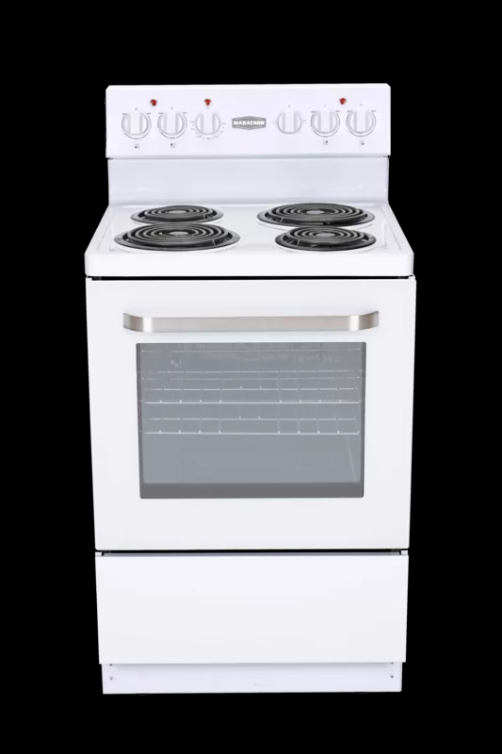
https://www.wayfair.ca/Marathon--24-Freestanding-Electric-Range-MER240W-L1016-K~MRHN1026.html?refid=GX416498370210-MRHN1026&device=c&ptid=870044274700&targetid=pla-870044274700&network=g&ireid=90490750&gclid=CjwKCAjwvZv0BRA8EiwAD9T2VbjjbZUOdggh4kWRxwFAauY-FCG-iFyXDRDd45H5Y7TFAv6Fh93DaxoCw8YQAvD_BwE
https://www.amazon.com/FIMO-Professional-Clay-Shaper-Tool/dp/B00JLL7VM4

Slide 2
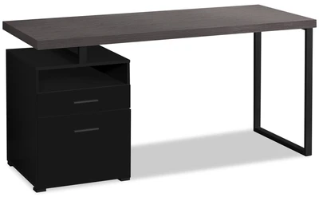
https://www.walmart.com/ip/Sharpie-Ultra-Fine-Point-Marker-Set-of-5-Black/14906336
https://olfa.com/professional/product/art-knife-w-5-blades-ak-1-5b/
https://www.amazon.ca/Kleenex%C2%AE-Pocket-Facial-Tissues-tissues/dp/B0045K2U0E
https://www.thebrick.com/products/orion-48-computer-desk

Slide 3
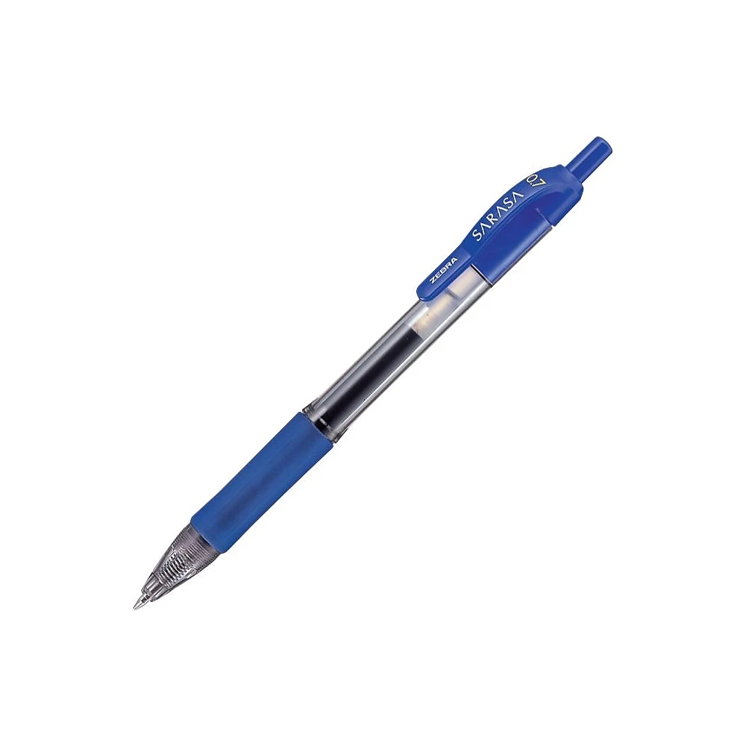
https://tradevistas.org/pencils-still-teaching-us-lessons-about-trade/
https://www.staples.ca/products/490612-en-zebra-sarasa-gel-pens-retractable-07mm-blue-10pack
https://www.walmart.ca/en/ip/Mini-Acrylic-Rolling-Pin-Fondant-Roller-Baking-Rough-Clay-Pizza-Pasta-Roller-Non-Stick/PRD20ZJWHBYZEH9

Slide 4
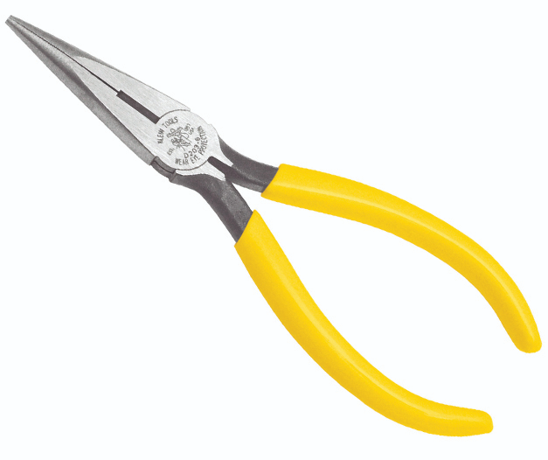
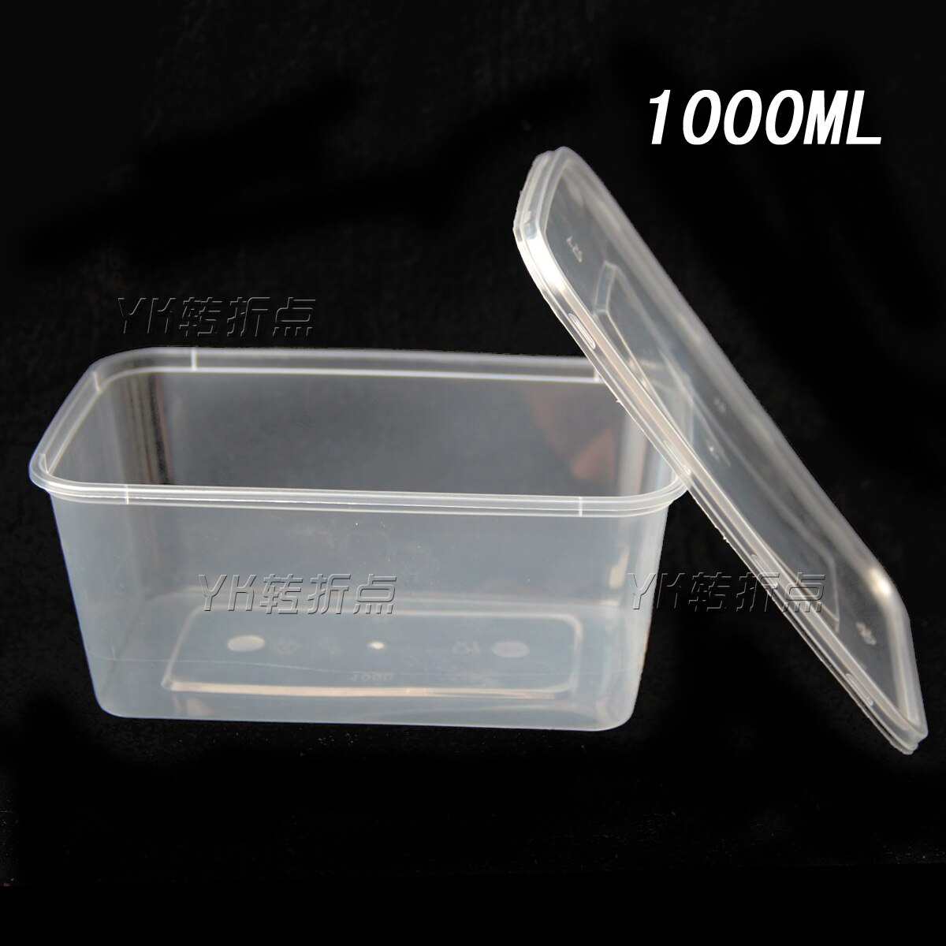
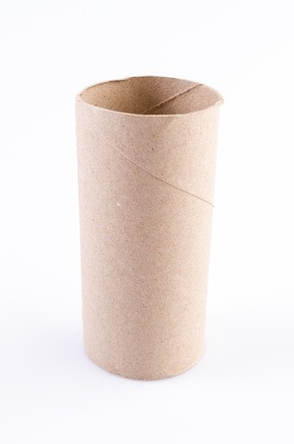
https://www.dakotariggers.com/Journeyman-Standard-Long-Nose-Pliers-6-Klein_p_282.html
https://www.aliexpress.com/item/32309558911.htm l

Slide 5
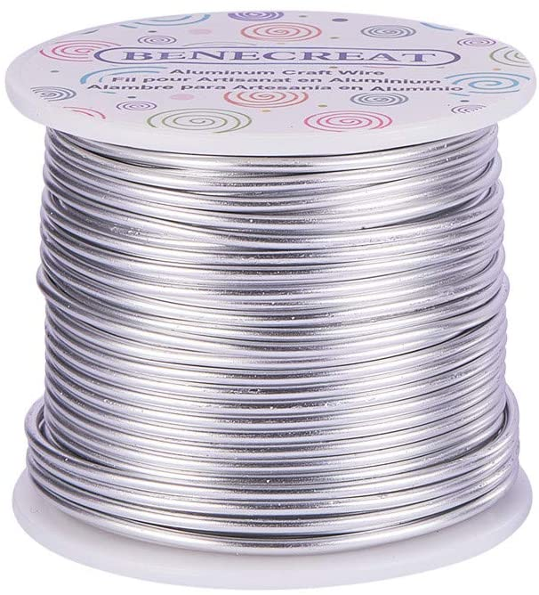
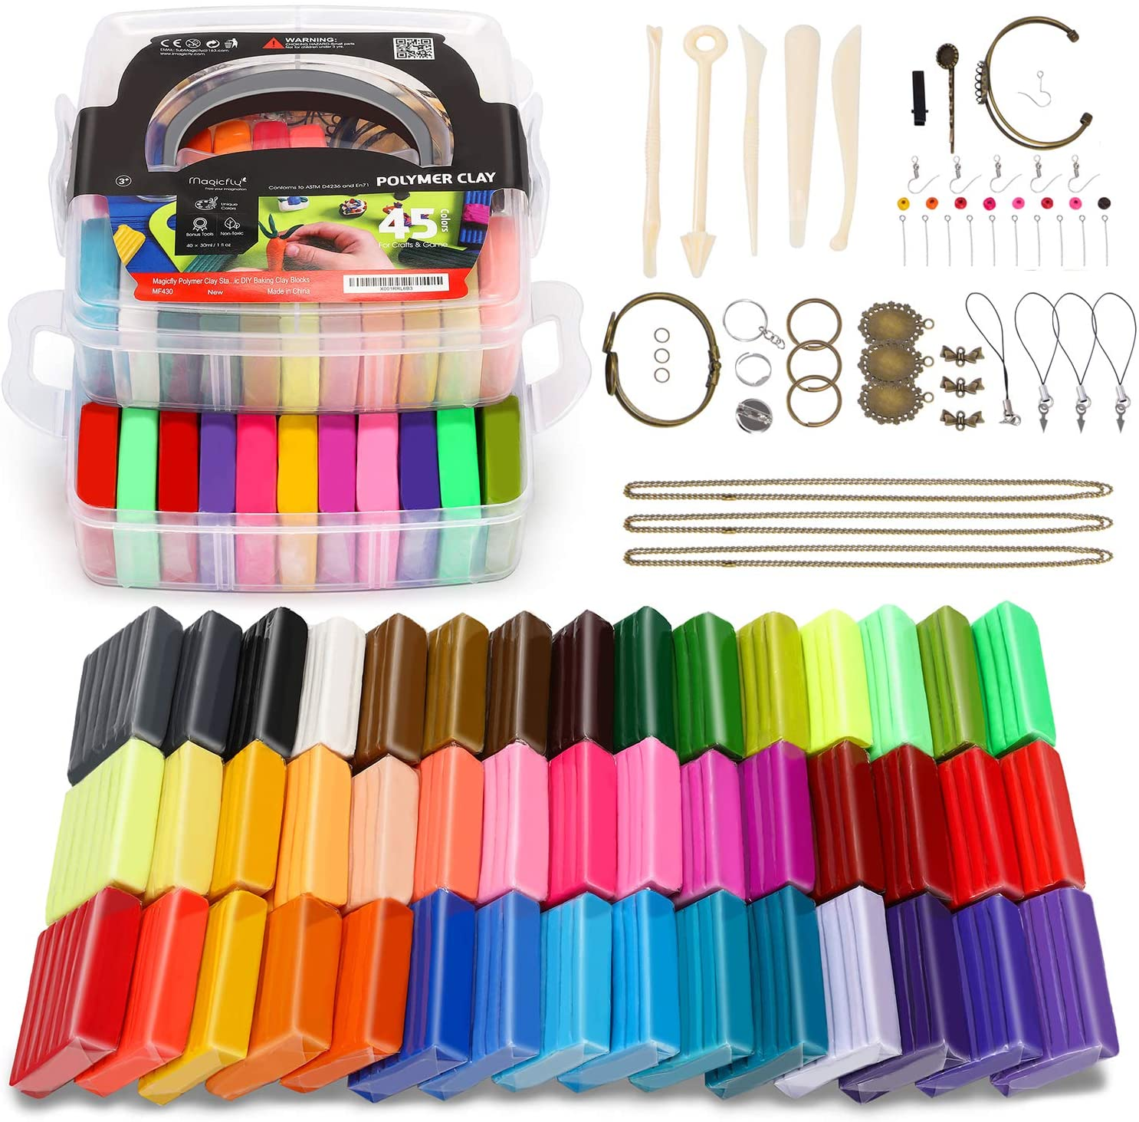
https://www.amazon.ca/BENECREAT-Aluminum-Anodized-Jewelry-Beading/dp/B0751YB21D
https://www.amazon.ca/Magicfly-Polymer-Clay-Starter-Kit/dp/B07CSRBCHF

Slide 6
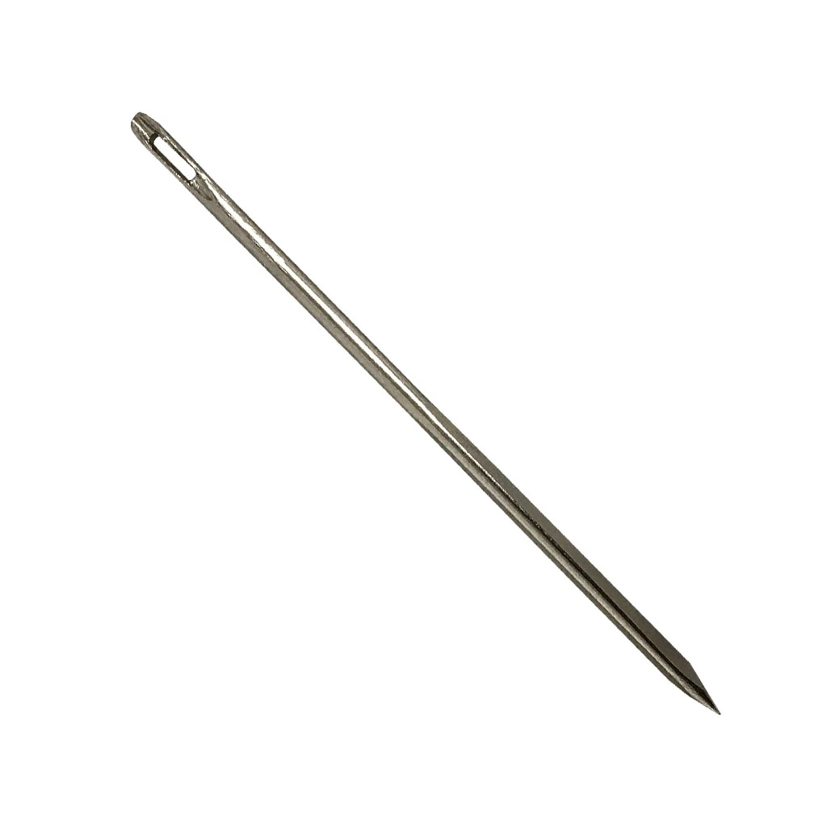
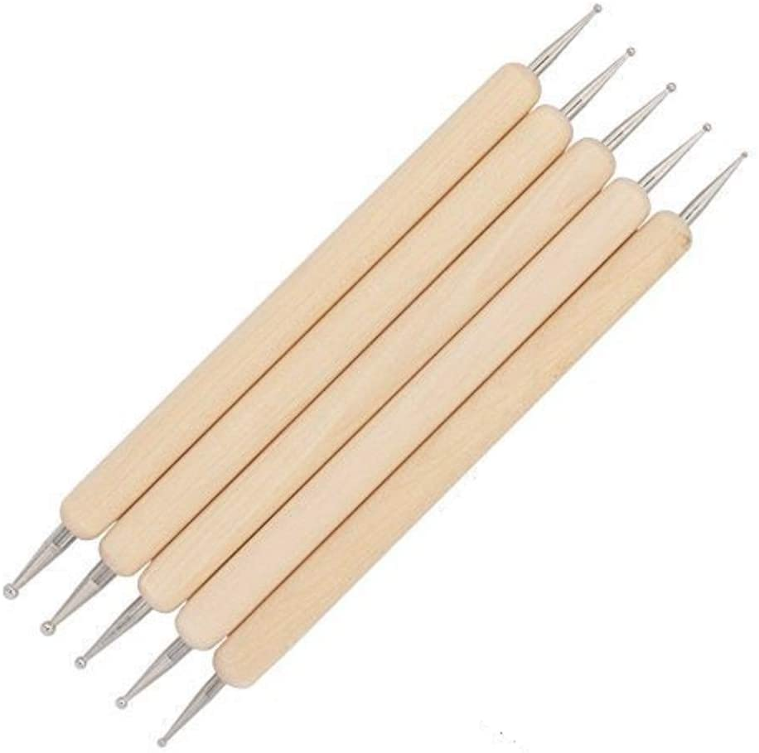
https://www.selfrelianceoutfitters.com/products/sail-needle-14
https://www.amazon.ca/COMIART-Styluses-Embossing-Pattern-Sculpting/dp/B077MBRFZC/ref=sr_1_13?crid=2JWUYG7UTU015&keywords=ball+stylus+tool&qid=1587406674&sprefix=ball+stylus%2Caps%2C202&sr=8-13

Slide 7
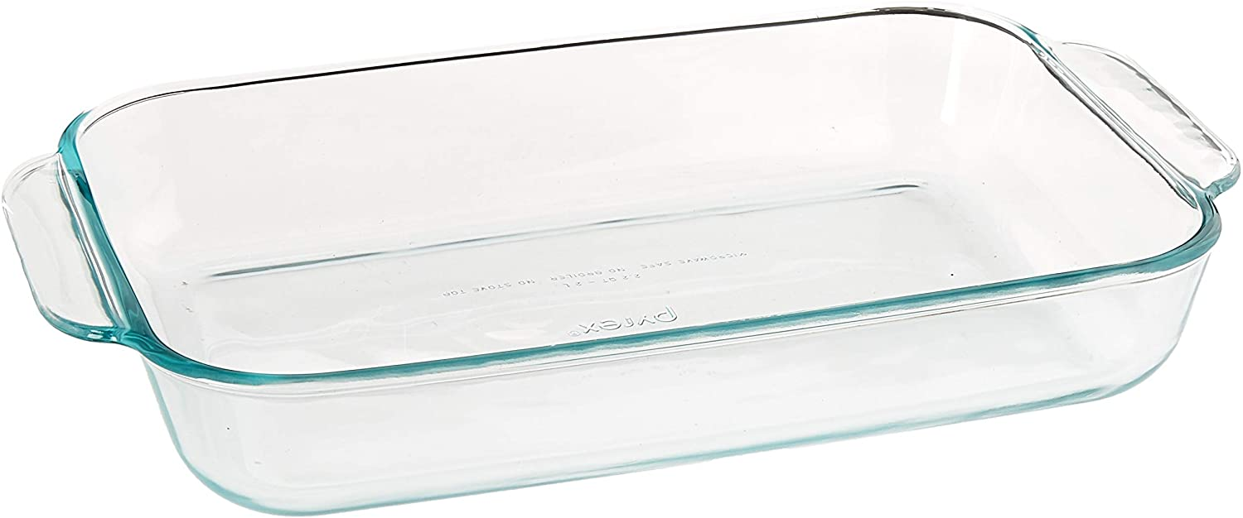
https://www.amazon.com/Pyrex-SYNCHKG055786-Basics-Oblong-Baking/dp/B00PI0G470/ref=sr_1_1?dchild=1&keywords=glass+tray+for+oven&qid=1587406794&sr=8-1

