Slide 1
The Water Cycle, Day 2
STEAM Camp
International School of Aruba

Slide 2
Schedule for Today
9:00AM - 9:15AM Opening
9:15AM – 9:40AM Different Stages of Water Cycle
9:40AM – 10:00 AM Cyber Investigation of Climate Change
10:00AM – 10:15AM Introduce: 3D Model of Water Cycle
10:15AM – 10:30AM Break
10:30AM – 11:30AM Create: 3D Model of Water Cycle
11:30AM – 12:20PM Lunch
12:20PM – 1:40PM Engineering Challenge
1:40PM – 1:50PM Cleanup & Wrap Up
1:50PM - 2:00PM Dismiss to Buses

Slide 3
Changing State
of Water
https://goo.gl/pN0IUU

Slide 4
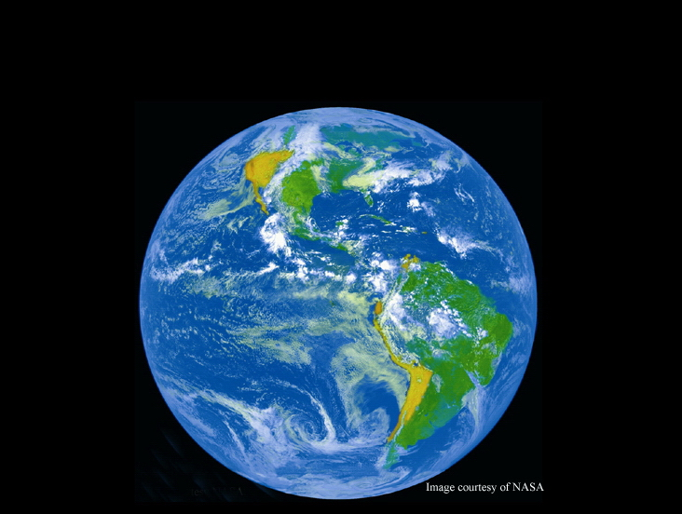
The Water Cycle

Slide 5
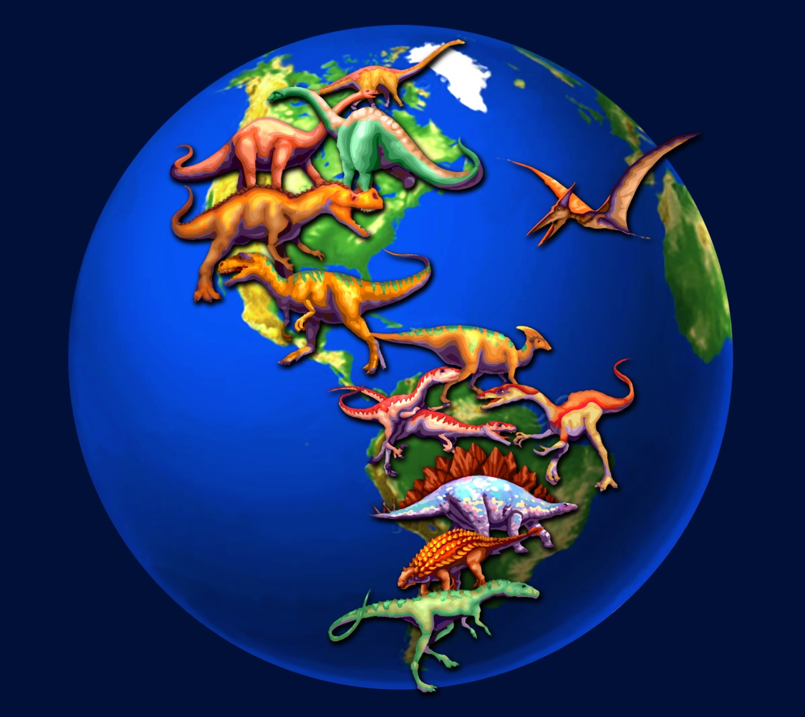
Water has been around for billions of years...

Slide 6
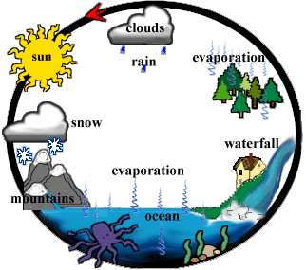
Water is Recycled Over and Over and Over...
Notes:
The water cycle is the continuous recycling of water on earth; from the oceans, up to the sky and down to land, to be transported back to the oceans and sky again. Water is constantly moving due to the energy of the sun transforming surface water into water vapor. The water vapor eventually forms clouds, and clouds condense back into water droplets. When the droplets become so dense in the clouds, the force of gravity pulls them back down to the earth where the cycle continues all over again.

Slide 7
What is the Water Cycle?
Transpiration
Evaporation
Condensation
Precipitation
Accumulation
Notes:
‹#›
The water cycle is made up of five processes; transpiration, evaporation, condensation, precipitation, and accumulation. Let’s investigate how each of these processes work to keep water from billions of years ago moving around the earth.

Slide 8
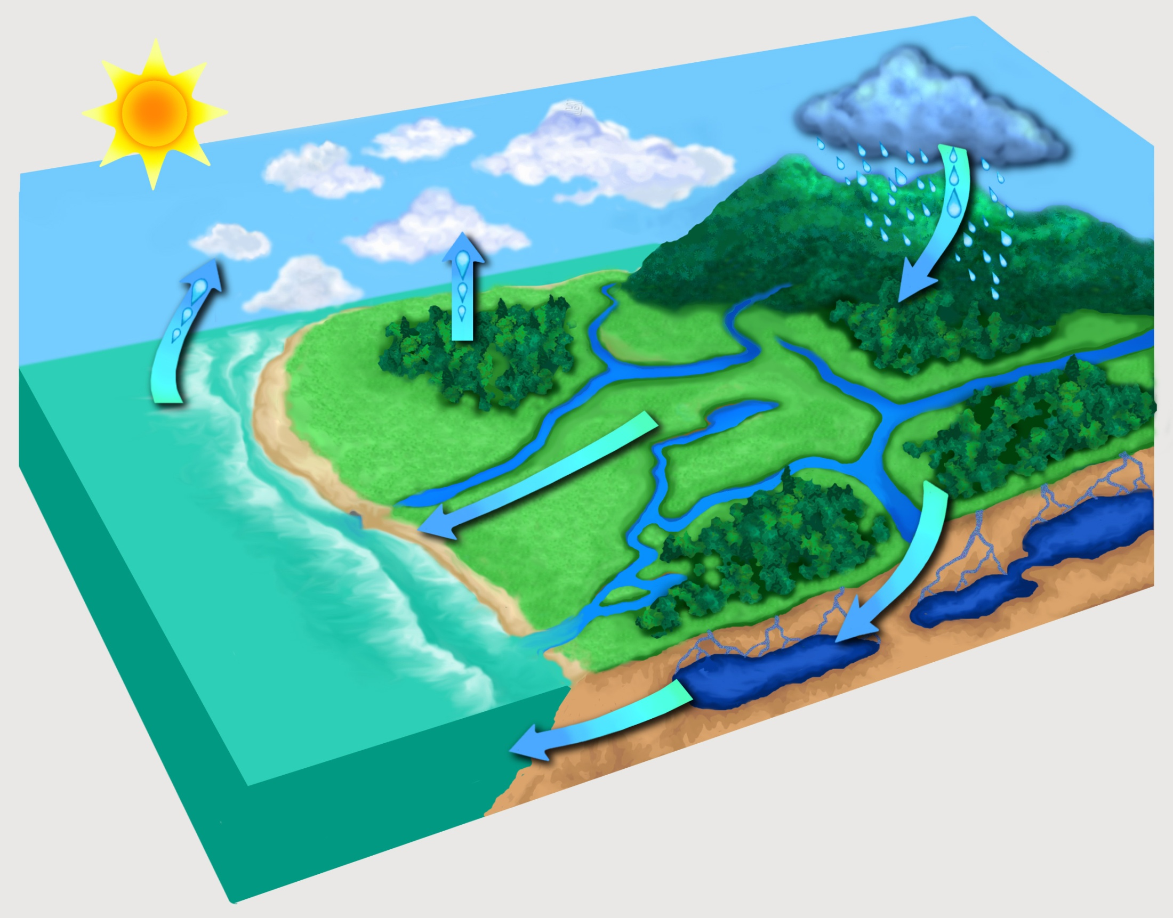
This is the water cycle!
condensation
transpiration
precipitation
evaporation
accumulation
Notes:
‹#›

Slide 9
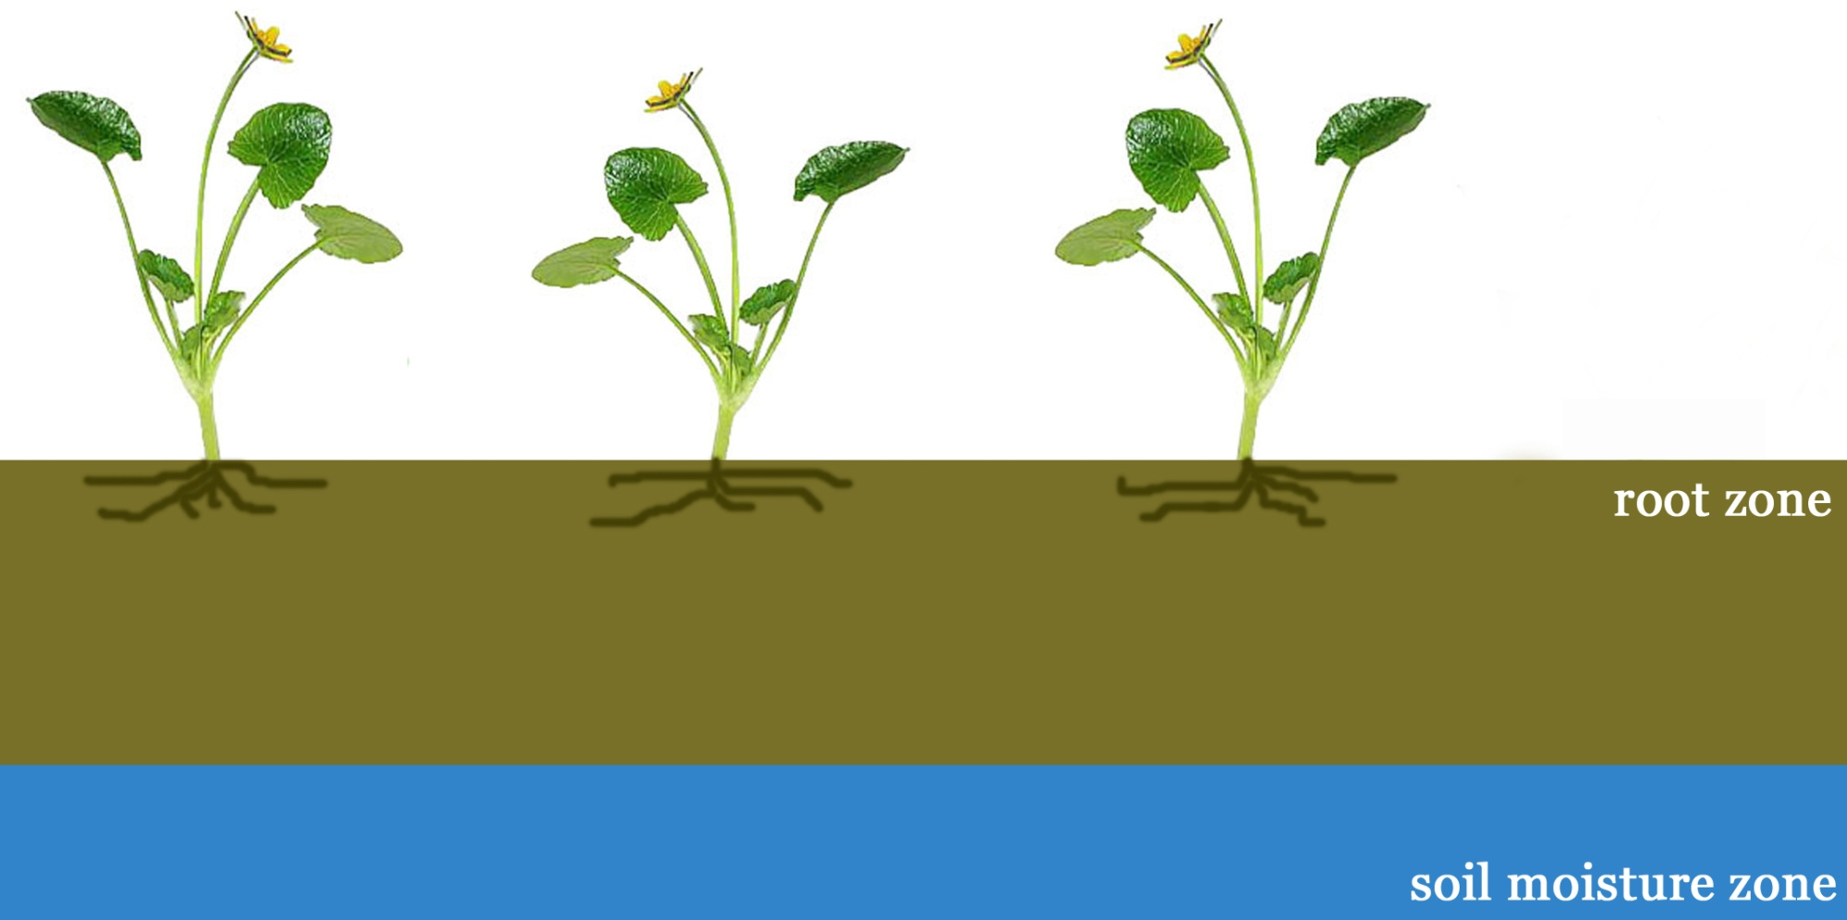
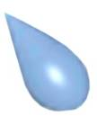
“Transpiration”
the evaporation of water from plants
Notes:
‹#›
Transpiration also cools plants and enables the flow of mineral nutrients from the roots. The amount of water lost by a plant depends on its size, along with the surrounding light intensity, temperature, humidity, wind speed, and soil water supply.

Slide 10
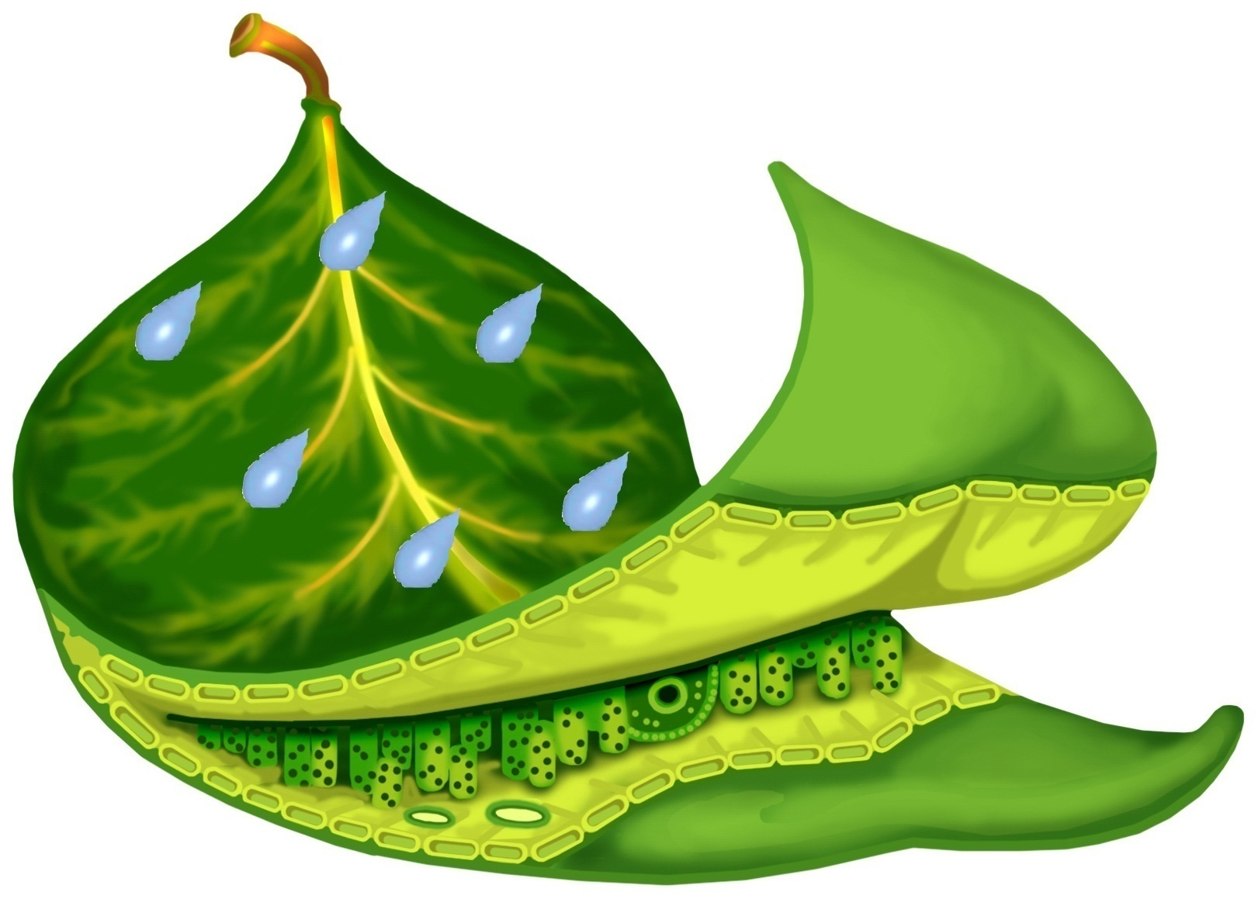
“Transpiration” Do plants really sweat?
Plants like me release water to supply photosynthesis, bring minerals up from the roots, and cool ourselves off.
Notes:
‹#›
Plants need water to survive and they obtain it from the soil, but plants can also ‘sweat’ water out through their leaves during dry spells or really sunny days; this is called transpiration. When plants transpire the water is in liquid form and changes into water vapor (gaseous state).
QUESTION: How is condensation related to weather?
ANSWER: Condensation forms clouds, which can produce rain, hail, or snow.

Slide 11
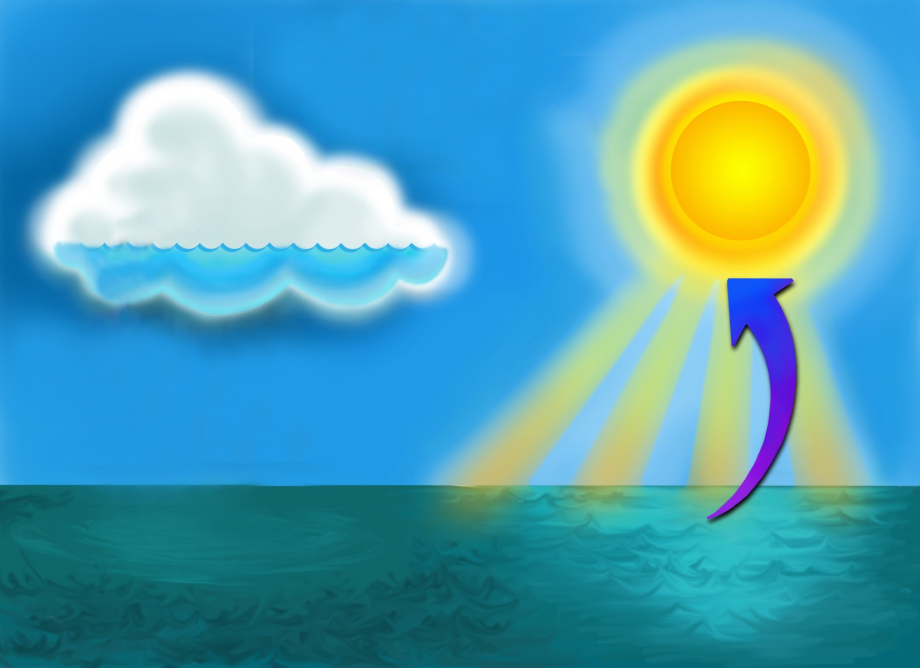
“Evaporation”
The conversion of water from a liquid to a gas
Solar energy drives evaporation of water from the ocean.
The evaporated water changes from a liquid form into
water vapor a gaseous form.
Notes:
Evaporation is a critical component of the water cycle, which is responsible for clouds and rain. Solar energy drives evaporation of water from oceans, lakes, moisture in the soil, and other sources of water.
QUESTION: How does evaporation relate to weather?
ANSWER: Evaporation is responsible for clouds and rain.

Slide 12
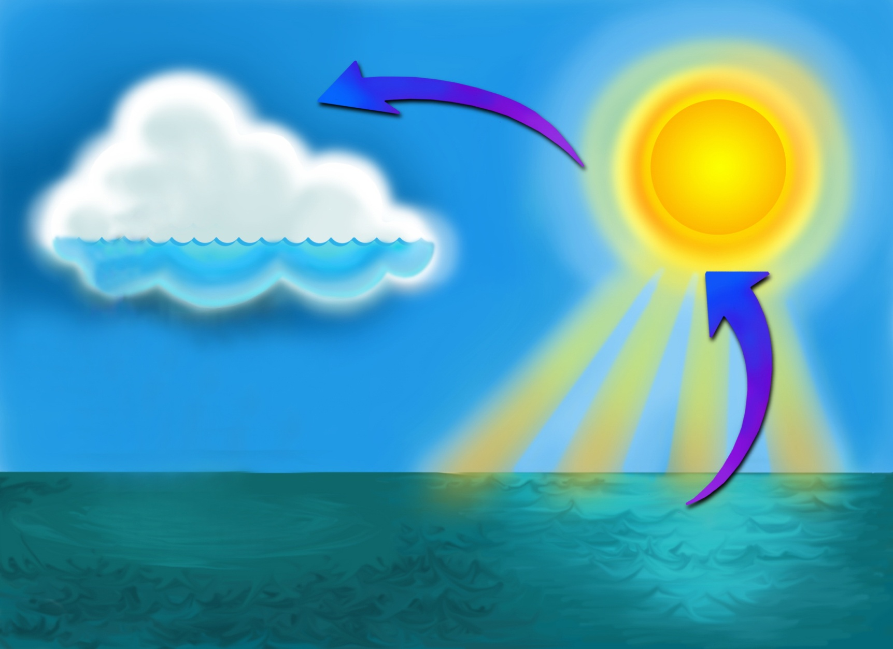
“Condensation”
The transformation of water vapor back into liquid water by cooling
Evaporated water is warmed and rises into the air where
it eventually cools and condenses to form clouds.
Notes:
‹#›
The water seen on the outside of a cold glass on a hot day is condensation. Condensation is the changing of water from a gaseous state back to a liquid state in the form of clouds.
The ocean is an integral part of the water cycle and is connected to all of the earth’s water reservoirs via evaporation and precipitation processes.

Slide 13
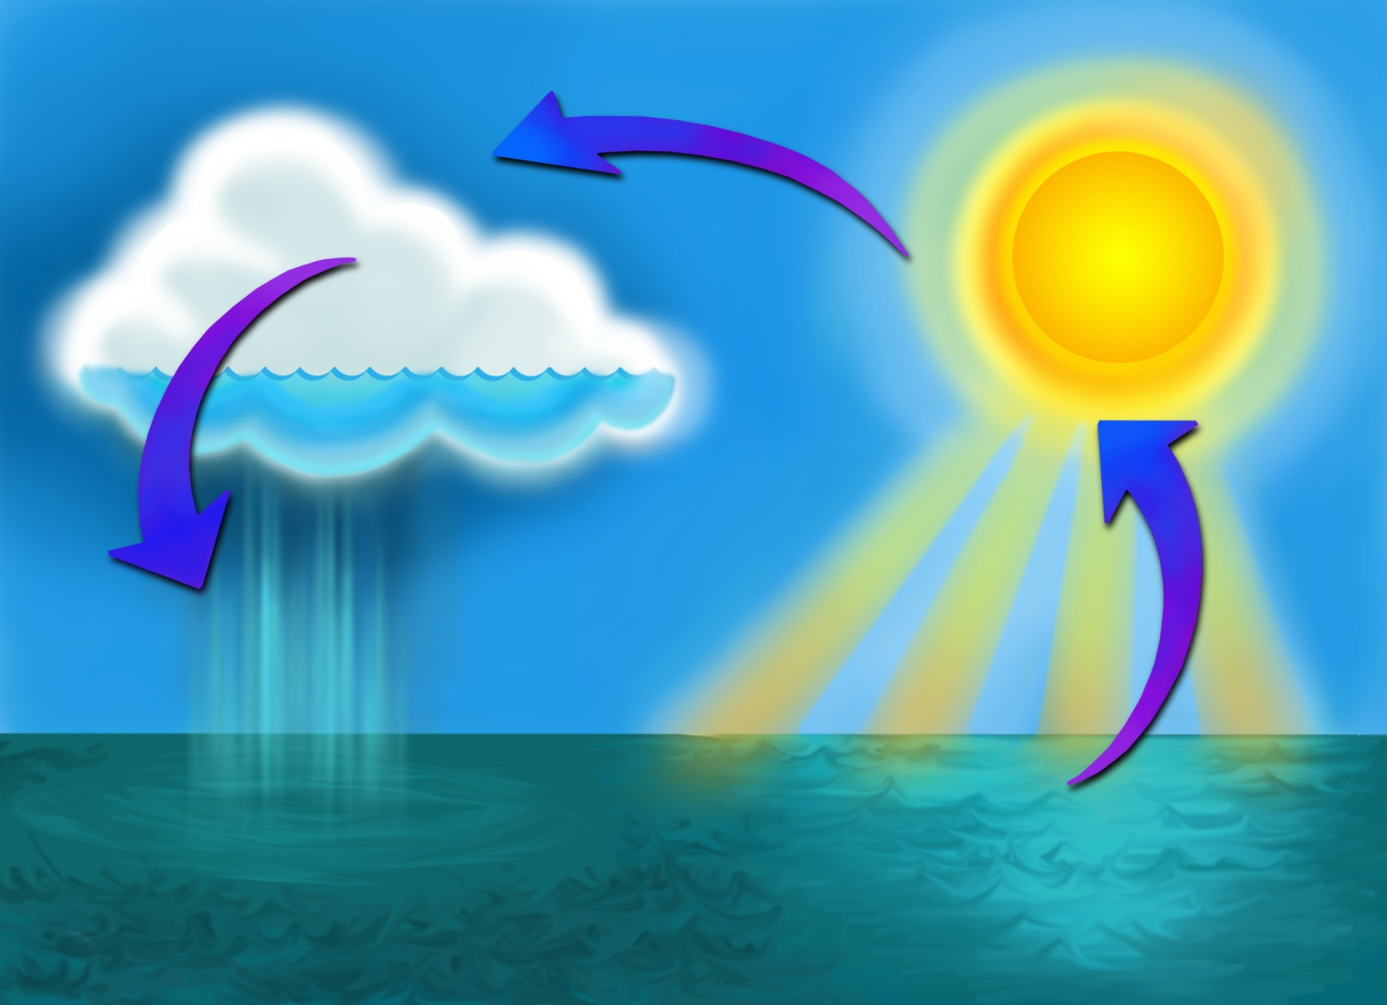
“Precipitation”
Rain, hail, or snow falling from the clouds
due to the condensation of water
When clouds become very heavy with
condensed water, the water is released
in the form of rain, hail, or snow.
Notes:
‹#›
Precipitation is a major component of weather and of the water cycle. Precipitation is responsible for depositing most of the fresh water on the planet.

Slide 14
“Accumulation”
The collection of precipitation into rivers, lakes, and oceans.
This completes the water cycle!

Slide 15
This is the water cycle!
condensation
transpiration
precipitation
evaporation
accumulation
Notes:
‹#›

Slide 16
https://goo.gl/Xi9TgZ
Natural Water Cycle Game

Slide 17
Climate Change &
The Water Cycle

Slide 18
Brainstorm in Pairs
What is climate change & what causes it?
How would climate change affect the water cycle?
Notes:
Climate change, also called global warming, refers to the rise in average surface temperatures on Earth. An overwhelming scientific consensus maintains that climate change is due primarily to the human use of fossil fuels, which releases carbon dioxide and other greenhouse gases into the air. The gases trap heat within the atmosphere, which can have a range of effects on ecosystems, including rising sea levels, severe weather events, and droughts that render landscapes more susceptible to wildfires.

Slide 19
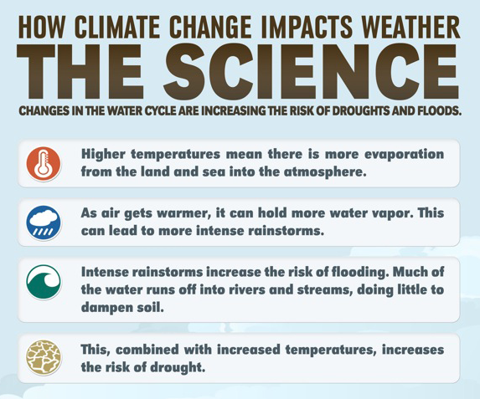

Slide 20
Climate Time Machine

Slide 21
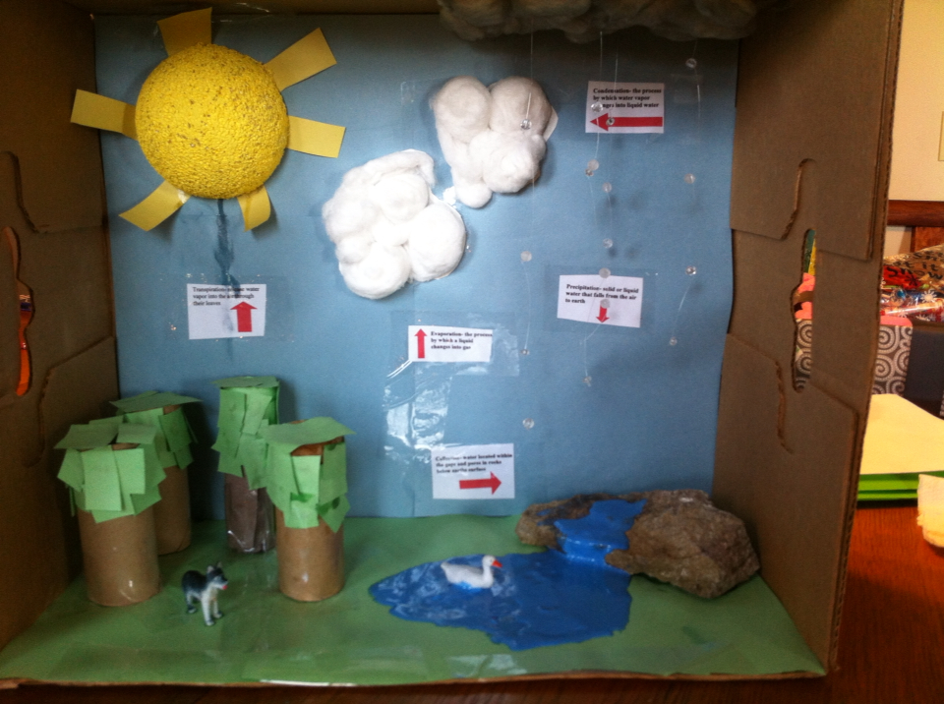
3D Water Cycle Model
Task: To create a 3D model of the water cycle.
Guidelines:
All 5 stages must be present
Your model must be 3 dimensional
Use a variety of materials

Slide 22
Break!

Slide 23
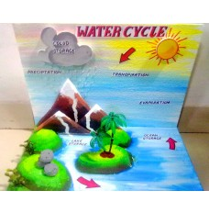
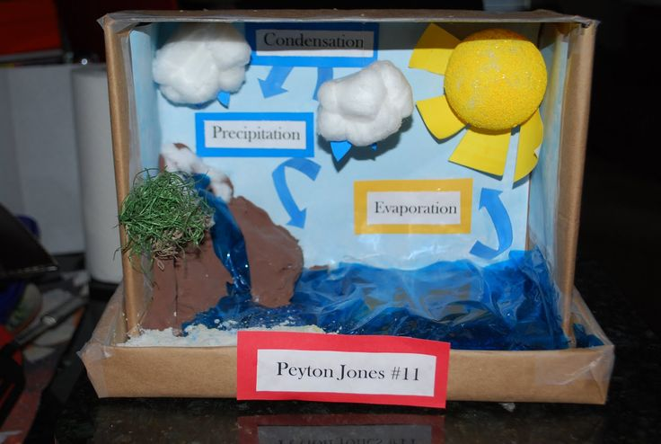
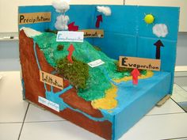
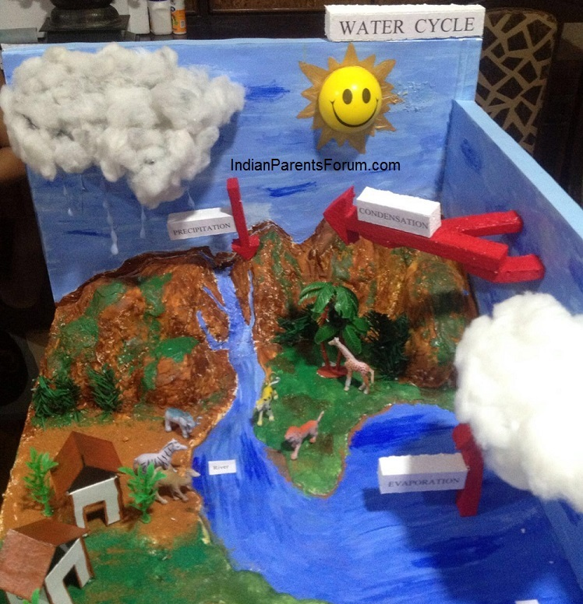
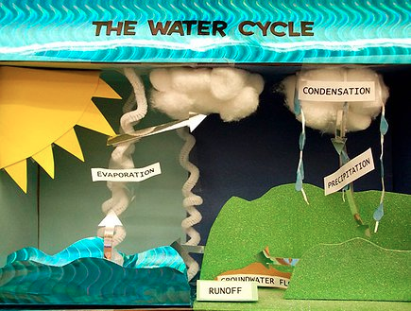
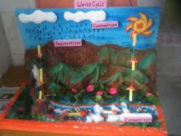

Slide 24
Lunch!

Slide 25
Engineering Challenge:
Build a Terrarium Aquarium

Slide 26
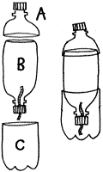
Procedure: Day 1
Draw a circle around the top of Bottle 1 (like image). Cut the top off of Bottle 1. Label the top “A” and label the bottom “C”
Draw a circle around the bottom of Bottle 2. Cut the bottom off of Bottle 2. Label the top of it B. (we don’t need the bottom of bottle 2.)
Thread the wick (piece of fabric) through the hole in the cap with ¾ of the fabric on outside.
Put the cap on the top of part B.
Add a layer of sand to part C about 1 inch high.

Slide 27
Procedure: Day 2
Fill up part C with water (fill up slowly & have the water fill in on the side of the bottle. to not disturb the sand.
Slowly add the shrimps and waterplant to part C.
Insert Part B with the cap upside down into Part C.
Tape Part B & Part C together (tape around the bottle twice then cut the tape).
Fill in Part B with 1 layer of gravel and then a 5 till 8 cm of soil
Add grass seeds to the soil of Part B
Add a little water to the soil.
Use Part A as the lid. Tape Part A to Part B (wrap around many times). Make sure it is completely closed.

Slide 28
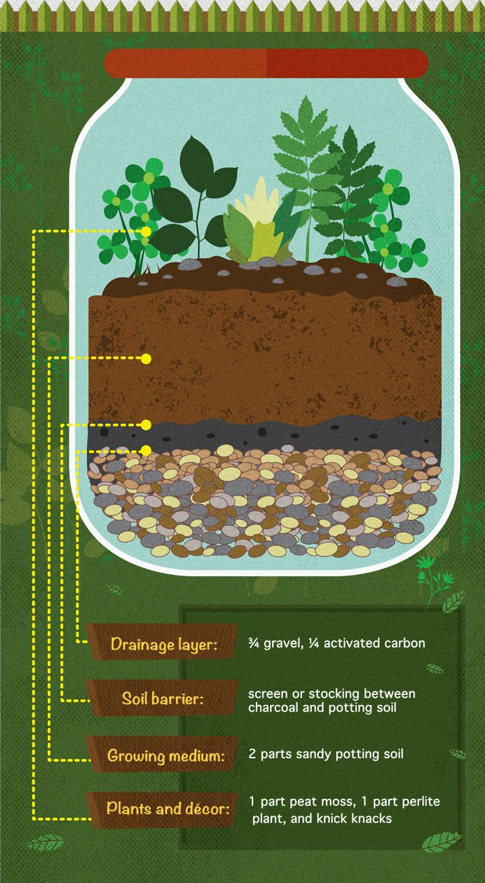
3D Model of
Water Cycle
If complete with 3D Model of Water Cycle, create an infographic poster about your terrarium aquarium.
The infographic will include information & visuals of what is happening in your ecosystem.
This can be used to explain to your parents on Friday!

