Slide 1
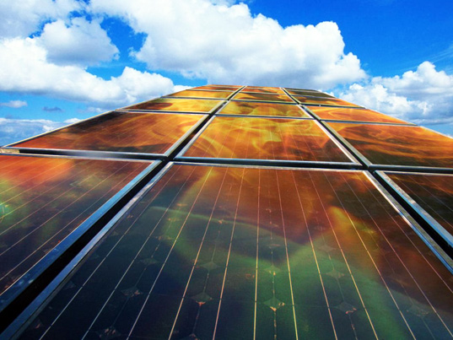
SOLAR TRACKING SYSTEM
Notes:
1

Slide 2
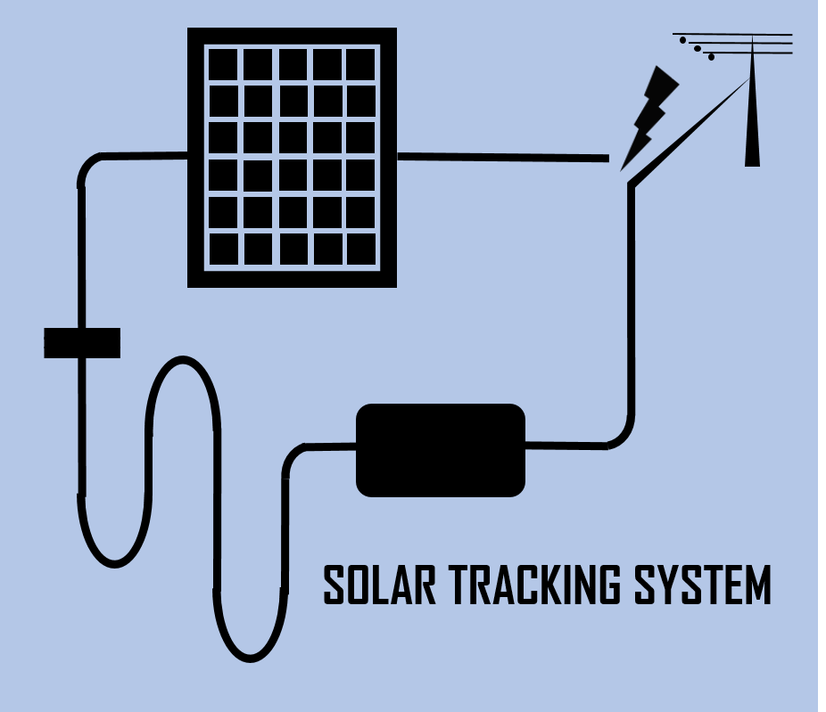
Solar Tracking for Maximum Power Output
This project was initiated to introduce and analyze new concepts and methodologies behind Solar Tracking Systems
By tracking the sun throughout the day, this device can absorb more energy than that is in a conventional and static solar panel system

Slide 3
Objectives
Solar Tracking System operate with a technology beyond the conventional
Deliverables
Solar energy becomes most popular energy source as a renewable energy source
Thus the market requires much efficient and powerful solar system
By this technology we can use maximum of the sunlight by tracking sunlight very accurately
Thus costumers would encourage to buy this technology rather than going for conventional methods

Slide 4
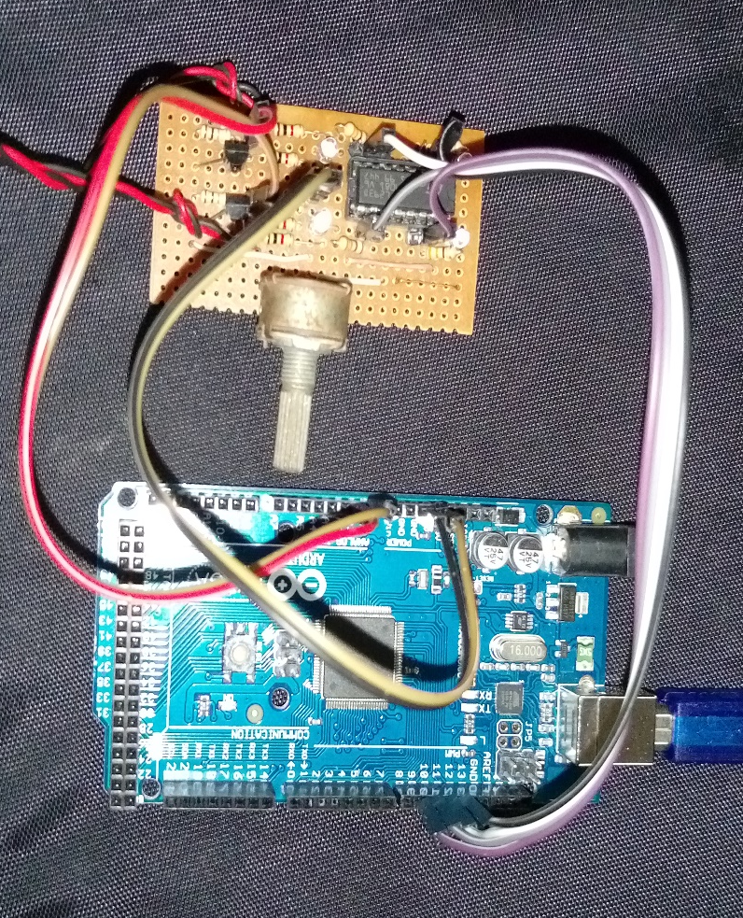
Circuit
Diagram
Motor Supply
6V
Stepper
Motor
+ 5
50K
330
330
1K
1K
1K
1K
IC
L293D
330
330
BC 547
10K
BC 547
BC 547
0
A1
12 11 10 9
+5
0
A0
Arduino
Power

Slide 5
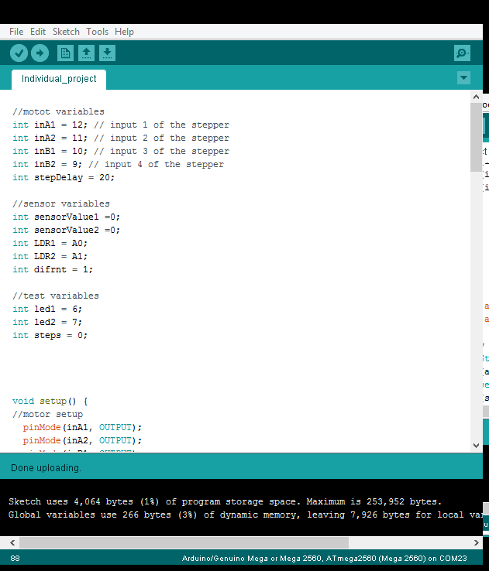
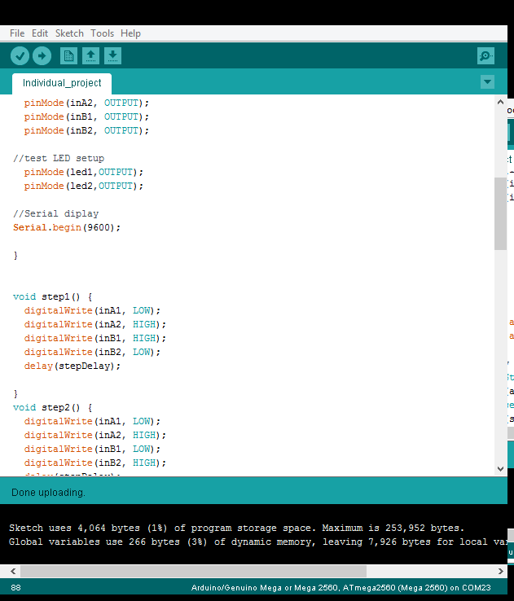
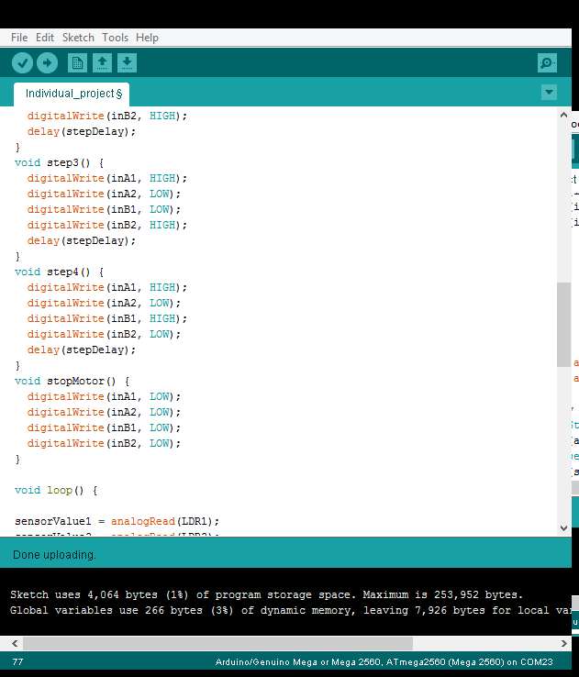
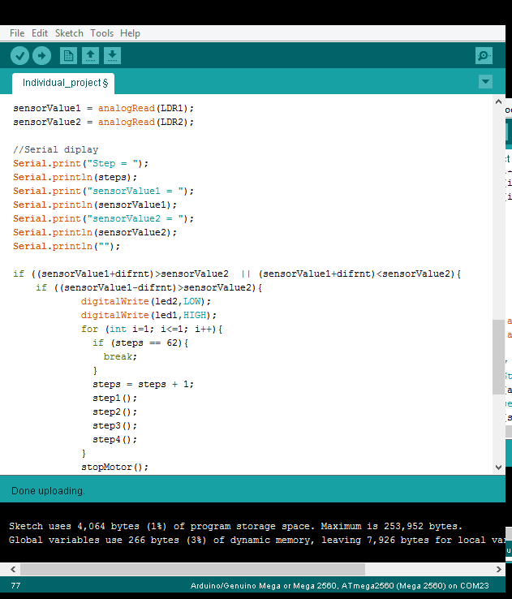
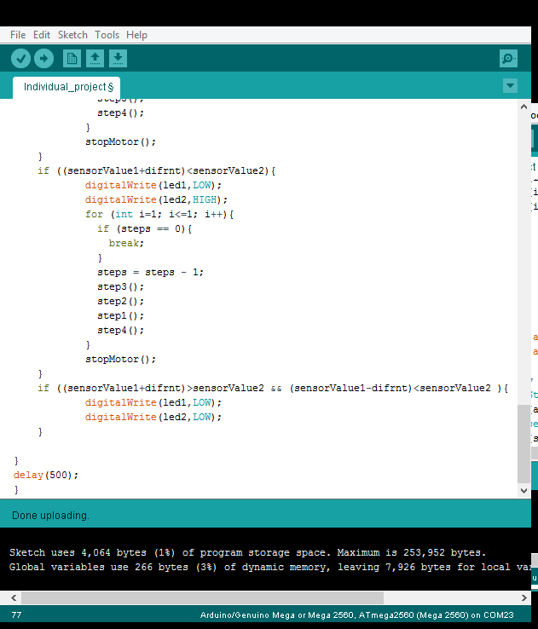
Arduino Code for the program

Slide 6
Challenges and Solutions
Motor
Problem :- Torque was not enough to handle the rotating mechanism
Solution :- The bipolar stepper motor in an old CD rom which was to be dumped was used and torque was more than enough
Rotating Mechanism
Problem :- Solar panel is Rotating and if a metal lever is
used to operate it, it should be moved in two direction
Solution :- A empty ink tube of a pen is used instead
Problem :- It was hard to find some motor mechanism or gear wheel to accurately move the solar panel
Solution :- Using the Head Driver of the CD ROM, solar panel could be easily controlled and it can be found without expending any money
X axis
Ink tube
CD Head Driver
Motor Mechanism
Y axis
Hinge

Slide 7
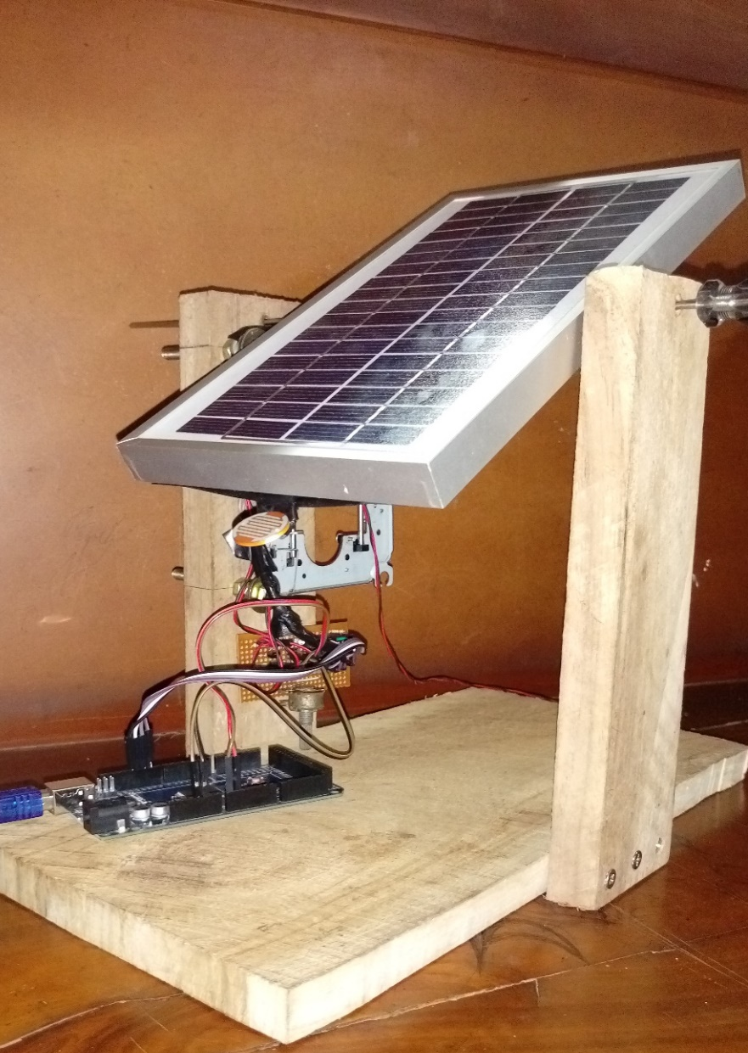
Budget
Item | Price ($)
Solar Panel | 10.00
L293D IC and Base | 1.50
Arduino MEGA(or if prefer micro controller) | 12.14
10 Resistors and one variable resistor | 0.50
4 LEDs | 0.143
2 LDRs | 3.00
2 transistors (BC 547) | 0.143
Ribbon and circuit wires | 0.43
Power supply | 1.07
Wooden stand | 2.14
TOTAL | 31.07

Slide 8
Calibrating and Performance
Variable Resistor for adjust difference between LDRs
Video demonstrate on how the circuit measure the difference
This variable resistor is used to operate this tracking device in different lighting conditions
Which changes the sensitiveness of the LDRs to the suitable values

Slide 9
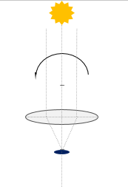
Further Improvements
Instead of two LDRs, hoping to use one LDR
having good sensitivity with a convex lens
Operates the Solar Tracking System using the
same power developed in the solar panel
Use much sensitive LDR circuit for the device
Introduce higher range of rotating angle
Design the circuit which consume minimum power for the controlling purposes of the device
Instead of Arduino, it can be used a micro controller to do the same controlling algorithm
Convex
Lens
LDR

