Slide 1
How to Make Pumpkin Chocolate Chip Muffins
By BrittanI Moffett

Slide 2
Prep Time: 15 minutes Cook Time: 20 minutes
Ingredients:
2 whole eggs
1 cup of sugar
8 oz canned pumpkin puree
¾ cup oil or applesauce
1.5 cups of flour
1 tsp. baking soda
½ tsp. baking powder
¼ tsp. ginger
¹/₈ tsp. cloves
¹/₈ tsp. nutmeg
½ tsp. salt
8 oz. chocolate chips
Supplies:
Mixing bowl and spoon
Mixer
Muffin pan
Cupcake liners

Slide 3
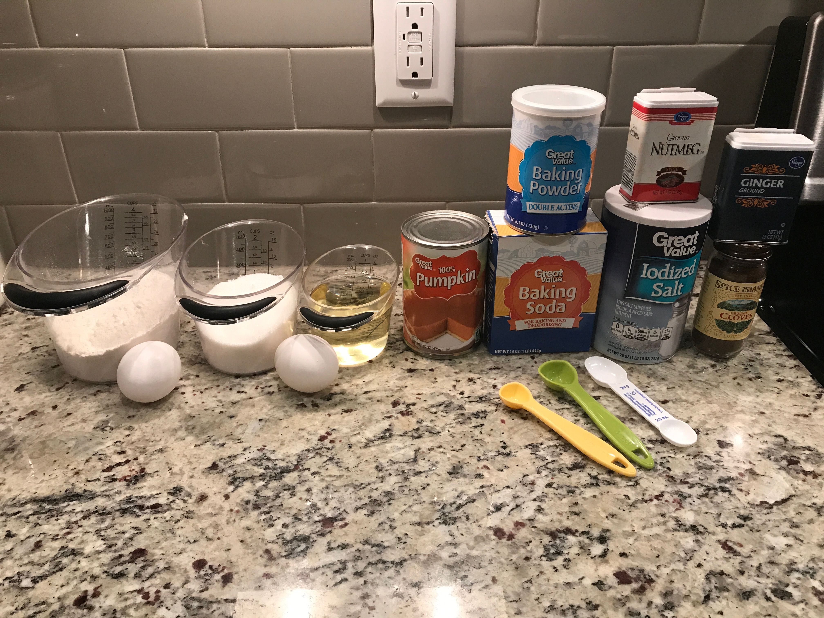
Directions:
1. Gather ingredients and preheat oven to 350º

Slide 4
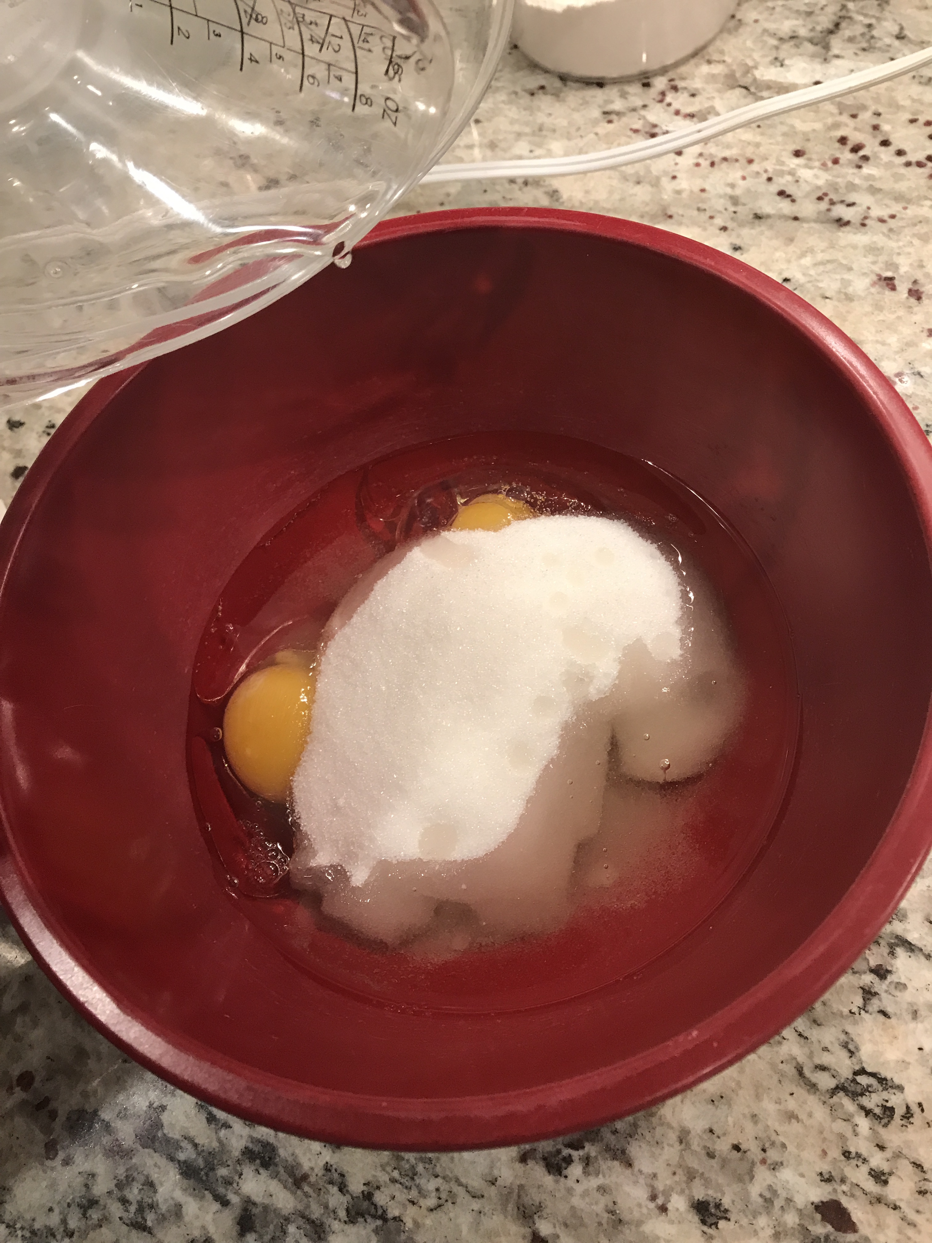
2. Crack eggs into mixing bowl and add sugar and oil

Slide 5
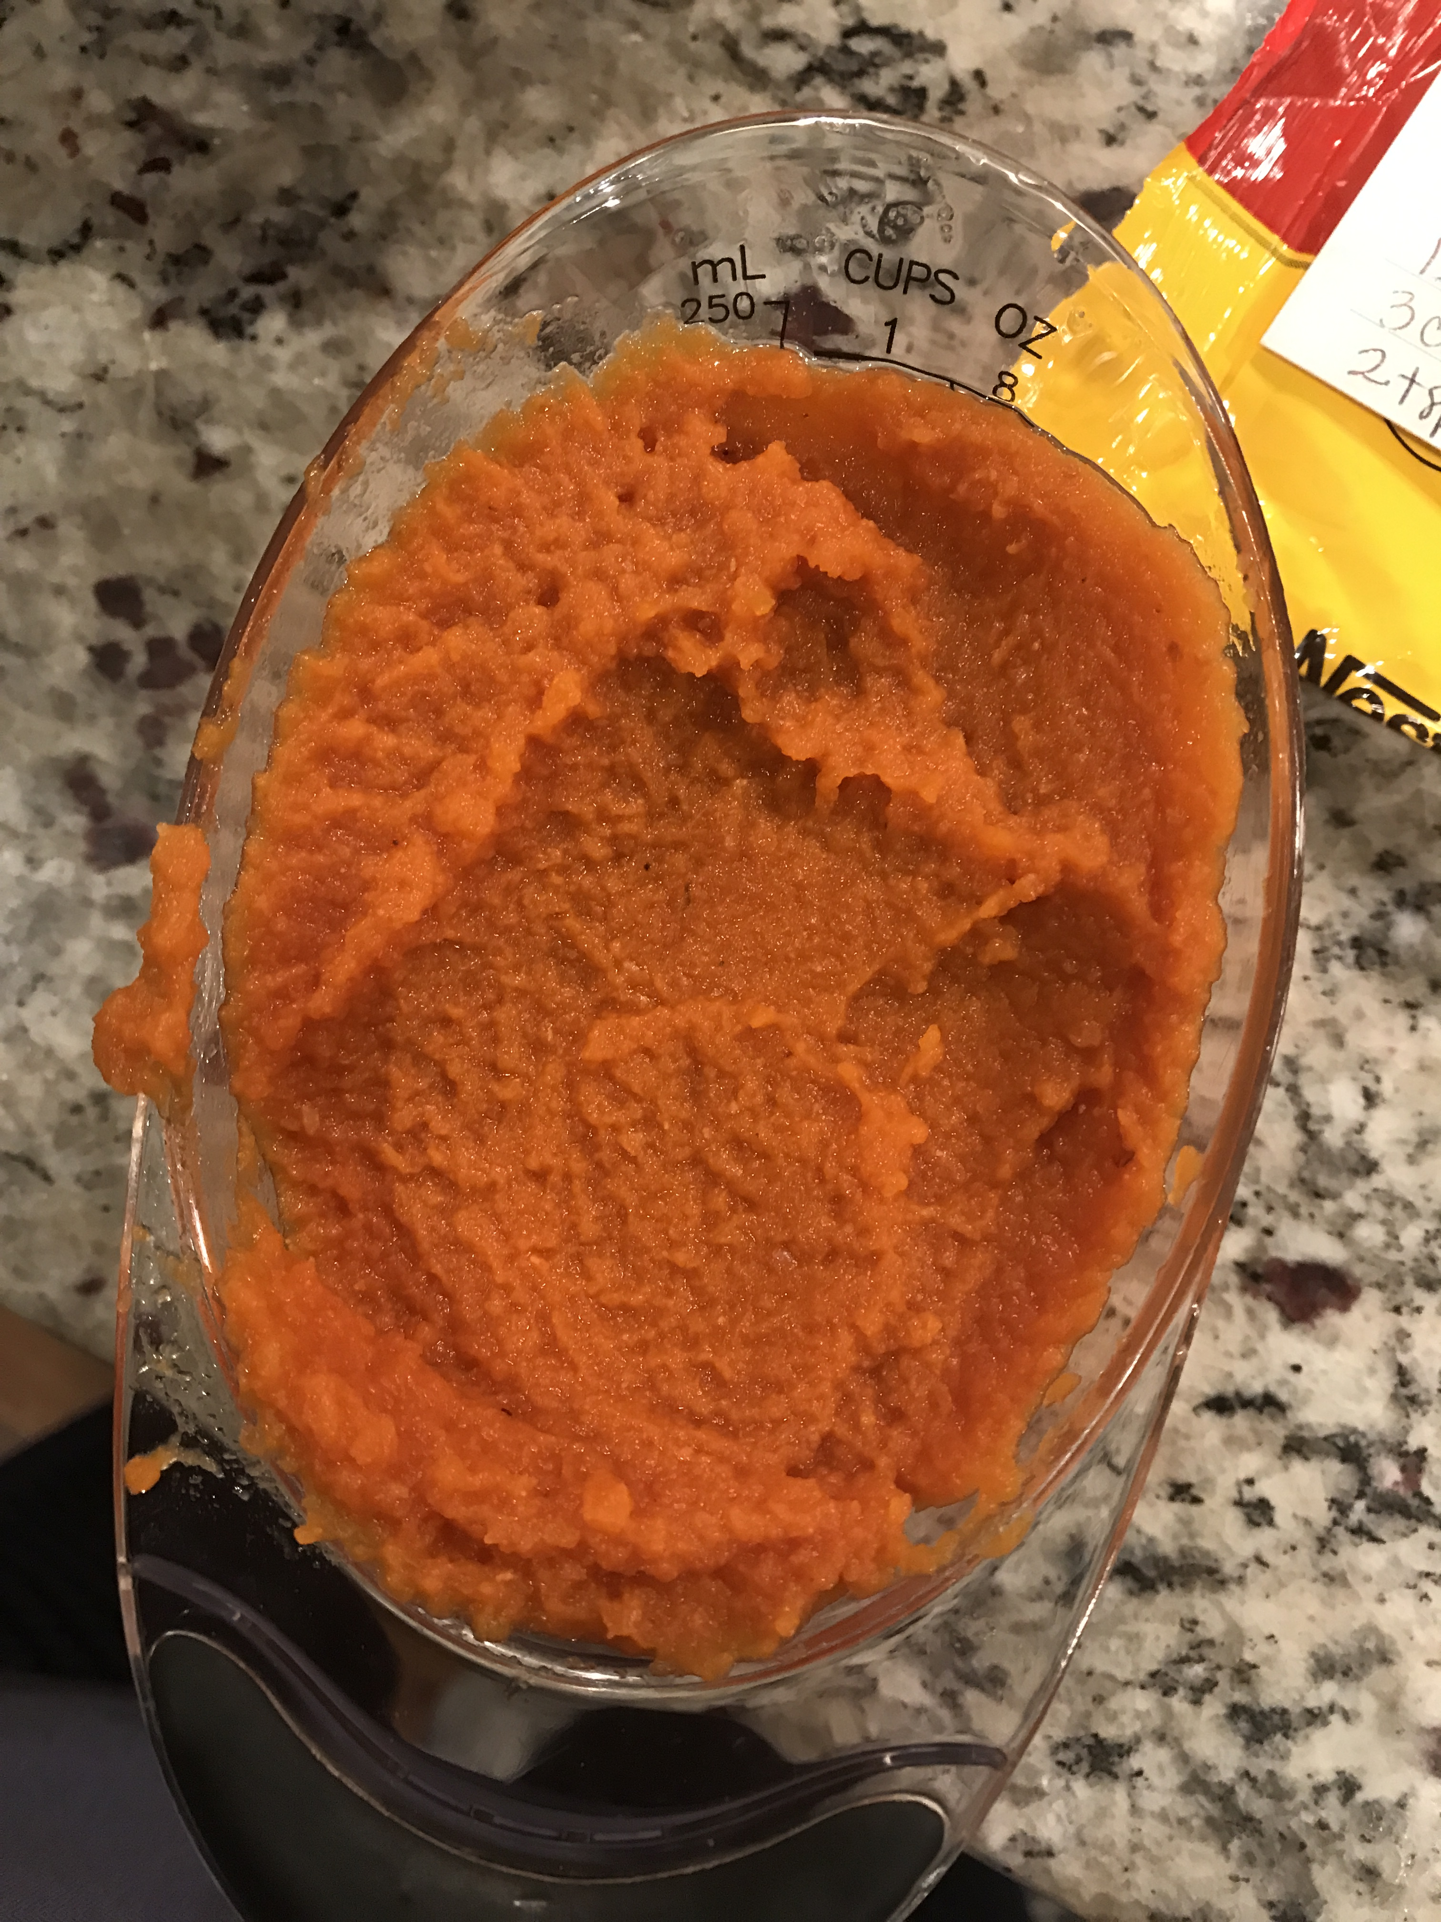
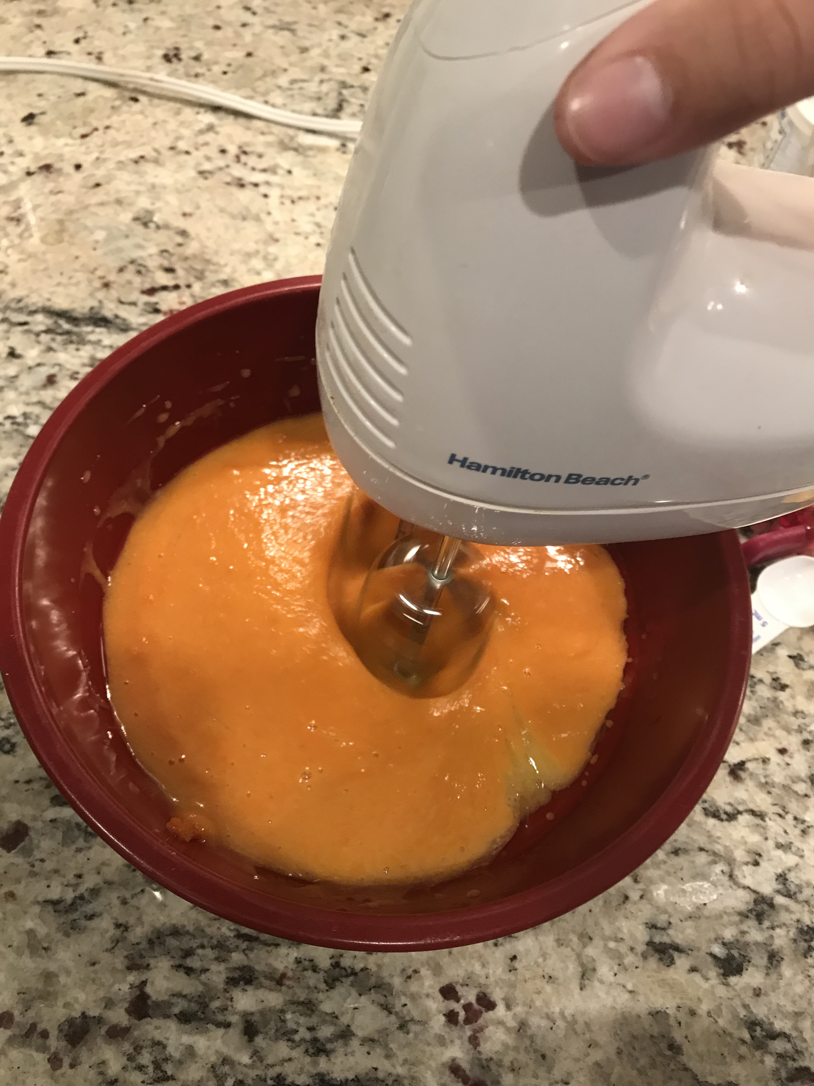
3. Measure 8 oz of pumpkin puree and add to mixing bowl

Slide 6
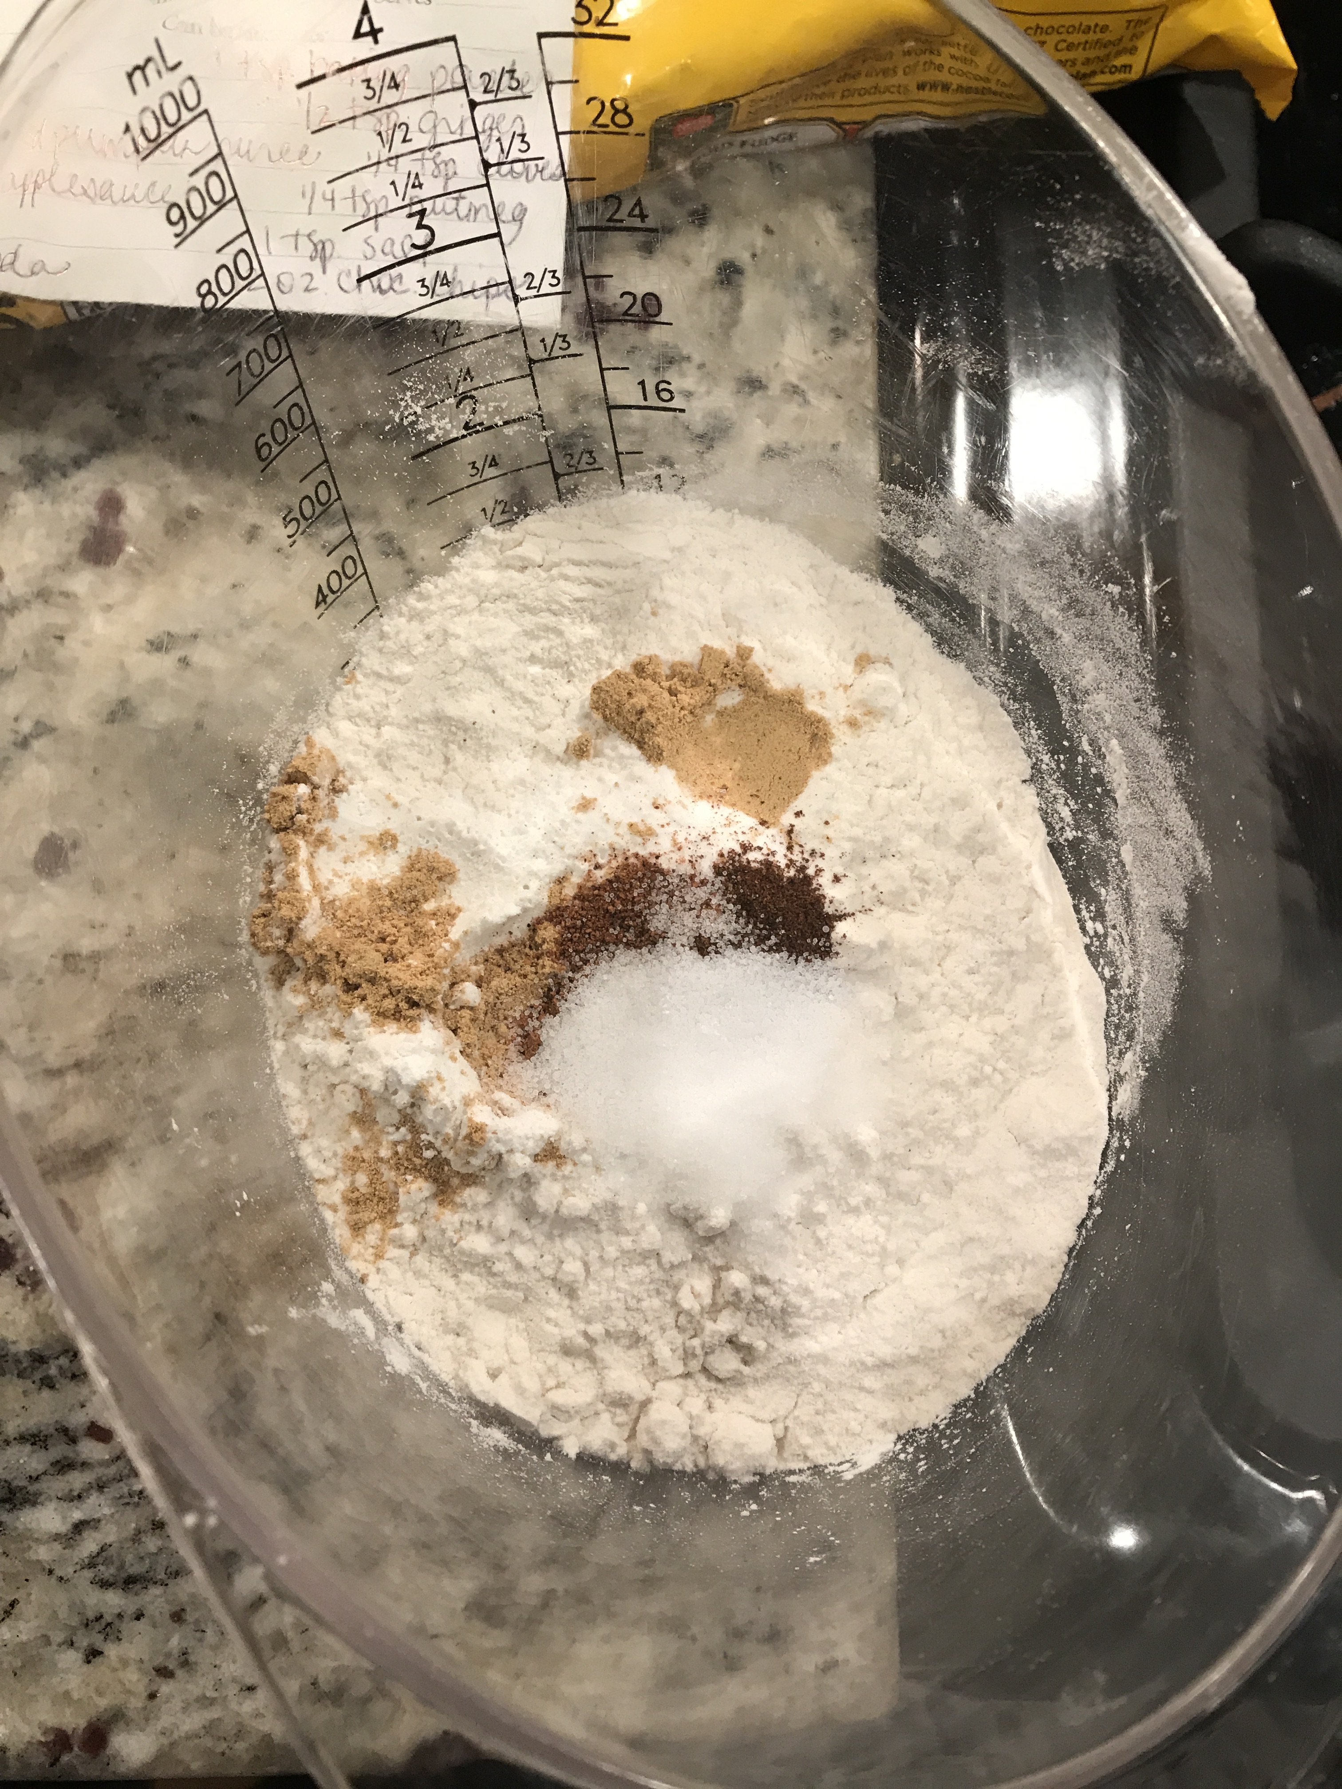
4. Measure flour in separate bowl and add in baking soda, baking powder, salt, and all other spices

Slide 7
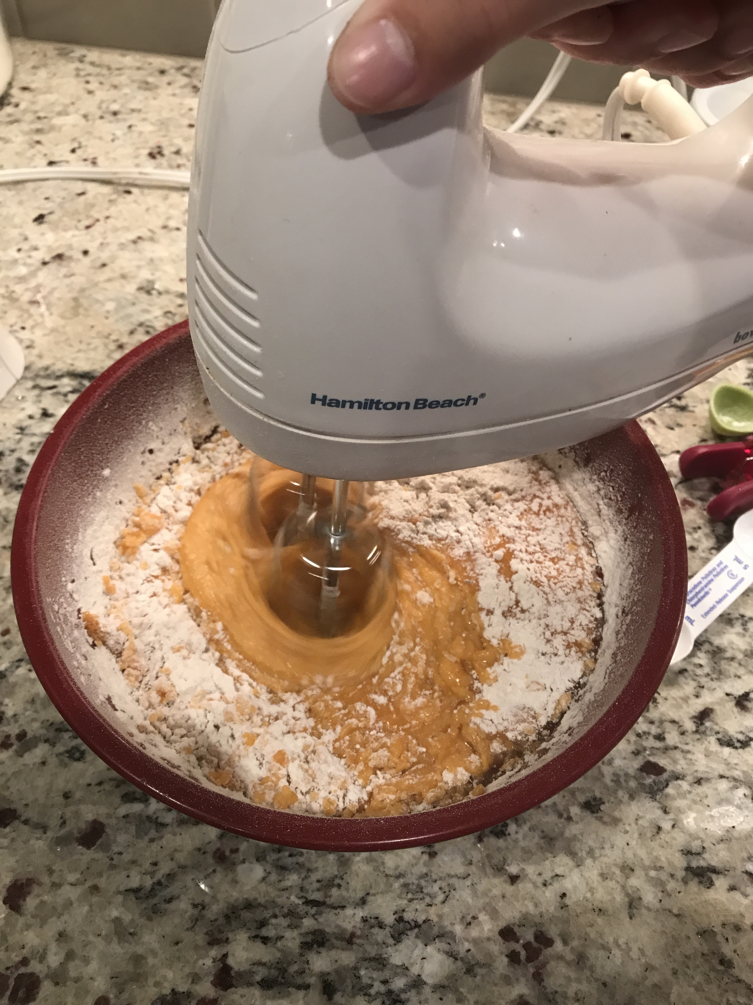
5. Slowly add flour mixture to puree mixture

Slide 8
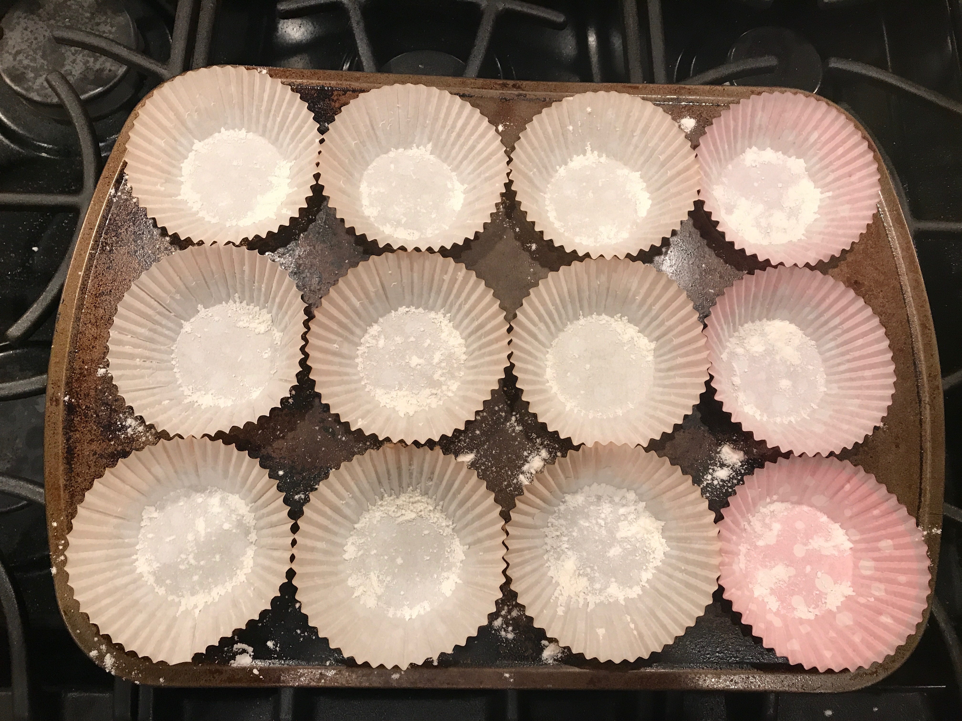
6. Prepare muffin pan with cupcake liners
Tip: sprinkle flour into cupcake liners so the muffins won’t stick

Slide 9
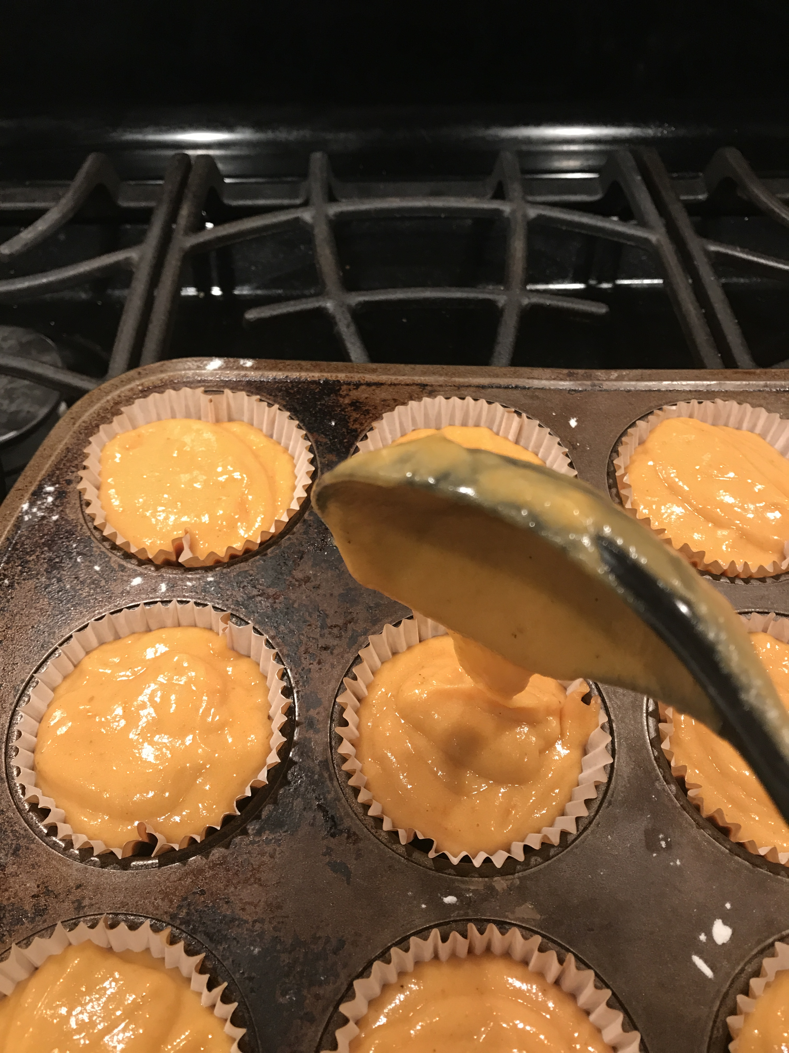
7. Pour mixture into cupcake liners filling them ¾ of the way full

Slide 10
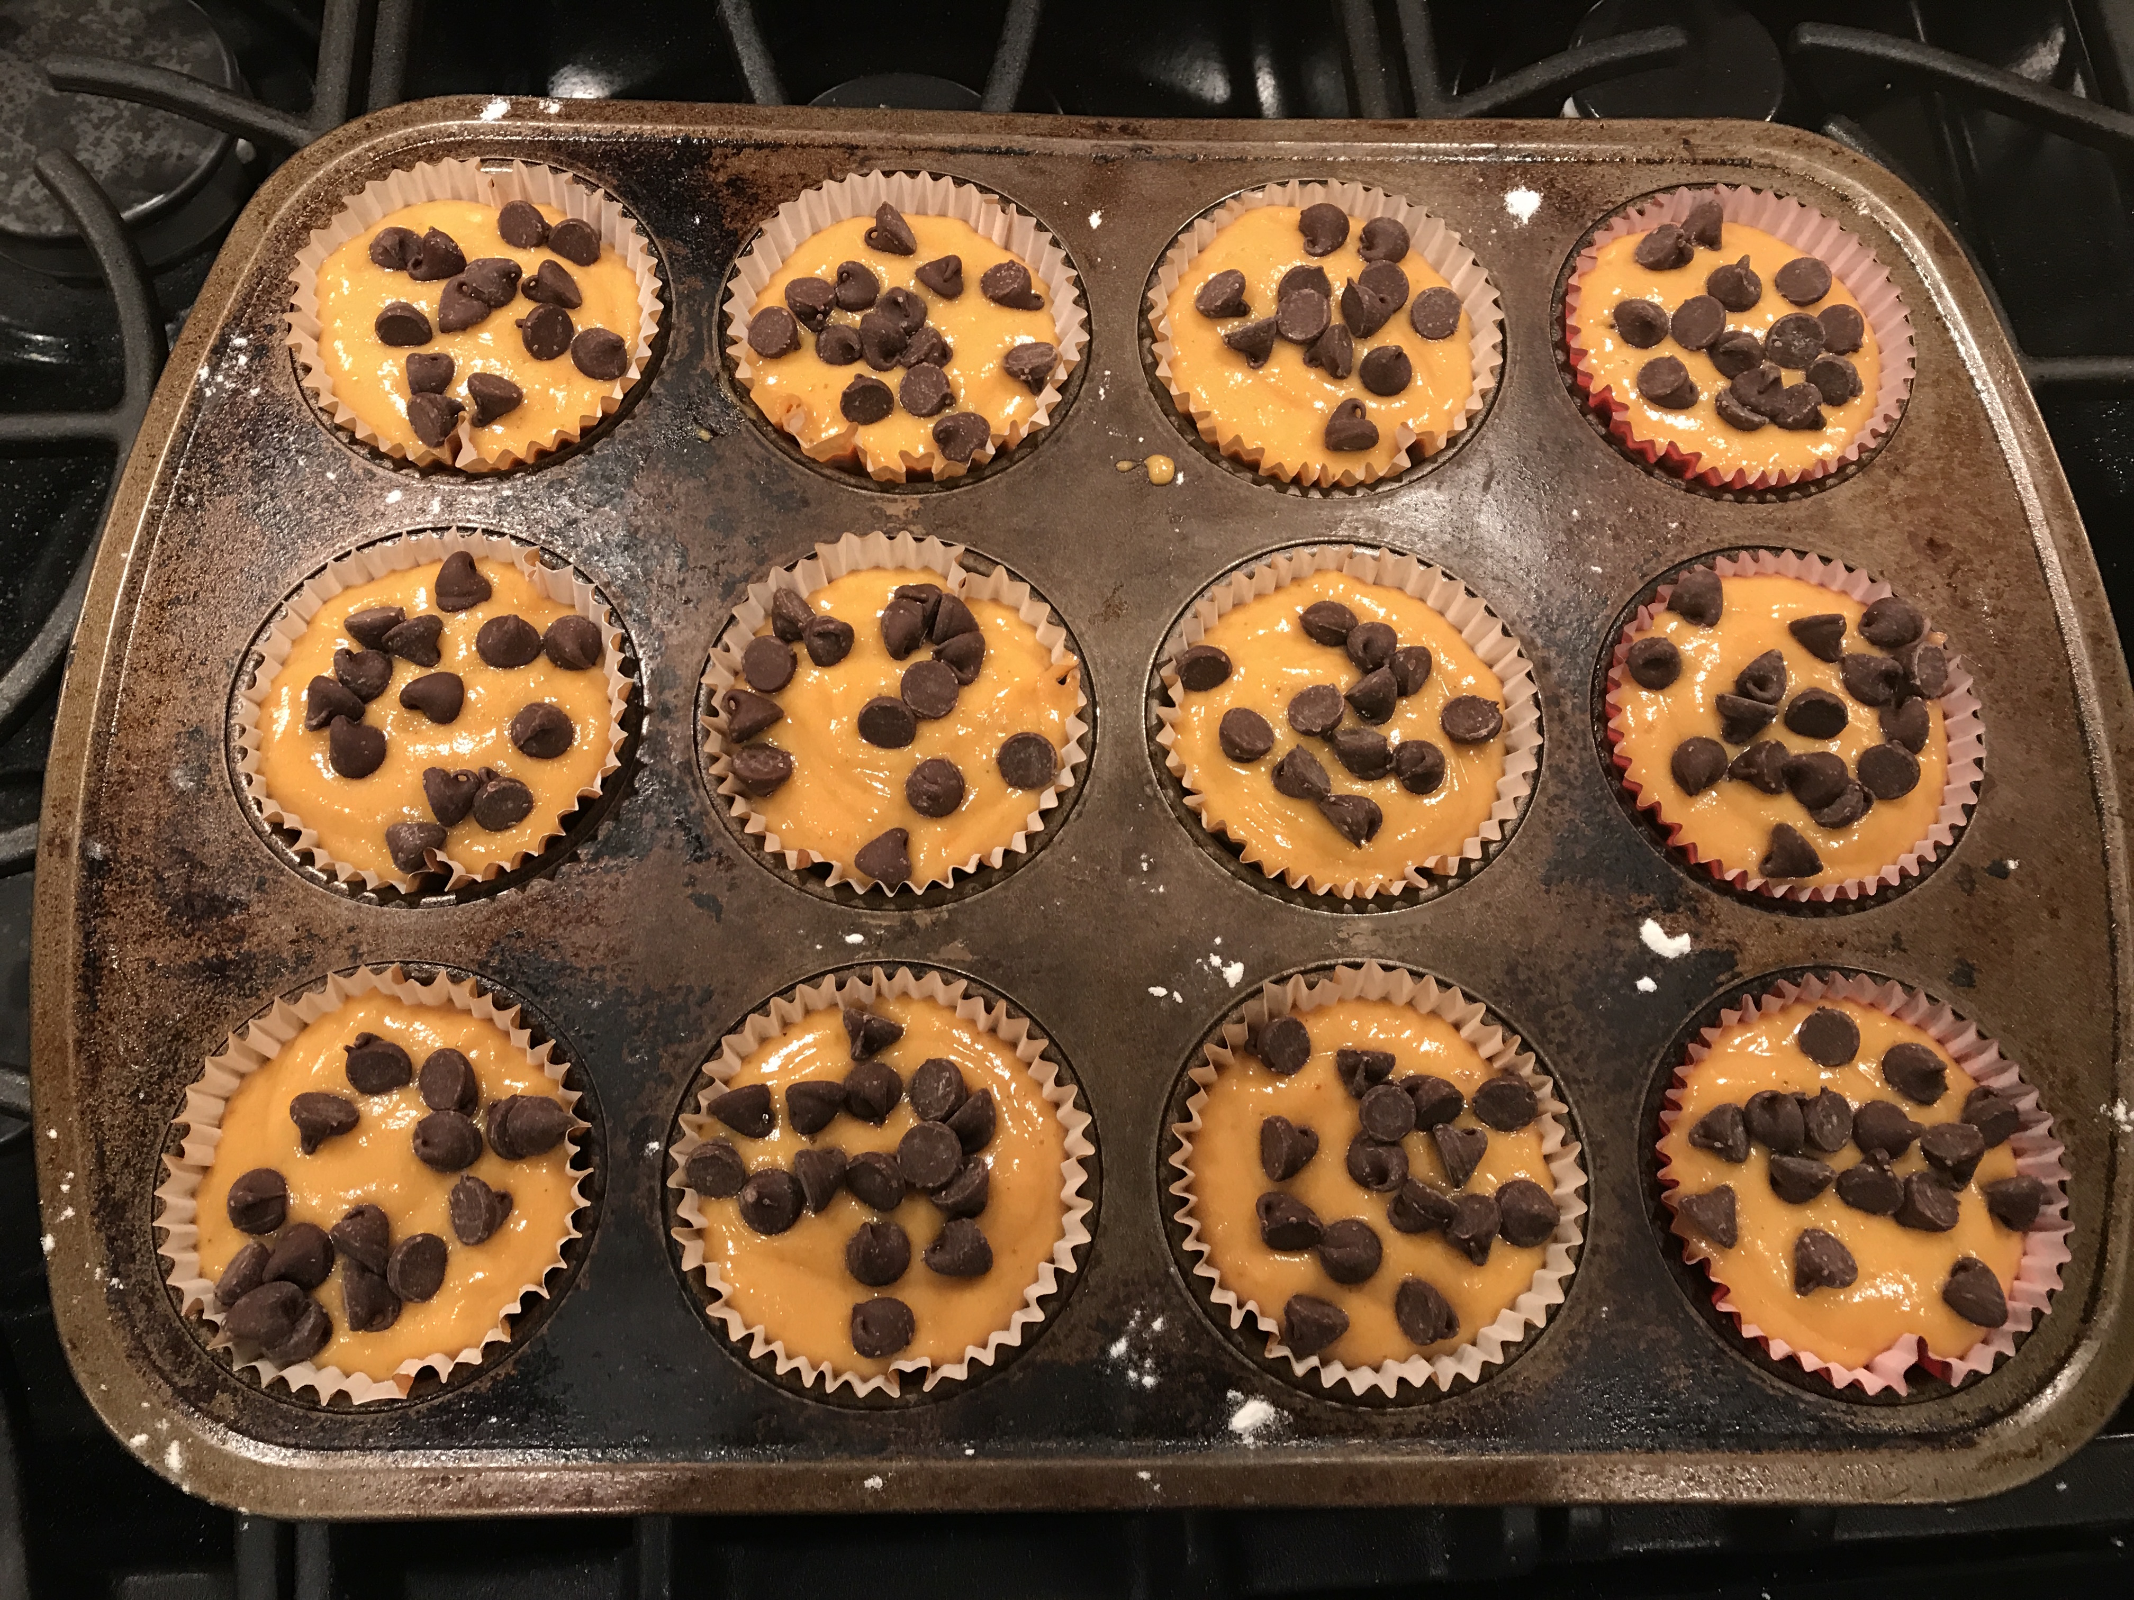
8. Sprinkle desired amount of chocolate chips on top before baking

Slide 11
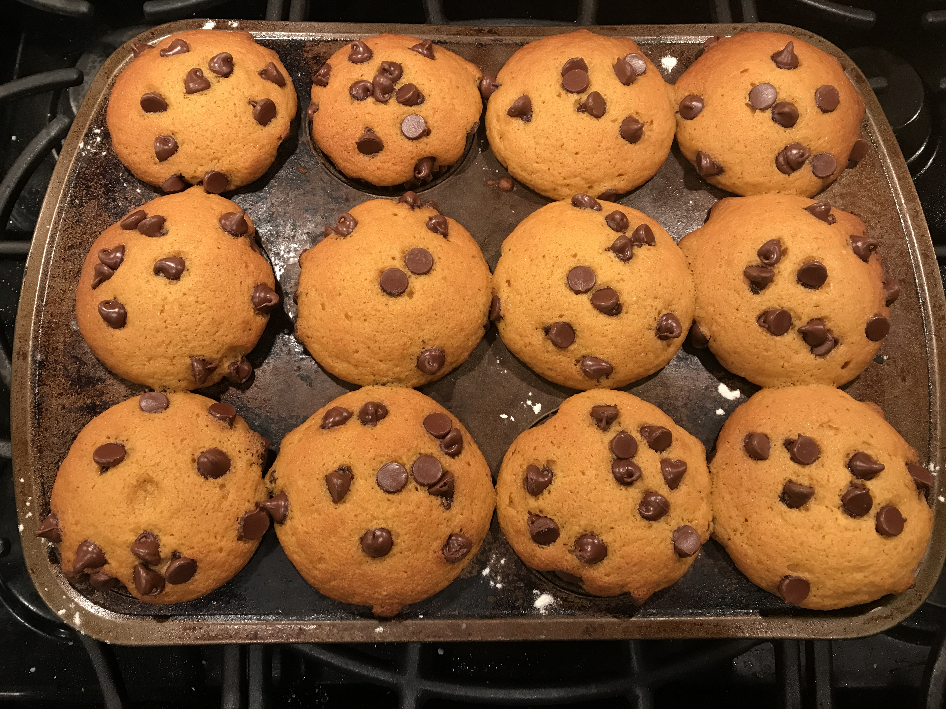
9. Bake muffins on 350º for 20-25 minutes

Slide 12
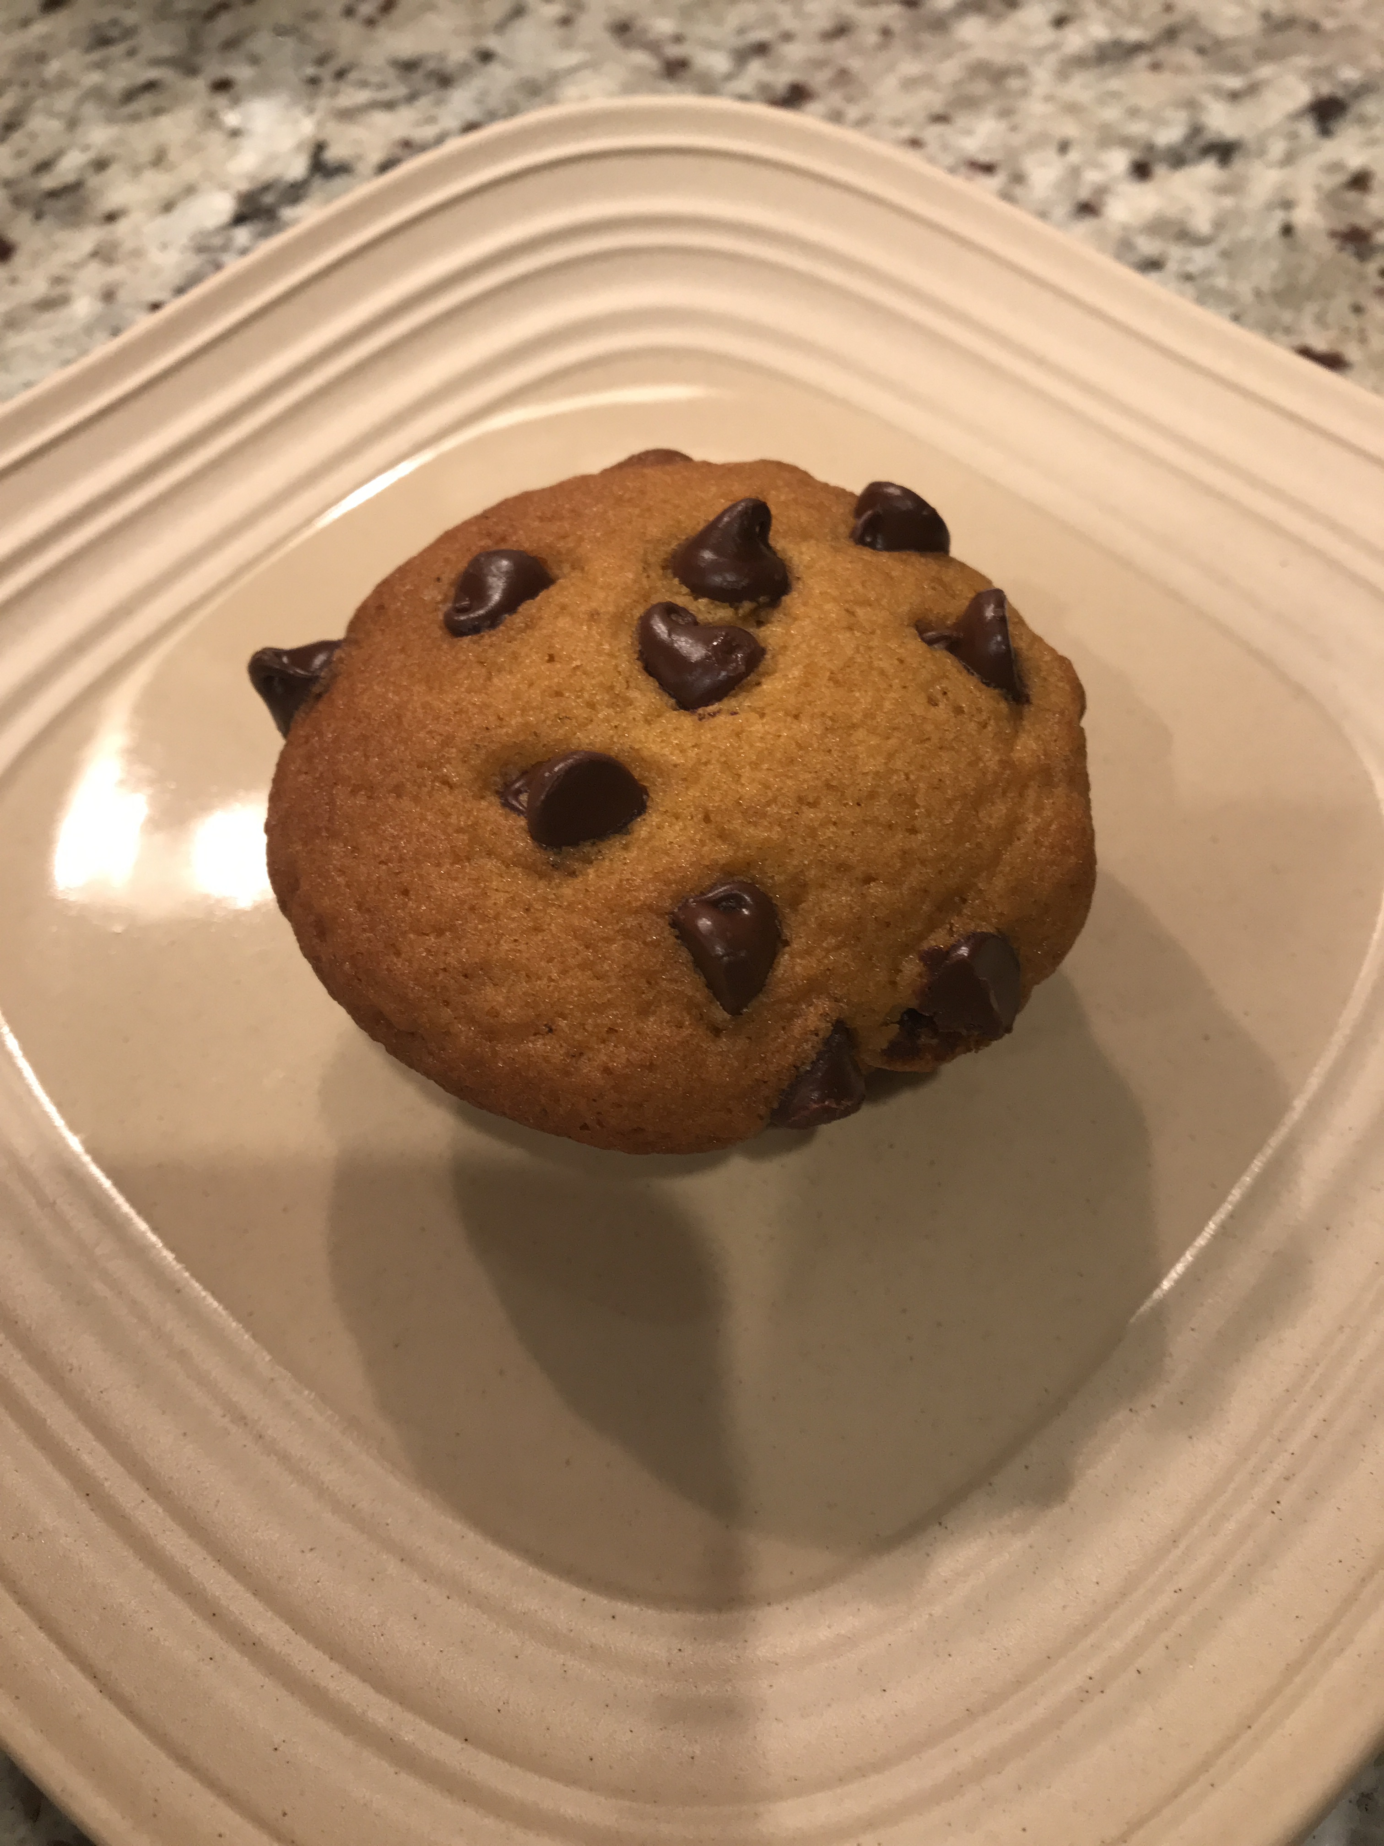
10. Enjoy!

