Slide 1
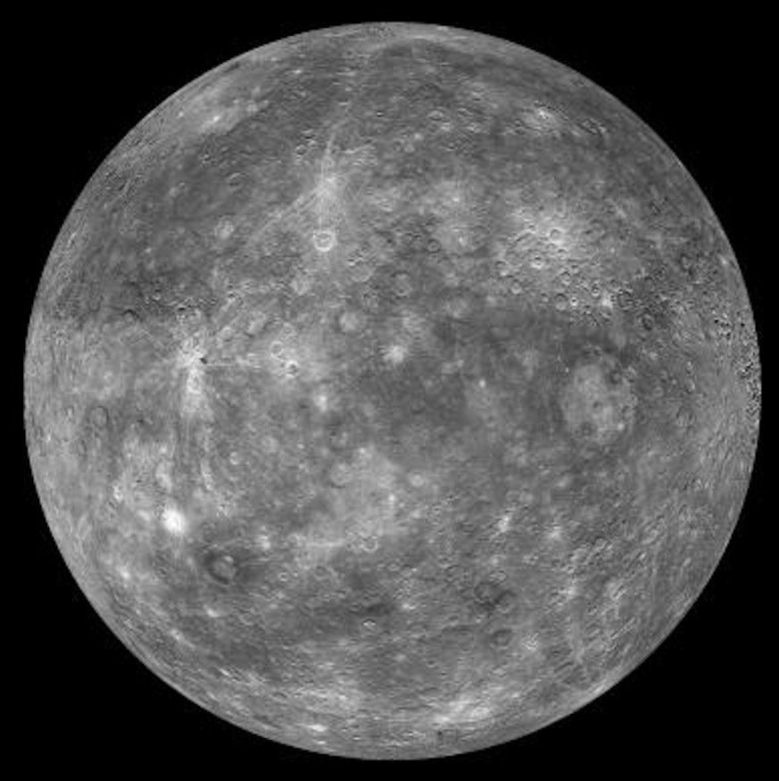
Fun Facts:
My orbit is 88 days
I have no moons
If you weigh 10 stone on Earth, you’d weigh just 3 ½ stone on this planet!
You might expect me to be the hottest planet, but I’m not. My temperature ranges from -173°C to 427°C
I am named after the Romans’ messenger to the Gods
Notes:
MERCURY

Slide 2
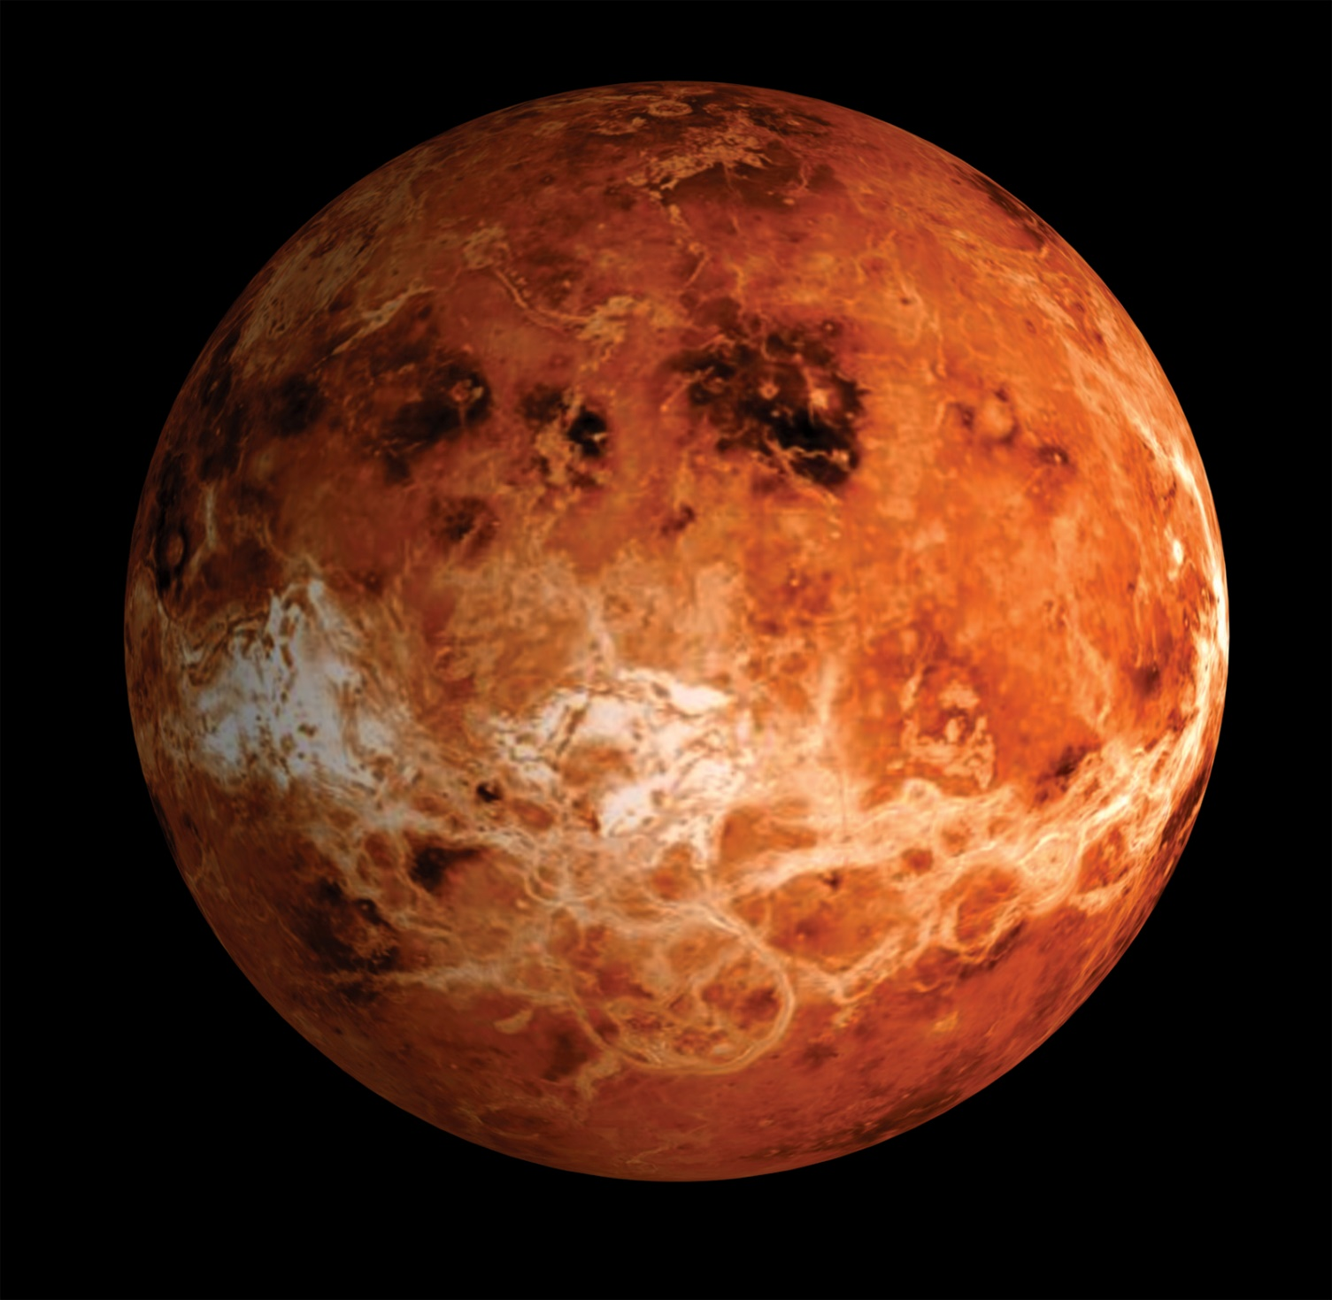
Fun Facts:
My day lasts longer than my year!
I’m similar in size to Earth. In fact, I’m known as Earth’s sister planet.
I’m known for retrograde rotation: this just means I rotate in the opposite direction to most planets
I’m the hottest planet and my dense atmosphere traps the heat like in a greenhouse
I am the second brightest object in the night’s sky
Notes:
VENUS

Slide 3
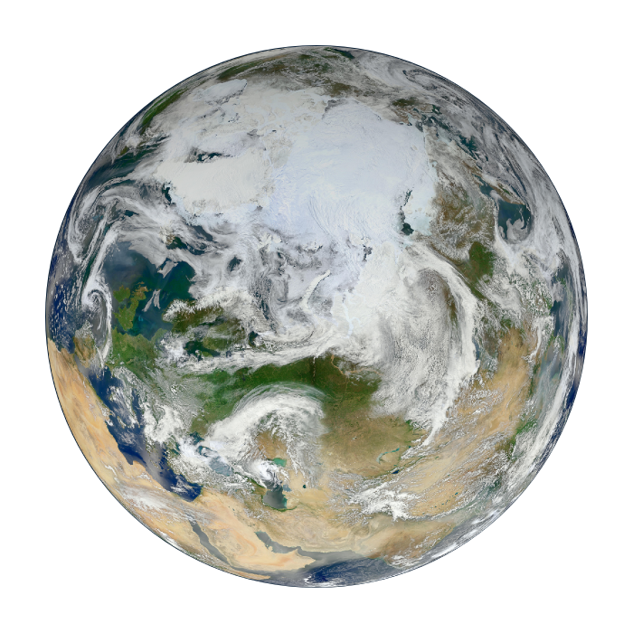
Fun Facts:
My orbit lasts 365.24 days. To make this easier to handle, one full day gets added on every four years!
My rotation is gradually slowing, by 17 milliseconds per 100 years
I’m the only planet not named after a God
I am the densest planet in the solar system
I only have one natural satellite
Notes:
EARTH

Slide 4
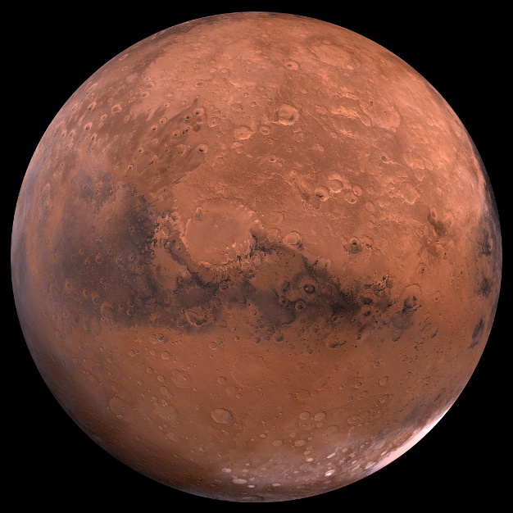
Fun Facts:
I was first recorded by scientists in Egypt
I have two moons
I am home to the tallest volcano in the solar system, which measures 21km high!
Pieces of me have fallen to Earth
I am known for my dust storms
One day I will have a ring, but I’ll be waiting 20-40 million years for this to happen!
Notes:
MARS

Slide 5
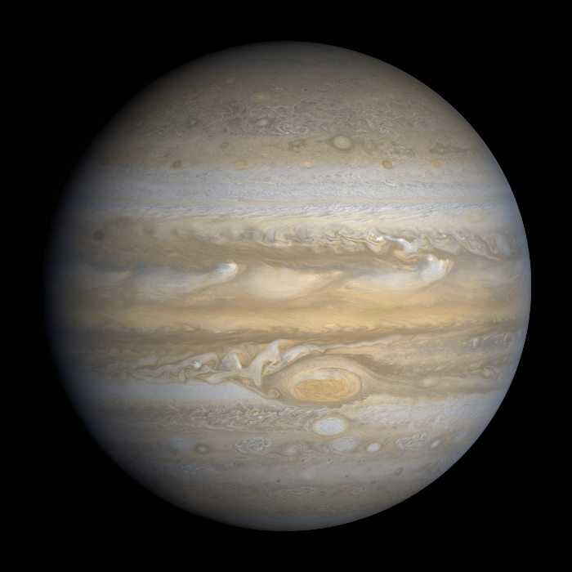
Fun Facts:
I am 2 ½ times more massive than all of the other planets in the solar system combined!
I am one of the 5 planets visible from Earth with the naked eye
My day is just 9 hours and 55 minutes
I have lots of moons. In fact, scientists still debate the true number!
90% of my atmosphere is made of hydrogen, meaning humans could never survive here
Notes:
JUPITER

Slide 6
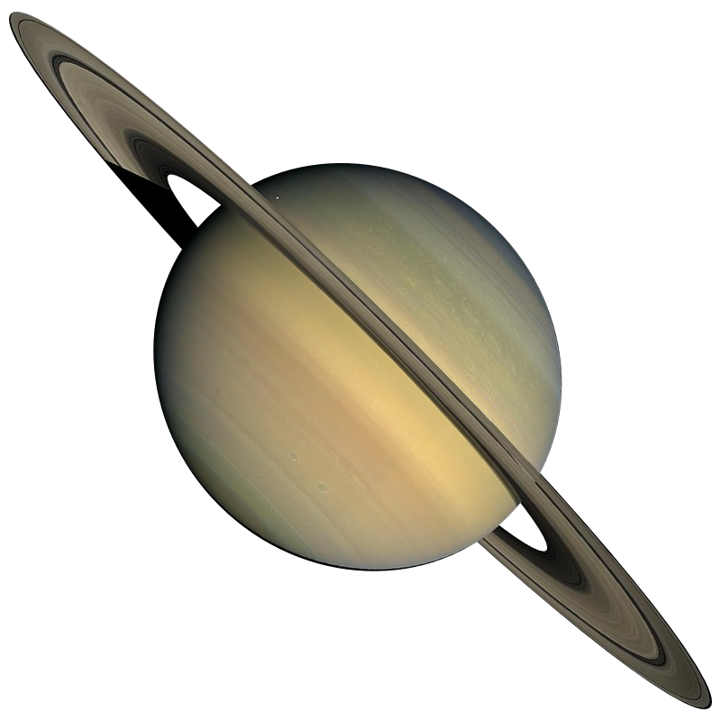
Fun Facts:
I have in excess of 30 moons
I am the flattest of all of the planets
I orbit the sun once every 29.4 Earth years
I have 150 moons and even these moons have moons! They are called moonlets!
Four spacecraft have visited me from Earth
It is possible to see me if you use binoculars or a small telescope
Notes:
SATURN

Slide 7
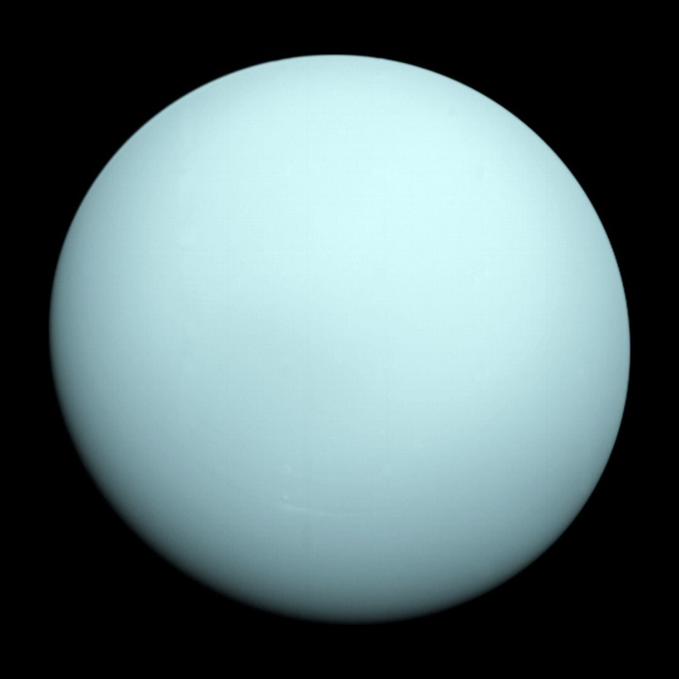
Fun Facts:
I was the first planet to be discovered using a telescope
I’m often described as ‘rolling around the Sun on my side’… I have a slow orbit and originally wasn’t identified as a planet because of it!
I’m referred to as an ‘ice giant’ planet
Some of my moons are named after Shakespearean characters!
I have two sets of thin, dark coloured rings.
Notes:
URANUS

Slide 8
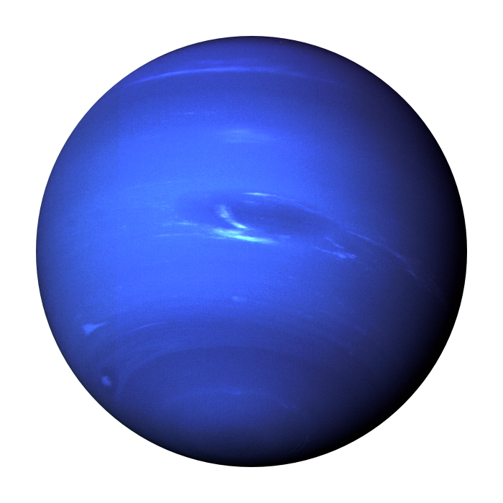
Fun Facts:
I take my name from the Roman God of the sea
The methane in my atmosphere absorbs red light, and this makes me appear bright blue
One of my largest ever storms was recorded in 1989 and it lasted over 5 years!
I am the windiest of all planets
I have very thin, icy rings
I spin rapidly on my axis because I’m not a solid body
Notes:
NEPTUNE

Slide 9
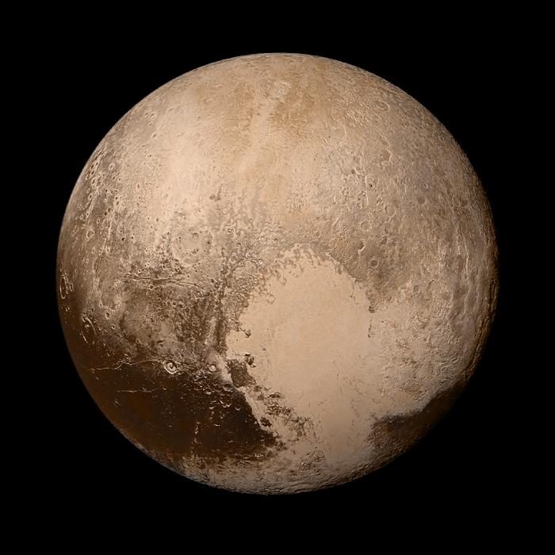
Fun Facts:
I was once considered a planet, but I was reclassified to a dwarf planet in 2006
I was named by an 11 year old schoolgirl from Oxford!
I’m smaller than many moons
Because of the shape of my orbit, I’m sometimes nearer the Sun than Neptune!
I was discovered in 1930
My surface temperature is colder than -200°C
Notes:
PLUTO

Slide 10
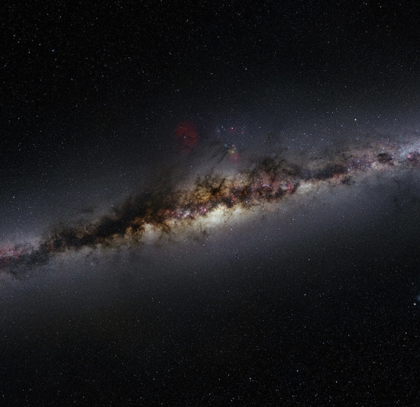
Fun Facts:
I am a galaxy; I’m your home in the universe
I began forming around 12 billion years ago
It is thought that I contain up to 400 billion stars
I contain a supermassive black hole, which contains the mass of around 4.3 million Suns.
In around 5 billion years, I’ll collide with Andromeda, another galaxy.
Notes:
MILKY WAY

Slide 11
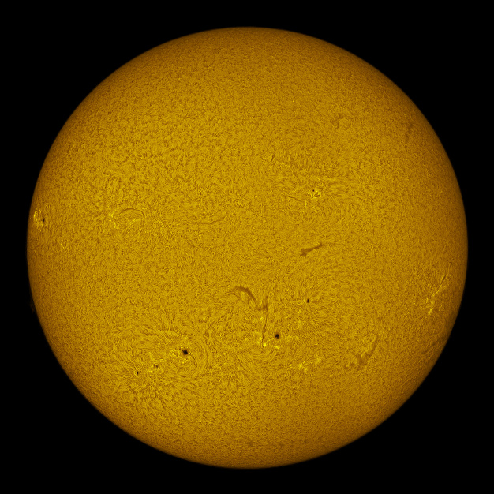
Fun Facts:
I am a star with temperatures of around 15 million°C
I am all of the colours mixed together, and I appear white
Around 960,000 Earths could fit inside me
Eventually, I will consume the Earth…
My light takes 8 minutes to reach the earth
At 4.5 billion years old, I am ‘middle aged’, meaning I have burnt off half of my hydrogen
Notes:
SUN

