Slide 1
RWDC FY14 National Challenge
First in Flight
North Carolina
Notes:
Hello and welcome to North Carolina’s 2014 Real world Design challenge presentation. Our team, is first and flight and we are from the STEM Early College at North Carolina A&T SU.

Slide 2
Group Members
Dennis Quaintance | Project Manager, Team Captain
Mercy Adekanle | Chief Operation Consultant
Carlo Lindner | Chief Design Consultant
Dylan Jordan | Chief Design Consultant
Via Abiera | Chief Business Case Consultant
Christine Nienhuis | Chief Business Case Consultant
Dhaval Mehta | Operational Consultant, Record Keeper

Slide 3
Design Requirements
Must Cover Search Area
Must be Able to Detect the Pests
Must Have a Takeoff and Landing Plan
Must Comply with FAA Regulations

Slide 4
Design Goals
 | Importance Factor (I-V) | Consists of:
Minimum Overall Cost | V | Initial cost and operating costs
Maximum Detection | V | Early Life Cycle Detection
Minimum Detection Time | II | Faster Aircraft

Slide 5
Measure of Design Effectiveness
Independent Analysis of Functionality
Measured In Bushels per Input Dollar
Objective Function Formula
(Crops Saved in one Year/Life Cycle Cost)
Crops Saved Measured in Bushels
Detailed Formula
(Crops Saved Per Acre x Acres Covered x 100 missions)/ Life Cycle Cost
Increases steeply as area expands

Slide 6
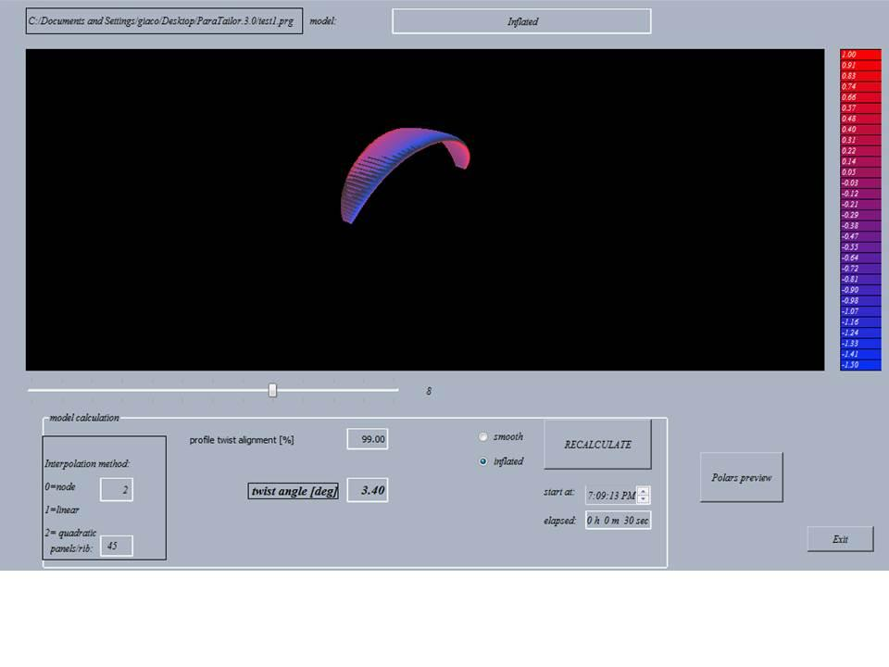
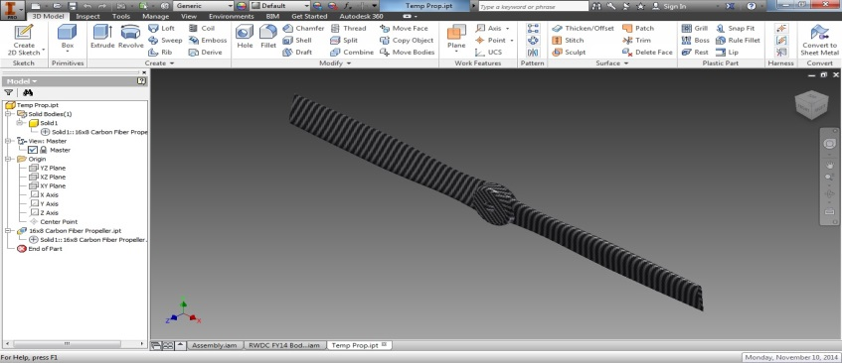
Software Used
UAV Design
Open Vehicle Sketch Pad
Creo Elements Pro
Inventor Pro
UAV/Cost Analysis
MathCad 2.0
Microsoft Excel 2010
Airfoil/Stress Analysis
Paratailor
JavaFoil Analysis
Inventor Pro
Communication
WindChill
Google Hangout
Google Docs
Paratailor
Inventor Professional

Slide 7
Final Design

Slide 8
Project Overview
Notes:
Once the team had a good idea of the challenge requirements and the goals we determined how to approach the project. We decided to integrate three strategies, a project management approach, the engineering design process, and an iterative refinement process. These strategies were used to ensure the success of the project.

Slide 9
Project Management Approach
Initiating: Understanding the challenge and the stakeholders
Executing: Following the engineering design process (conceptual, preliminary, detailed design)
Closing: Presentation of the project at Nationals, analysis of team effectiveness
Planning: Assigning team roles and outlining deadlines

Slide 10
Execution (Engineering Design Process)
Conceptual Design
Preliminary Design
Detailed Design (Iterative Process)

Slide 11
Iterative Design
Identify Room For Improvement
Create Improved Design
Analyze Improved Design
Document Improved Design

Slide 12
First Iteration

Slide 13
First Iteration Room For Improvement
Many blunt surfaces which increase drag
Poor distribution of stress
Difficult to manufacture
High manufacturing costs
No protection for propeller
Structurally unstable
Poor payload distribution

Slide 14
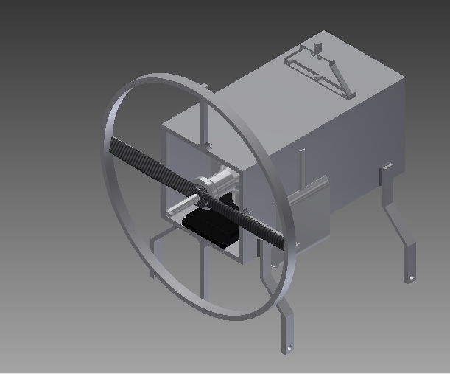
Second Iteration

Slide 15
Second Iteration Room For Improvement
Poor landing concept
Poor drag characteristics
Poor Control System
Infeasible Motor Concept
Tractor design

Slide 16
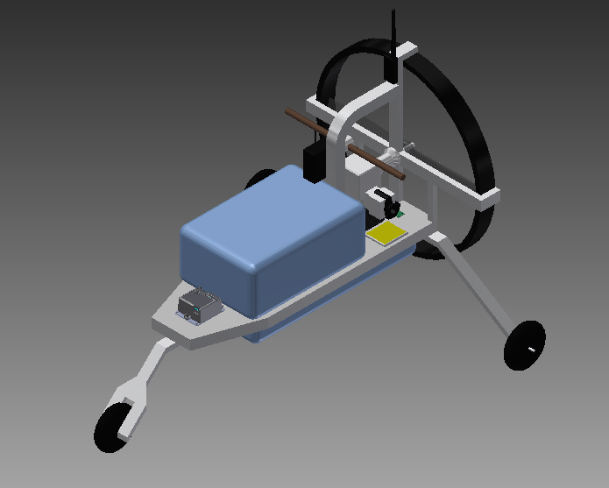
Final Iteration

Slide 17
Design Improvements Made for Final
Drag characteristics reduced
Durability of control system increased
Improved landing gear system
Improved engine and propeller
Pusher design for stable flight

Slide 18
Design Analysis- Airframe

Slide 19
Design Analysis- Parafoil

Slide 20
Business Case
Notes:
Design characteristics only get a product so far. Cost and marketability is what make a design viable. To prove the team’s design was truly viable in the real world we made a practical business case for it.

Slide 21
Applications
Agriculture
Antarctic Exploration
Canopy Cover Analysis
Oil Spill Mitigation
Soil Analysis
Tsunami Response
Water Analysis
Spectral Library

Slide 22
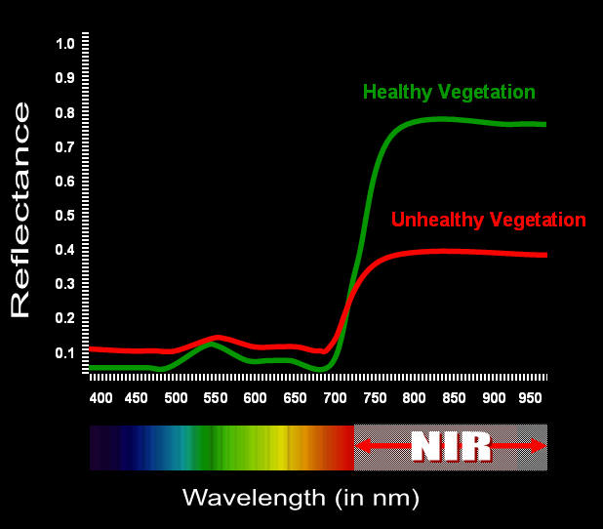
Canopy Cover Analysis Example
Notes:
For the application of canopy cover analysis, scientists would monitor Near Infra Red Reflectance as shown in the graph above to easily determine forest health on a large scale.

Slide 23
Direct Cost
Major Design Goal
Consisted of:
Airframe, Flight control, Alternate flight control, Onboard sensors, and C3
Cost Reduced Through Use of Third Party Components
Parafoil Cost estimated using cost of ripstop silicone impregnated nylon
UAV Acquisition Cost: $6,603.79
Total System Cost: $13,207.58

Slide 24
Changes to Direct Cost
Autopilot
Cheaper alternative
Number of motors
Went from 2 to 1
Type of Laptop
New to refurbished
Total saved: $973.78
Notes:
Saved $486.89 (1)

Slide 25
Diagram of Design Components
Notes:
The parts of the design that add cost are shown in this diagram. Some of these components were integrated into third party systems to reduce the overall cost of the system.

Slide 26
Operational Costs
National Challenge Challenged Team to Reduce Operational Costs
One Aircraft Configuration: $250.37 per hour
Safety Pilot
Data Analyst
Gasoline
Two Aircraft Configuration (Final Configuration): $425.37 per hour
Range Safety/Aircraft Launch & Recovery/ Maintenance
Data Analyst
Safety Pilot
Gasoline
Notes:
Gasoline Vs. Natural Gas
-Natural Gas was more expensive due to less demand. (EIA- Energy Information Administration)

Slide 27
Objective Function
Objective Function Value = 129 Bushels/Dollar
Higher Than Expected
Acres Covered Increased significantly
Life Cycle cost had only a small increase

Slide 28
Challenges and their Solutions
Veteran/Newcomer Interaction
Mentorship
Software Compatibility
Moved design from Creo to Inventor
Design Complexity
Developed separate protocol
Communication Difficulties
Moved all communication to Google

Slide 29
Closing Points
High Versatility
Large Profit Margin
Yearly Operational Cost: $330,189.50
Yearly Profit: $528,030,440.31
Effective Detection Method
Detection before damage
Low Life Cycle Cost
Minimal Operating Costs

Slide 30
Mentors and Acknowledgements
Calvin Miller - Coach
Dennis Quaintance Sr. - Parent
Dr. Kizito - Mechanical Engineering Professor
Phillip Sous - Past member

Slide 31
Thank You!

