Slide 1
VEGEtek - 003
Current sensing circuit
Hossam “VEGETA” Moghrabi

Slide 2
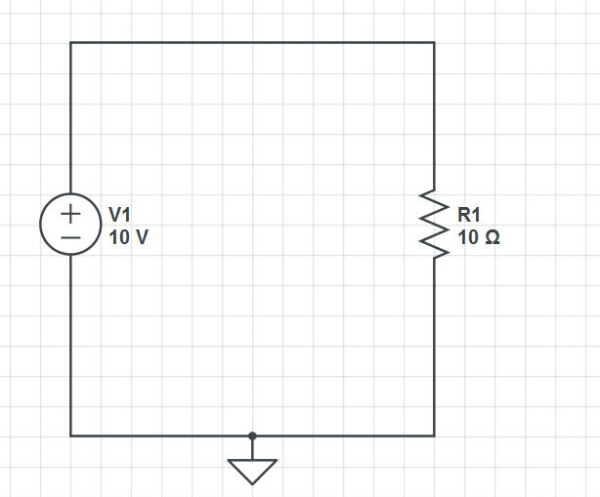
This is what a basic circuit looks like:
V1: voltage source = 10v.
R1: load = 10 Ohms.
Ohm’s law: V = I x R.
So, I = V / R.
For this example: I = 10 / 10 = 1 A.
Figure 1: Basic circuit.
How can we measure it?

Slide 3
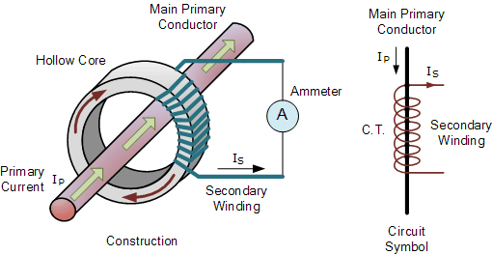
Ways to measure current:
1- Indirect method: such as current transformers (figure 2) and Hall effect sensors, which relies on Faraday's law of induction to sense current in a circuit and convert it to a proportional voltage.
These methods are suitable more for high current systems.
2- Direct method: which relies on Ohm’s law which states that V = I x R.
This method is suitable for low currents and widely used in electronics devices.
Figure 2: Current transformer

Slide 4
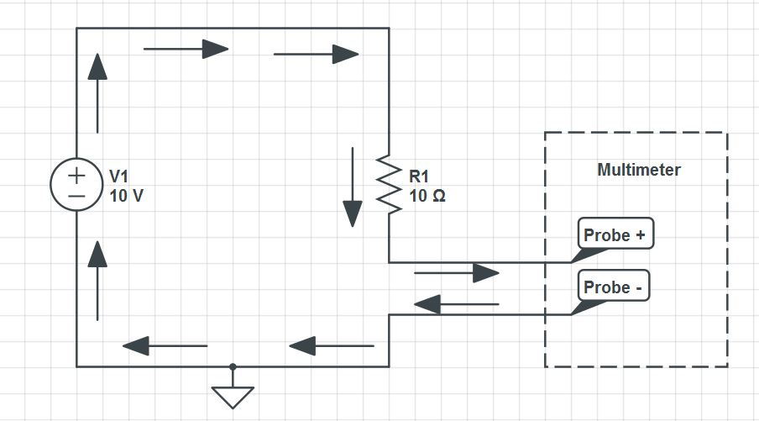
Measuring current using a Multimeter
1- cut the circuit.
2- use the “current” multimeter input jack, not the voltage one.
3- put the probes as figure 3 to close the circuit.
Figure 3: Multimeter measuring current

Slide 5
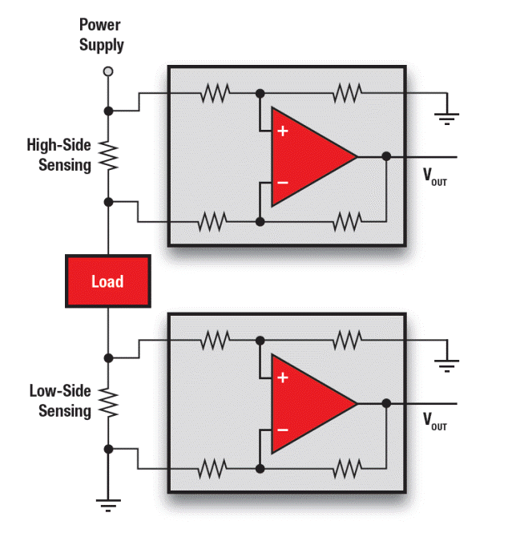
High-side and low-side sensing
Direct sensing has 2 methods: High-side and low-side sensing. It depends on the position of the shunt resistor with respect to the load.
This op-amp configuration is called “differential amplifier” which it amplifies the voltage difference between its inputs.
Figure 4: High and low side sensing

Slide 6
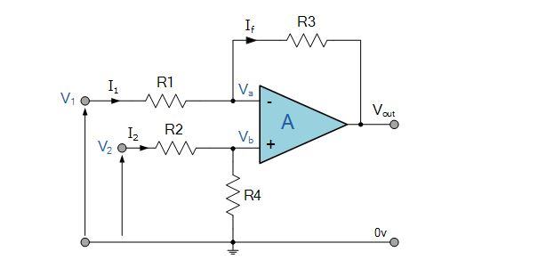
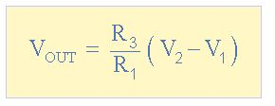
Differential amplifier
The op-amp will amplify the voltage difference between its two inputs according to this equation:
Figure 5: Differential amplifier
If all 4 resistors where the same value (like 10k) this will be a unity gain differential amplifier which the output voltage is: [ V_out = V2 – V1 ] since R3/R1 = 1/1 = 1. This will give the voltage difference directly as it is.
However, it is common to have a gain of 10 or so in such practical circuits because the voltage difference may be so small, for example: If shunt resistor is 0.1 Ohms (very common) and the current is 1A, this will result in 1 x 0.1 = 0.1v across shunt resistor, this will mean 0.1v output of the differential amplifier when unity gain is used, so it is 0.1v per 1 A. While using a gain of 10 will mean 1v per 1A which is a lot easy and practical.

